Slide 1

ACTE CTE Learn Affiliates Conference
Tuesday, April 22, 1-2:30 pm ET
Notes:
Good afternoon, everyone, and welcome to the ACTE CTE Learn Affiliates Conference! We’re so glad you could join us today.
This conference is designed for our state partners who currently have a CTE Learn MOU in place, as well as for other state leaders who have expressed interest in learning more about how this platform can support their professional development goals.
Today’s session will highlight strategies, success stories, and practical tools to help you promote and maximize the impact of your CTE Learn site. Whether you’re already on board or exploring the possibilities, we’re excited to have you with us and look forward to a collaborative and inspiring discussion.

Slide 2
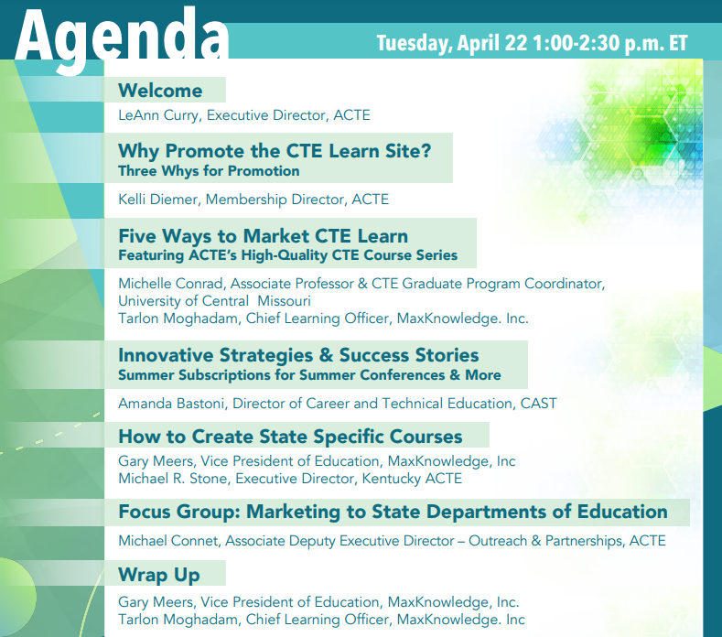
Notes:
Here’s a quick look at today’s agenda.
We’ll begin with a welcome from ACTE Executive Director LeAnn Curry, followed by an overview of why promoting your CTE Learn site matters.
We’ll then explore five key marketing strategies—like website integration, email campaigns, and webinars—that you can use to engage your educators.
We’ll also hear about ACTE’s High-Quality CTE Course Series, community building through the Career Ed Lounge, and innovative state-level strategies.
Finally, we’ll close with updates on custom course development and state agency outreach.
Please feel free to enter your questions in the chat at any time—we’ll have a Q&A session at the end of the program.

Slide 3
WELCOME
LeAnn Curry
Executive director, acte

Slide 4
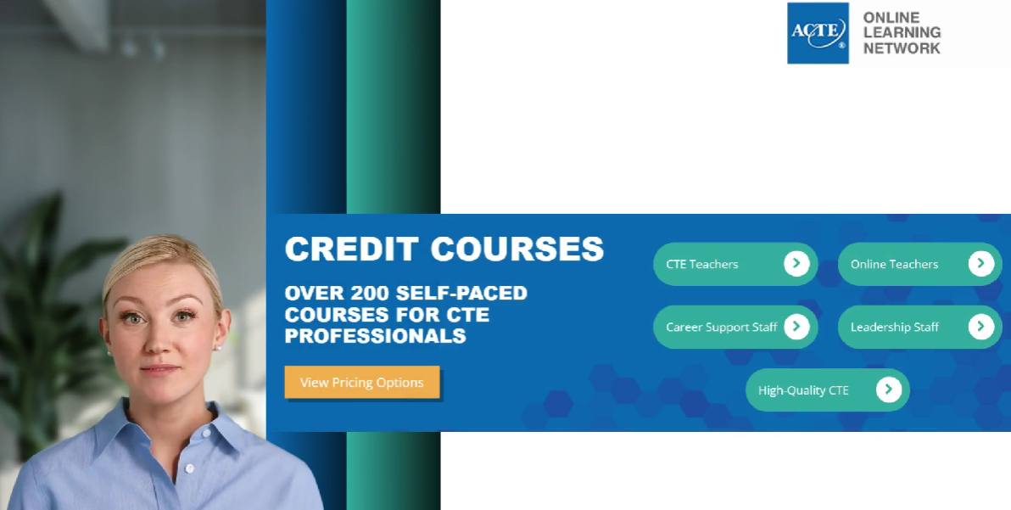
Watch a Brief Overview of CTE Learn

Slide 5
Why Promote the CTE Learn Site?
Kelli Diemer
Membership director, acte
Notes:
Thanks, LeAnn. I’d like to take just a few minutes to answer the question: Why promote the CTE Learn site?

Slide 6

Professional Development Access Anytime, Anywhere
CTE-Focused Content
Affordable, Scalable Training
Consistent Quality Across the State
Support for New and Veteran Teachers
Leadership Development
Micro-Credentials and Certificates
Equity and Access
Aligns with Perkins V Goals
Data and Reproting
Support for Student Outcomes
Notes:
CTE Learn delivers tremendous value to educators and states by offering professional development that is flexible, relevant, and strategically aligned with statewide goals—here are key ways it supports your educators and advances your mission.
Professional Development Access Anytime, Anywhere: CTE Learn offers flexible, self-paced online courses, making it easy for educators to access training that fits their schedules.
CTE-Focused Content: Courses are specifically designed for career and technical education professionals, ensuring relevance and immediate classroom and program impact.
Affordable, Scalable Training: Statewide support provides cost-effective professional development for large numbers of educators—ideal for meeting PD requirements without breaking budgets.
Consistent Quality Across the State: Supporting CTE Learn ensures all educators have access to the same high-quality, standards-aligned training, no matter where they are located.
Support for New and Veteran Teachers: Whether teachers are just starting out or experienced in the field, CTE Learn offers resources and courses that meet diverse professional needs.
Leadership Development: The platform includes modules on instructional leadership, program management, and career pathways—supporting the growth of future leaders.
Micro-Credentials and Certificates: Educators can earn digital badges and certificates that recognize their professional learning and support educator licensure renewal in many states.
Equity and Access: Online delivery increases professional development access for rural, remote, and underserved communities.
Aligns with Perkins V Goals: CTE Learn supports the continuous improvement and professional development goals outlined in Perkins V state plans.
Data and Reporting: States can access usage data to measure impact, identify trends, and report progress on educator development initiatives.
Support for Student Outcomes: High-quality teacher PD leads to stronger instruction, which improves student engagement, achievement, and workforce readiness.

Slide 7
Three Quick Reasons Why?
  CTE Learn Royalties
  List of leads
  State Courses
Notes:
When it comes to promoting your state’s CTE Learn site, there are three quick—but powerful—reasons to lean in:
First, CTE Learn Royalties. - Each time an educator takes a course through your state’s portal, a portion of that revenue is returned to your state association. This is a simple, sustainable way to generate additional funds that you can reinvest into member services, events, or outreach.
Second, you receive a List of Leads. - MaxKnowledge shares contact information from individuals who register through your portal—these are prospective members or stakeholders you can reach out to with tailored communications or invitations to join your state association.
And third, State Courses. - Your state has the opportunity to create and host its own courses on the platform. These can align with your state-specific initiatives, priorities, or certification requirements—giving you a customized and relevant professional development offering that’s accessible statewide.
Together, these benefits make CTE Learn more than just a learning platform—it’s a strategic asset for your state association.

Slide 8
Five Ways to Market CTE Learn
Tarlon Moghadam
Chief Learning Officer, MaxKNowledge

Slide 9
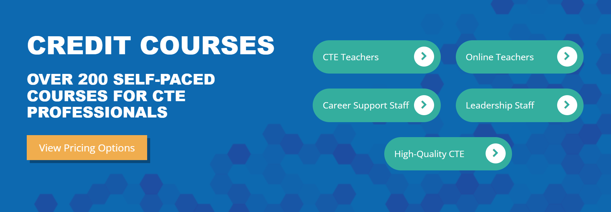
Market your CTE Learn Site

Slide 10
Website Presence
Newsletters
Flyers
Email Marketing
Webinars
Notes:
Hi everyone! My name is Tarlon Moghadam, and I’m the Chief Learning Officer at MaxKnowledge. I handle all things related to CTE Learn—from start to finish—so I’m really excited to be here today to share a few strategies that can help you get the most out of your state portal.
We’re going to walk through five simple but effective ways to market your CTE Learn site to your audience. These are things we've seen work well with our partners, and they're all easy to implement.
The five strategies we’ll cover are: website presence, newsletters, flyers, email marketing, and webinars.
Let’s go ahead and dive into the first one—your website.

Slide 11
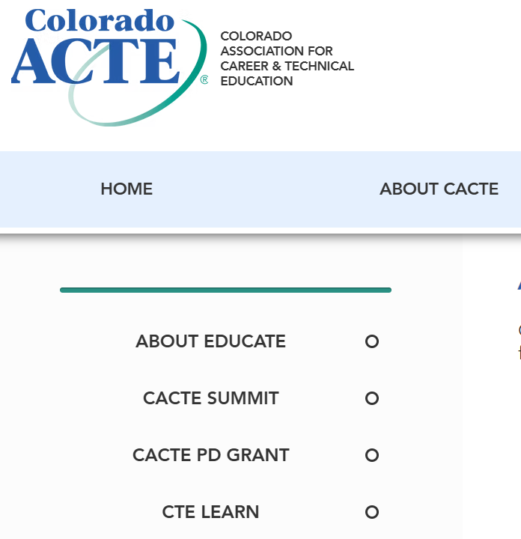
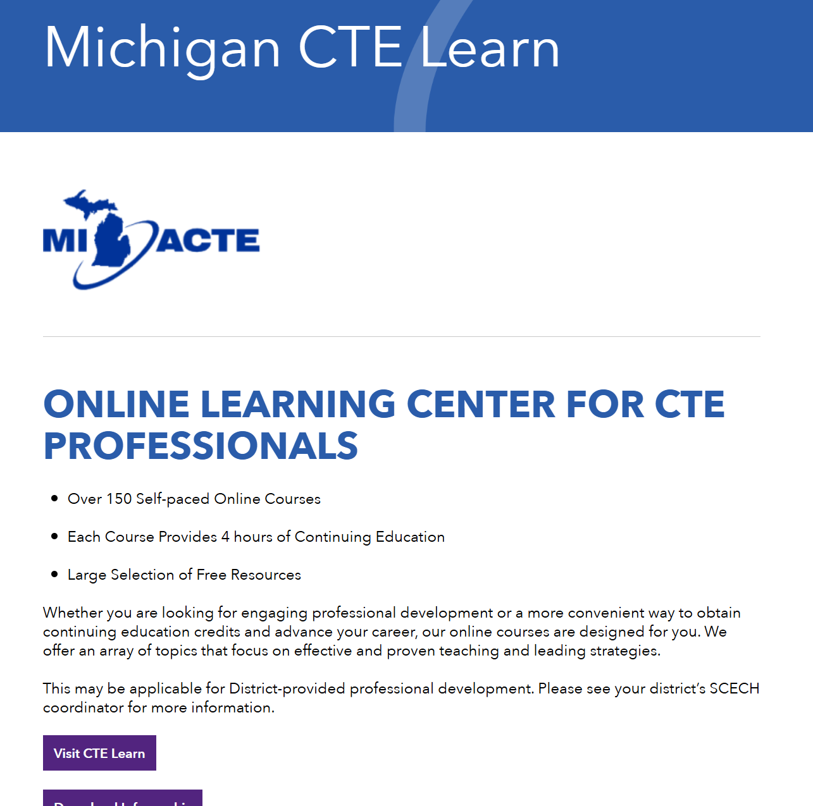
Website Presence
Navigation
Dedicated Space
Link to your Online Learning Site
Notes:
It might seem simple, but having a clear, easy-to-find link to your Online Learning Center makes a big difference—both for your members and for potential learners who might not be members yet.
I’ve seen our partners approach this in a couple of ways. Some go the straightforward route and hyperlink directly to their CTE Learn portal right from their main navigation. Others create a dedicated landing page with some extra context—what CTE Learn is, who it’s for—and then include a direct link from there.
Either option works! The key is just making sure there is a visible presence somewhere on your site. So whether it's a button, a menu link, or a full page, just having it there helps drive engagement.

Slide 12
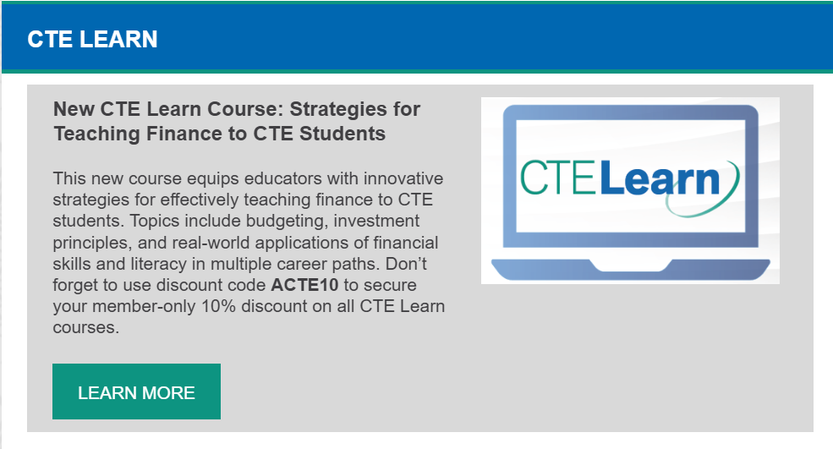
Newsletters
New Course Promotions
Special Offers
Updates to your Site
Notes:
The second way to market your CTE Learn portal is through newsletters.
A lot of our partners already send out weekly or monthly newsletters to their members—and this is a perfect place to plug in information about CTE Learn.
Some include promotions for new courses, highlight site-wide special offers, or share any updates that are posted directly on the portal. It’s a simple way to keep CTE Learn top of mind and drive steady engagement.
Now, you might be wondering—where does this information come from? Well, I actually send out monthly emails with all of these updates, promotions, and highlights. Some of our partners take that content and just drop it straight into their newsletters. So if you're getting those emails from me, feel free to repurpose them—it makes it super easy to stay consistent with your messaging.

Slide 13
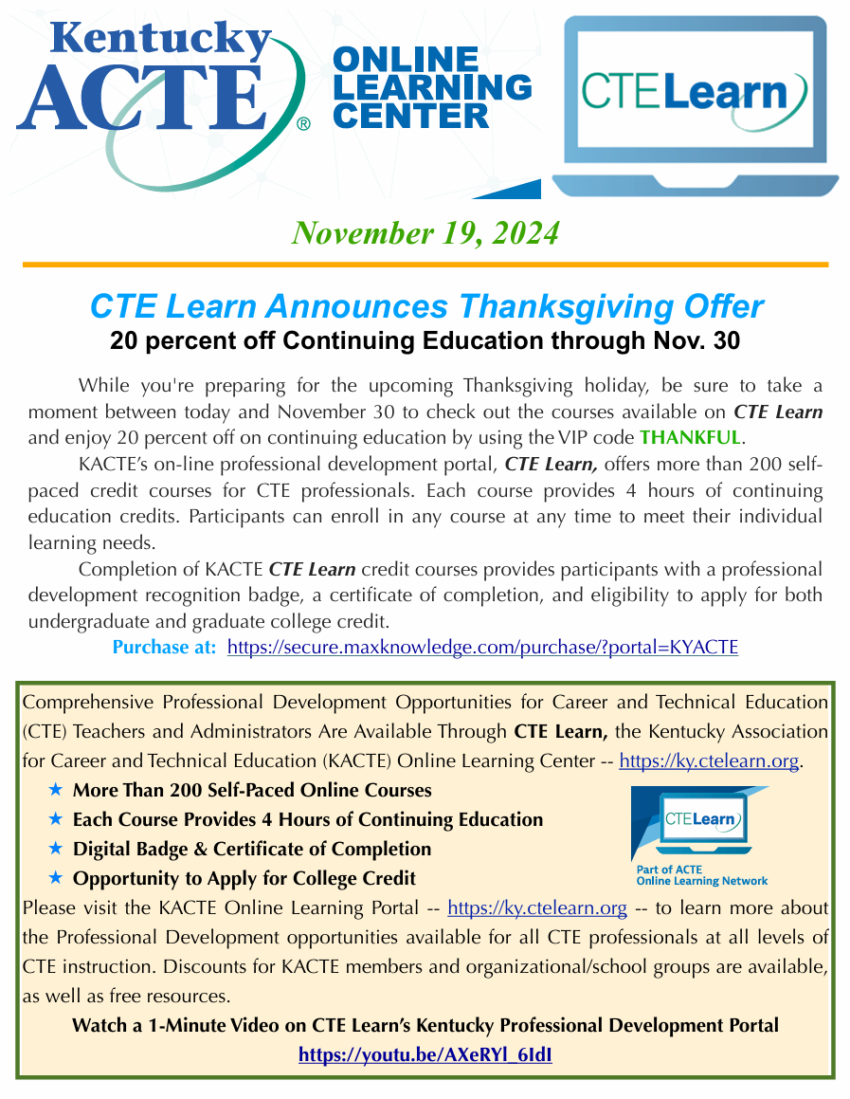
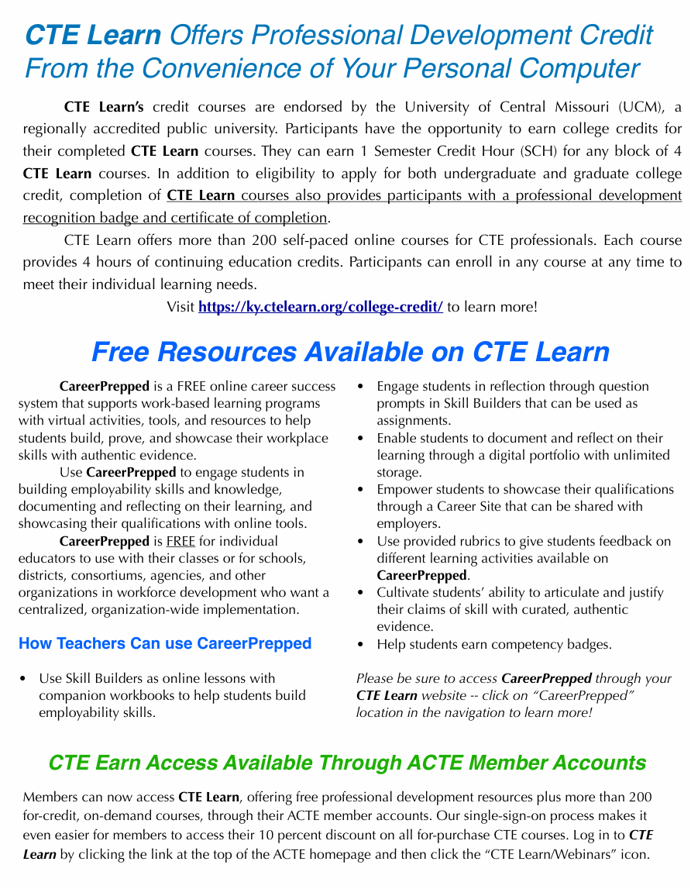
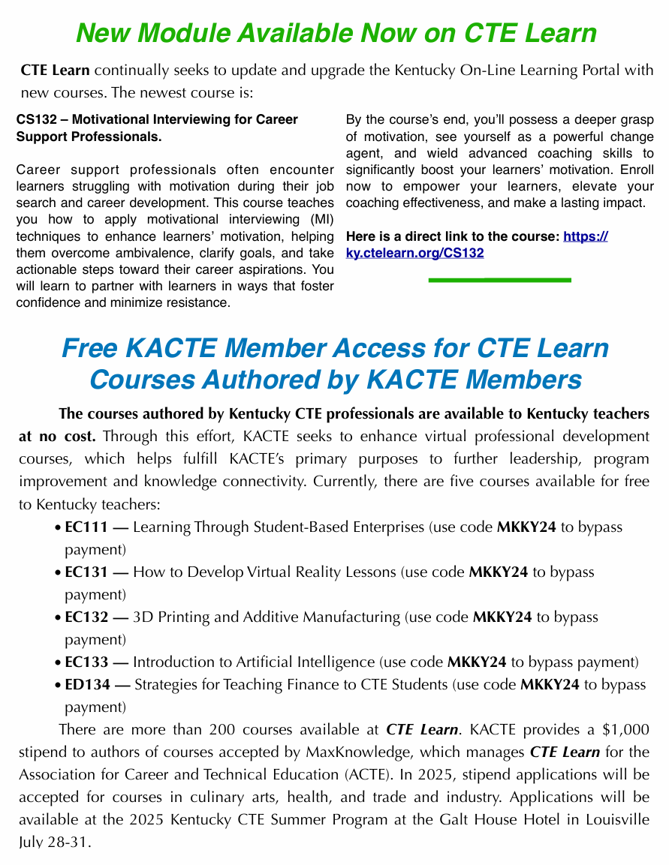
Notes:
One fantastic example of this in action is Mike Stone, the Executive Director of Kentucky ACTE. He regularly creates a dedicated, three-page newsletter just for Kentucky CTE Learn news—and it’s incredible. It’s such a creative and impactful way to keep members informed and excited about the platform.

Slide 14
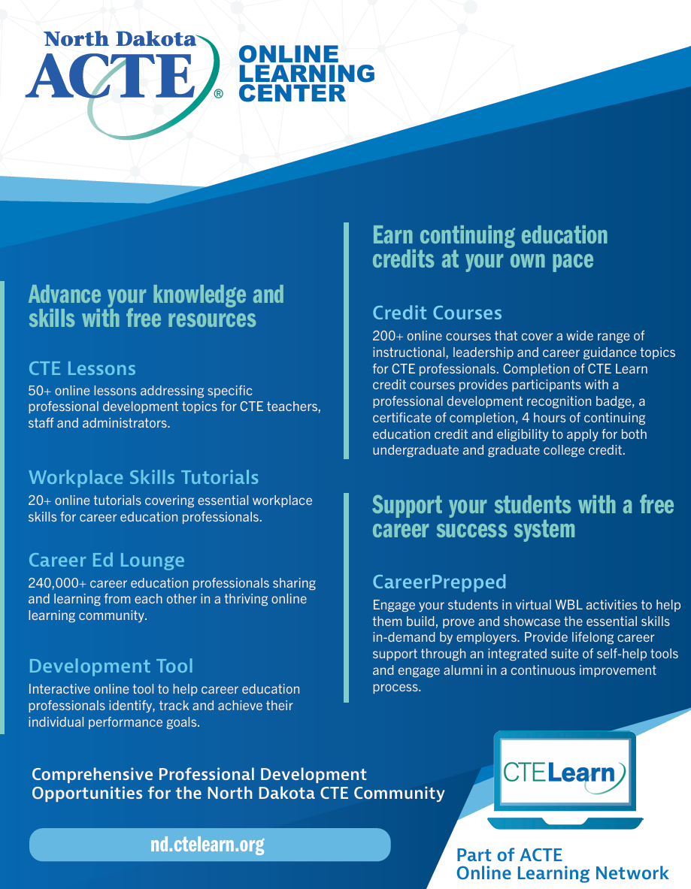
Flyers
Digital Flyer
Printed Flyer
Sponsored Prints
Distribute in Meetings
Notes:
The third way to market your CTE Learn portal is through flyers.
We provide digital flyers that are ready to go—great for sharing online, attaching to emails, or posting on your website or social media.
But we also offer a printed flyer service. If you have an upcoming meeting, conference, or event where you want to hand something out physically, we can print and ship flyers directly to you—and the best part is, the cost is completely covered by us.
It’s a great way to create visibility in person and give members a tangible reminder to check out the platform.

Slide 15
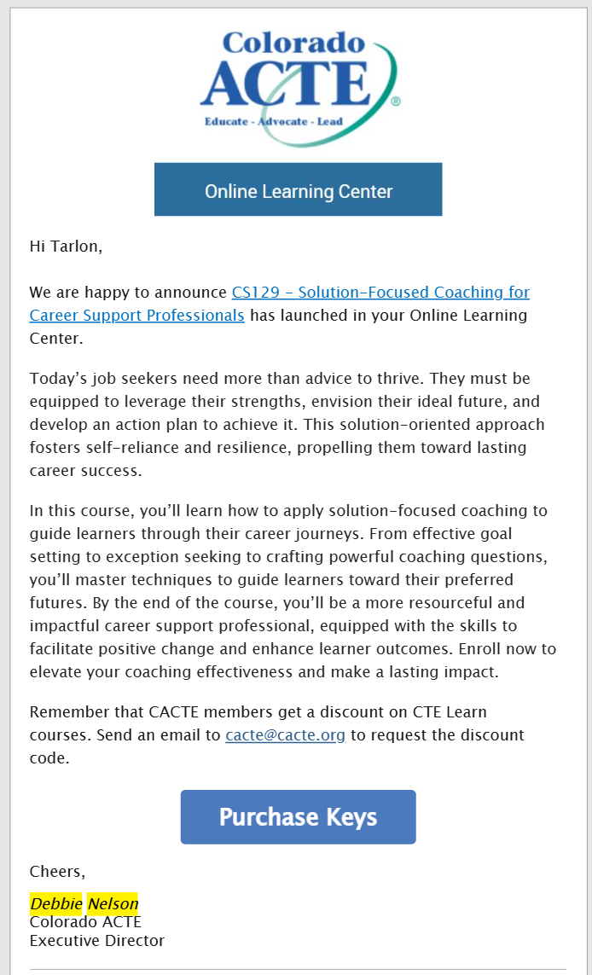
Email Marketing
MaxKnowledge streamlines the email marketing process for you.
Utilizes Constant Contact to manage email distribution to your mailing list on behalf of your Online Learning Center.
Sends a monthly email for your review, approval, and preferred sending dates.
Schedules the email after receiving your approval and date selection.
Notes:
Another incredible service we offer is email marketing.
We know how busy you all are, so this is designed to take the load off while still keeping your CTE Learn portal in front of your members.
One of our partners, Debbie Nelson, Executive Director of Colorado ACTE, has really taken advantage of this. She simply provides us with her email contact list, and from there—we handle the rest.
Each month, we put together a draft email for her with timely updates or promotions, get her approval, confirm the send date, and then we schedule it using our Constant Contact account.
It’s super simple, and it’s a great way to consistently engage your audience without having to add another task to your already full plate.

Slide 16
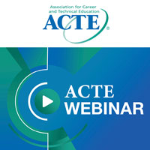
Webinars
Conduct webinars focusing on topics covered in CTE Learn courses. Motivate participants to complete the course beforehand to facilitate discussions on best practices and peer collaboration.
Post these webinars directly on your state portal.
Notes:
The fifth way to market your CTE Learn portal is through webinars.
Hosting webinars—especially around topics covered in CTE Learn courses—is a great way to drive engagement. You can encourage participants to complete a course ahead of time, then use the webinar as a space for deeper discussion, sharing best practices, and connecting with peers.
We can even create a dedicated section in your state’s portal just for your webinars. And they don’t have to be CTE Learn-specific—we’re happy to host any and all webinars you want to share with your members.
The key benefit here is that members will need to log into the site to access the webinar. And once they’ve logged in, they’re not only more likely to explore other offerings—they’ll also start receiving automatic updates from the system, like new course launch emails and special offers. So it creates a natural path to continued engagement.
I hope these five marketing ideas sparked some inspiration and gave you a few easy ways to boost engagement with your CTE Learn portal.
Please feel free to contact me at any time if you’d like to take advantage of any of the services we offer—or even if you just want to brainstorm new ways to get the word out.
I’ll drop my email in the chat, so don’t hesitate to reach out. If you have questions, ideas, or want to collaborate, I’m always happy to hop on a call and connect directly.
It’s truly a pleasure working with all of our amazing partners, and I’m here to support you however I can.

Slide 17
ACTE’S High-Quality CTE Course Series
Michelle Conrad
Associate professor & cte graduate program coordinator, university of central Missouri

Slide 18
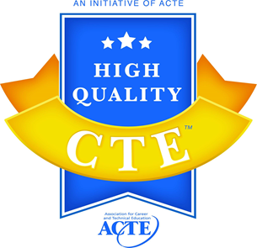
High-Quality Courses
Standards-aligned and integrated curriculum
Sequencing and articulation
Student assessment
Prepared and effective program staff
Engaging instruction
Access and supports
Facilities, equipment, technology, and materials
Business and community partnerships
Student career development
Career and technical student organizations
Work-based learning
Data and program improvement
https://www.ctelearn.org/hq-cte/pd-map

Slide 19
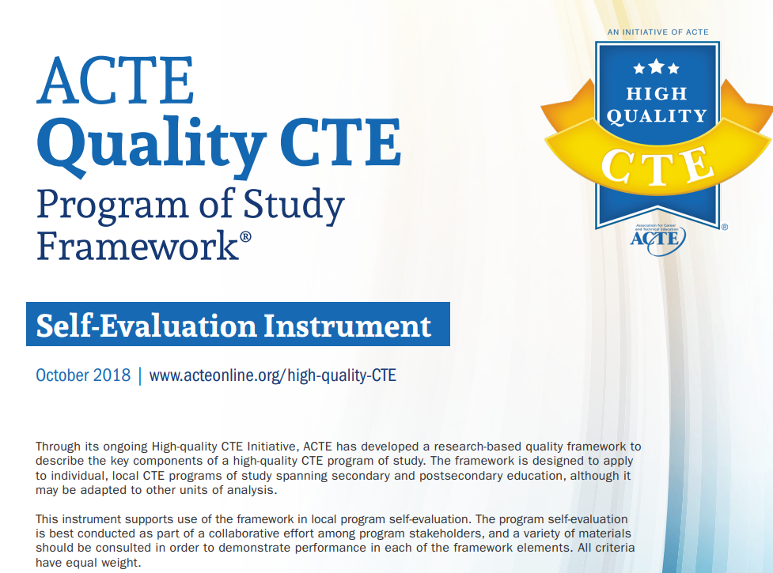
ACTE High-Quality Framework
https://www.acteonline.org/professional-development/high-quality-cte-tools/

Slide 20
Career Ed Lounge Online Community Groups
Michelle Conner
Senior Manager, Professional Learning & Content, ACTE

Slide 21
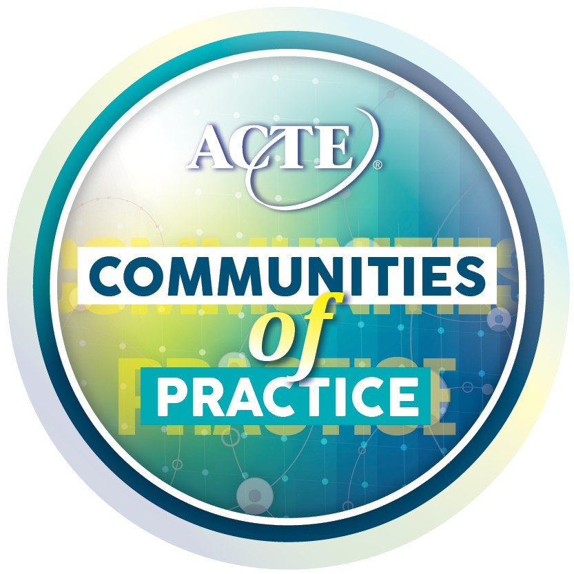
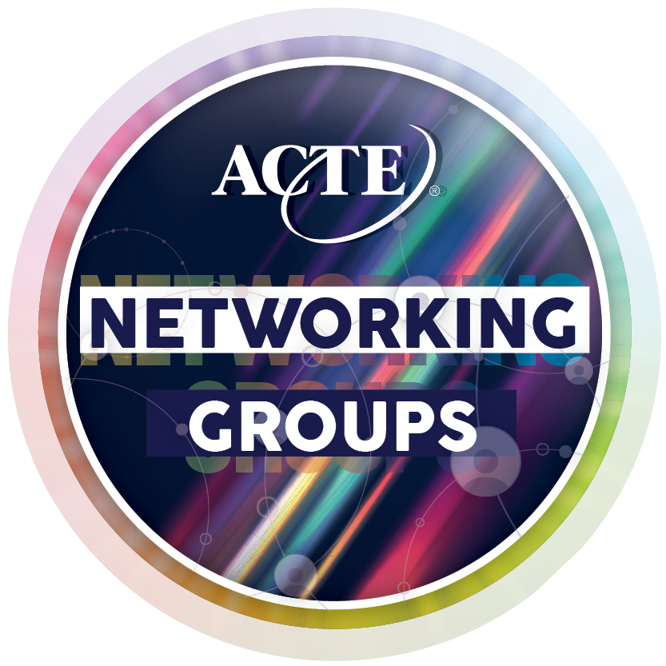
Career Ed Lounge Online Community Groups

Slide 22
Innovative Strategies & Success Stories
Brian L. Pyles, Ph.d.
Executive director, Michigan ACTE

Slide 23

Intentional Efforts
State Continuing Education Clock Hours (SCECH)
Michigan Categorical Funding Section 61i – FY 2023
Conference Presentations
Brian L. Pyles, Ph.D.
Executive Director
Michigan ACTE
brian.pyles.mi@gmail.com
517-599-7495

Slide 24
Innovative Strategies & Success Stories
Amanda bastoni
Director of Career and Technical Education, CAST

Slide 25
Innovative Strategies & Success Stories
What Professional Development do Instructors Need?
Amanda Bastoni
Director of Career Technical and Adult Education, CAST
abastoni@cast.org

Slide 26
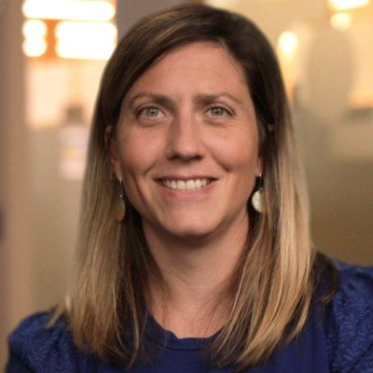
Introduction
CAST is a nonprofit education research and development organization that created the Universal Design for Learning framework and UDL Guidelines, now used all over the world to make learning more inclusive.
  UDL is called out in Perkins V as a permissible use of funds for professional development and learning.
Amanda Bastoni
Abastoni@cast.org

Slide 27
MI CTE Project
In 2023, we were selected by Michigan’s Department of Labor and Economic Opportunity (MI LEO) to lead a three-year initiative to expand, evolve, and improve postsecondary career and technical education across the state of Michigan.

Slide 28
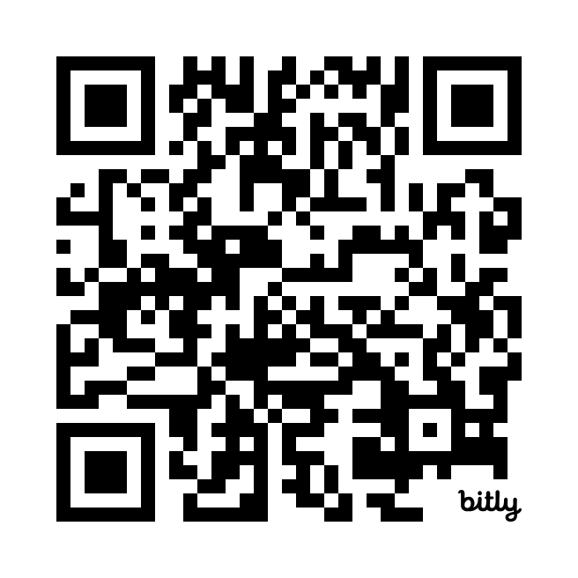
MI CTE Project
Conduct a gap analysis & literature review
Form a state-wide advisory board
Collect the PD needs of post-secondary CTE teachers in MI (from educators/instructors)
Create 4 free online courses for MI CTE
Create an addition 5 courses designed and developed by Post-secondary Educators in MI
Publish on findings and approaches
Promote a centralized repository for MI CTE specific instructional modules and best practices
The Michigan Department of Labor, Economic & Opportunity-Workforce Development (LEO-WD) has partnered with CAST on a 3-year initiative to increase access to quality professional development (PD) for postsecondary career technical education (CTE) programs statewide.
Year 1: Program Gap Analysis, Literature Review, Statewide Advisory Board
Year 2: Free PD courses, tailored PD, monthly webinars
Year 3: Promote a central repository for CTE instructional modules and best practices

Slide 29
Initial Gap Analysis Findings
Training
New teacher training
Curriculum design
Classroom management
Assessment design and implementation
Advisory groups engagement
Data training
New Director training
Perkins V
Special Pops (SWD, ELL, Non-Trad)
Faculty
Turnover/shortage of teachers
Recruitment of faculty (especially in rural areas)
Faculty don't have CTE specific cohort groups
Accessibility
Funding for PD
Desire for PD sessions to be made available online
Not having enough time to prioritize PD

Slide 30
Gap Analysis: Comments
"…nothing is within driving distance..." (referring to networking)
"...they don't know what they don't know..." (referring to instructor training)
"...classroom approach, how to develop a quality test...the inner workings of how to be a good teacher..."
“…not everyone agrees with terminology…”
“…data people don’t understand what directors need…”
“…don’t get to count students who earn credentials if they move toward an associate degree track…”
“…new directors training did not cover enough…didn’t spell out indicator and concentrator information…”

Slide 31
Professional development for CTE faculty is sorely needed and often under-prioritized. As technology continues to advance the problem becomes more acute.
Don Hutchinson, Macomb CC

Slide 32
Not overly surprised; although good to know others have/face same opportunities/challenges/needs.
Mark Dunneback, Kalamazoo Valley CC

Slide 33
Yes, finally everything we've been talking about for years...excited to see how we will go forward…Totally agree with all that was shared... especially supporting CTE teachers in pedagogy and practice.
Krista McKinney-King, Wayne RESA

Slide 34
MI Findings Align with National Findings...
Most post-secondary CTE educators report little or no appropriate on- boarding and do not truly understanding their responsibilities
(Thierer, 2021)
“... so overwhelming [,] like drinking out of a fire hose” - CTE faculty moving from industry to academia (Thierer, 2021)
Faculty training on disability is limited and disability training designed for CTE faculty specifically is nearly non-existant (Carballo et al., 2021; Moriña & Carballo, 2017).

Slide 35
Literature Review
  High Level Findings
    The literature produced a lengthy list of strategies for recruitment and retention along with the caveat that the strongest studies show little impact. So, what does work?
    Quality PD works, as a high leverage strategy that can increase student success as well as teacher confidence and self-efficacy. What is self-efficacy?
    Teacher self-efficacy is a teacher's belief in their ability to teach students and achieve learning outcomes...It's a psychological concept that can influence a teacher's behaviors and choices, especially when faced with challenging situations. Why is this important?
    Teacher confidence and self-efficacy are known to improve educator retention rates and student outcomes. How?
Notes:
What is self-efficacy? Teacher self-efficacy is a teacher's belief in their ability to teach students and achieve learning outcomes. It's a psychological concept that can influence a teacher's behaviors and choices, especially when faced with challenging situations
How? PD quality impacts teacher self-efficacy in three areas of instructional effectiveness – clarity of instruction, cognitive activation, and classroom management.
Yoon, I., & Goddard, R. D. (2023). Professional development quality and instructional effectiveness: Testing the mediating role of teacher self-efficacy beliefs. Professional Development in Education, 1–15. https://doi.org/10.1080/19415257.2023.2264309

Slide 36
Building Instructor Self-Efficacy
Did you know? Educators with high Teacher Self-Efficacy tend to:
More effectively cope with a range of problem behaviors
Use proactive, student-centered classroom behavior strategies and practices
Establish less conflictual relationships with students
Use more diverse instructional strategies
Differentiate more frequently
Change their goals according to students’ needs
Are more positive about trying new instructional strategies
Experience less stress and burn out (irrespective of pre- or inservice context, grade level, and location)
Experience higher levels of personal accomplishment, commitment and job satisfaction

Slide 37
So How Should PD for Post-Secondary Educators be Designed?
Through this Project and Working in Collaboration with CTE Learn we can Meet all of these Goals:
Feels relevant to CTE Educators (contextualized, personalized and specific)
Provides Strategies for Supporting a Wide Range of Learners (SWD)
Builds Teacher Self-Efficacy
Flexible & Asynchronous (reduce travel)
Promote Educator Growth (payment)

Slide 38
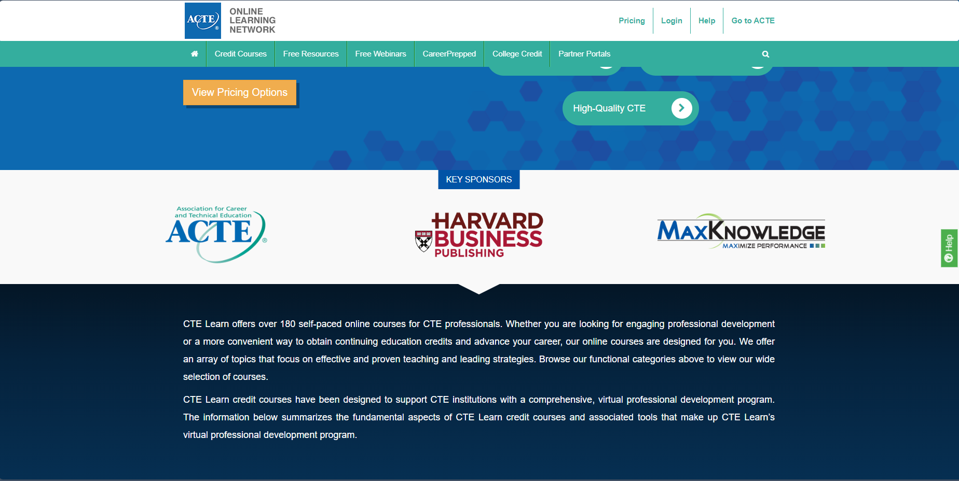
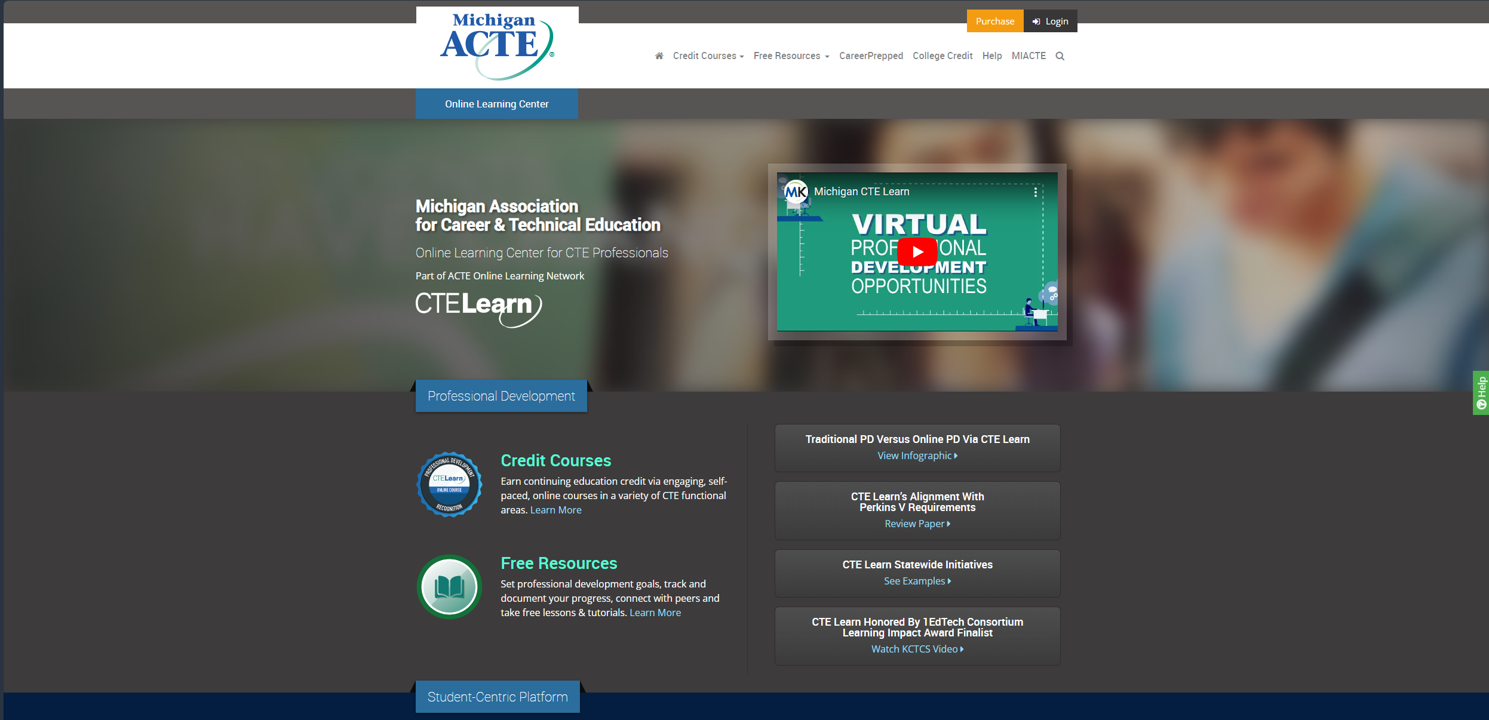
What is MI Doing: Leveraging CTE Learn
347 users in the Michigan portal enrolling in courses
On average MIACTE users take between 2-4 hours to take courses.
Each user takes on average between 1-2 courses on the site.

Slide 39
White Paper
This whitepaper highlights an opportunity to rethink professional development (PD) through the lens of Universal Design for Learning (UDL). By focusing on practical strategies grounded in design thinking, the paper explores how intentional program and environment design can lead to increased teacher confidence and improved student outcomes.
For postsecondary CTE educators, this resource offers actionable insights into how UDL can help bridge the gap between today’s instructional challenges and the need for meaningful, impactful professional development. Readers will gain a deeper understanding of how implementing inclusive and flexible approaches can create environments where every learner can thrive.
Gaps in Understanding the Professional Development Needs of Postsecondary CTE Educators: Universal Design for Learning (UDL) as a Viable Solution

Slide 40
Research
Rivera, N. (2024). Understanding How CTE Educators Perceive That Professional Development Supports Educational Practices and Retention (Doctoral dissertation, Walden University).
40 Year Literature Review on Teacher Self-Efficacy
The Many Dimensions of Academic Ableism: Career and Technical Education (CTE) Faculty Attitudes in Engaging with Disabled Community College Students

Slide 41
How to Create State Specific Courses
Gary meers
vice President, maxknowledgE
Michael R. Stone
Executive Director, Kentucky acte

Slide 42
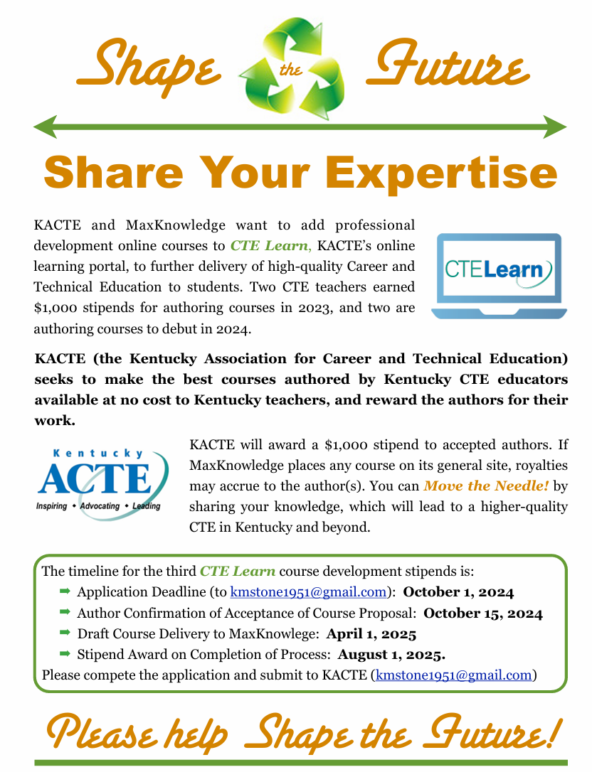
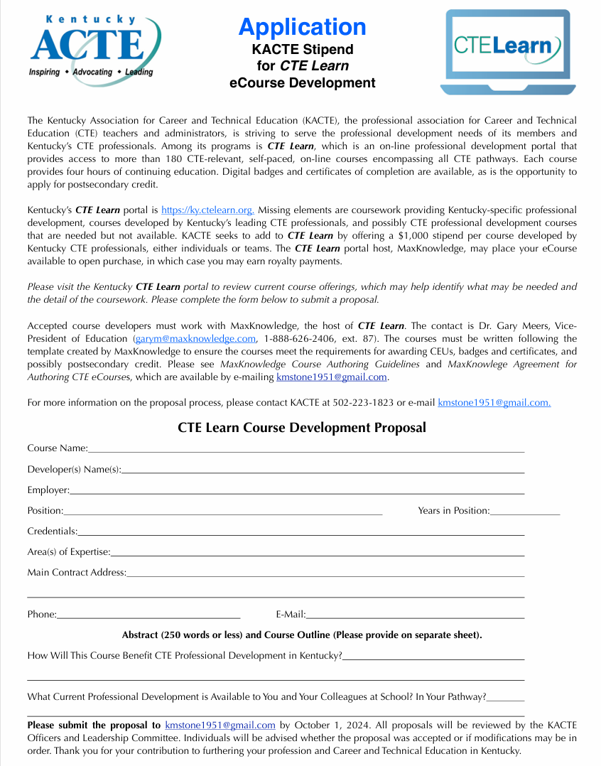

Slide 43
Authoring Steps
Referral or invitation to become an author
Review course template, authoring guidelines and sample course.
Phone call or zoom meeting with Gary Meers
Finalization of course topic
Submission of course outline and objectives
Signing of authoring agreement
Completion of the course
Submission of course
Revision of course if needed.

Slide 44
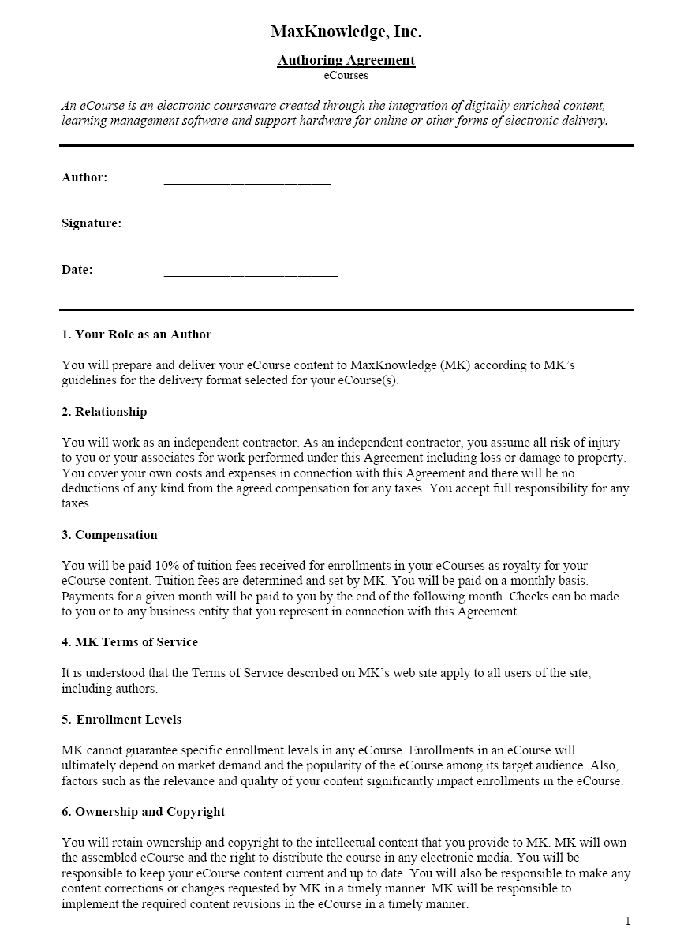
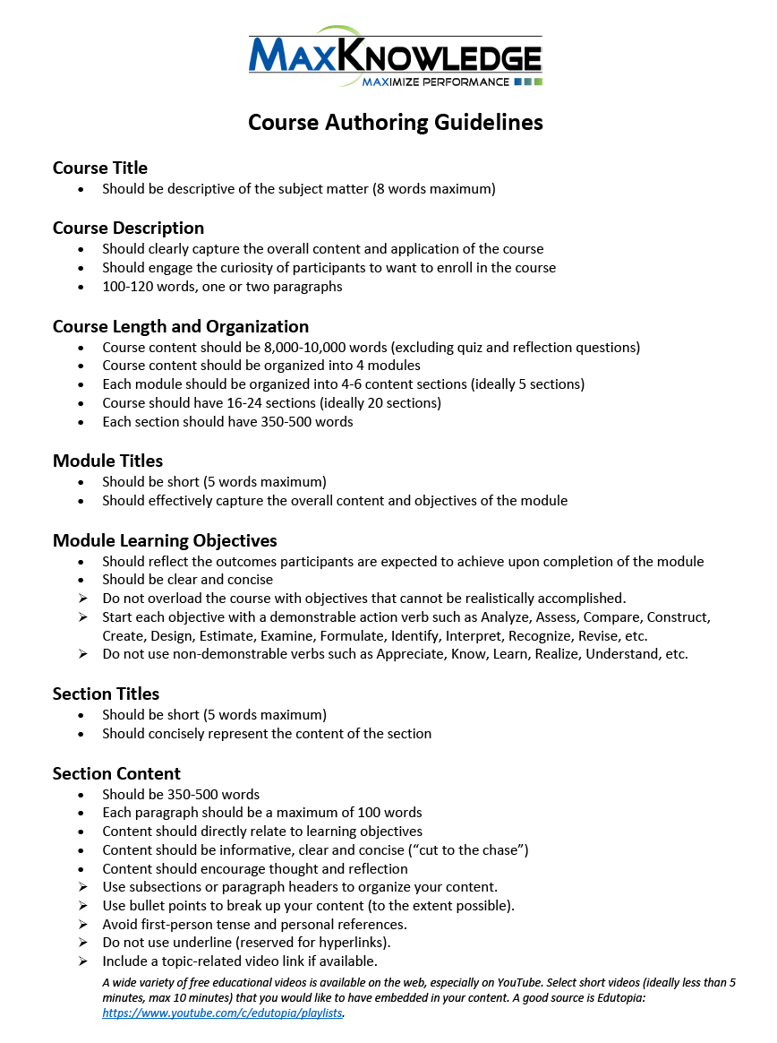
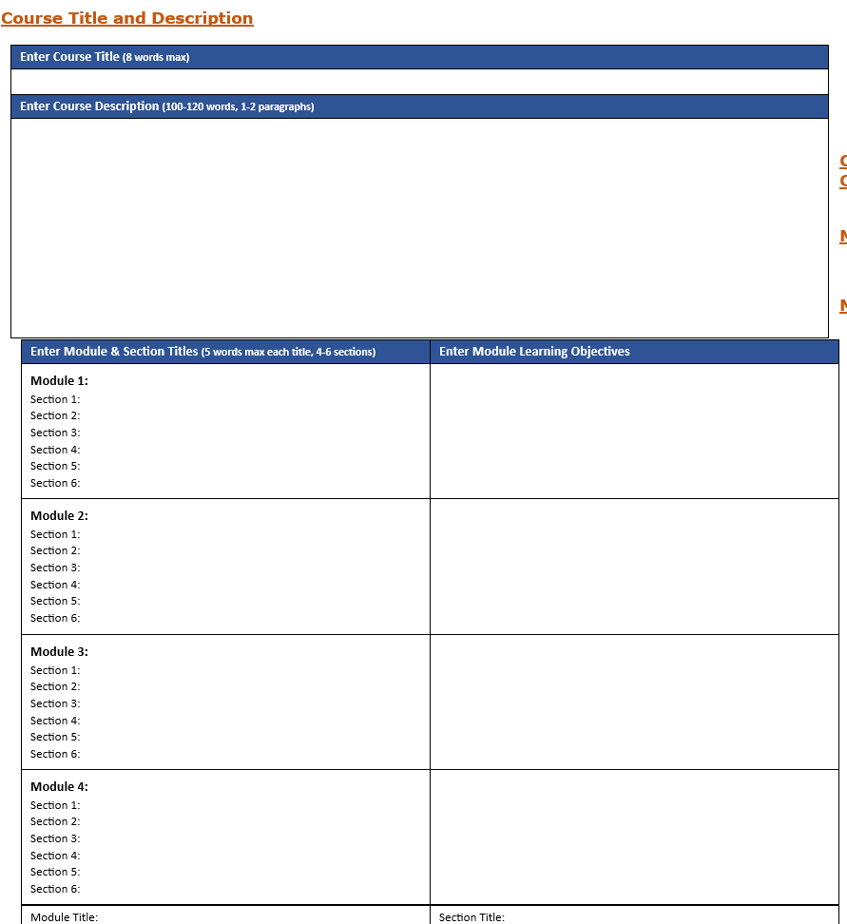
Notes:
Link to files: https://www.dropbox.com/scl/fo/qi0uza9p8tq9ugiooqxgh/ABtmaKfaLhQ9WWKdRvwXcUc?rlkey=e546o5kmxpbue52oekmft9lil&st=mwhnljn4&dl=0

Slide 45
CTE Learn Course Development Assistance
The vice president of education for MaxKnowledge provides continuous support throughout the writing process from author identification to course completion.
“Serves as a guide to the side.”
The authoring guidelines provide instruction on how to complete each section of their course.
Course template gives author the format for completing their course.
Author provides content as subject matter expert.

Slide 46
Focus Group: Marketing to State Departments of Education
Michael Connet
Associate Deputy Executive Director
Outreach & Partnerships, ACTE

Slide 47
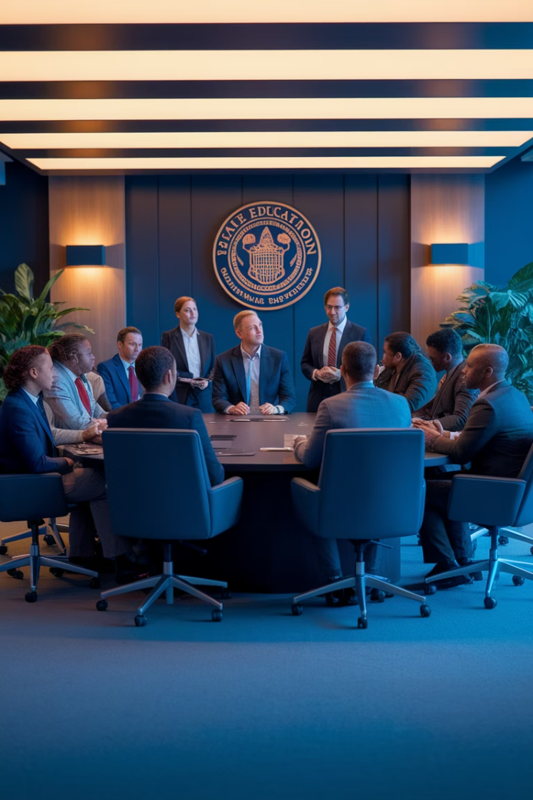
Gaining State Support for Your CTE Learn Platform
Elevate your professional development offerings
Connect educators with customized learning
Drive member engagement and retention
Notes:
•Customized PD for your state’s CTE educators
•Boosts member value and engagement
•Establishes your association as a go-to PD source
DISCUSSION: How have you introduced your state’s CTE Learn platform to members so far, and what’s worked or not worked?

Slide 48
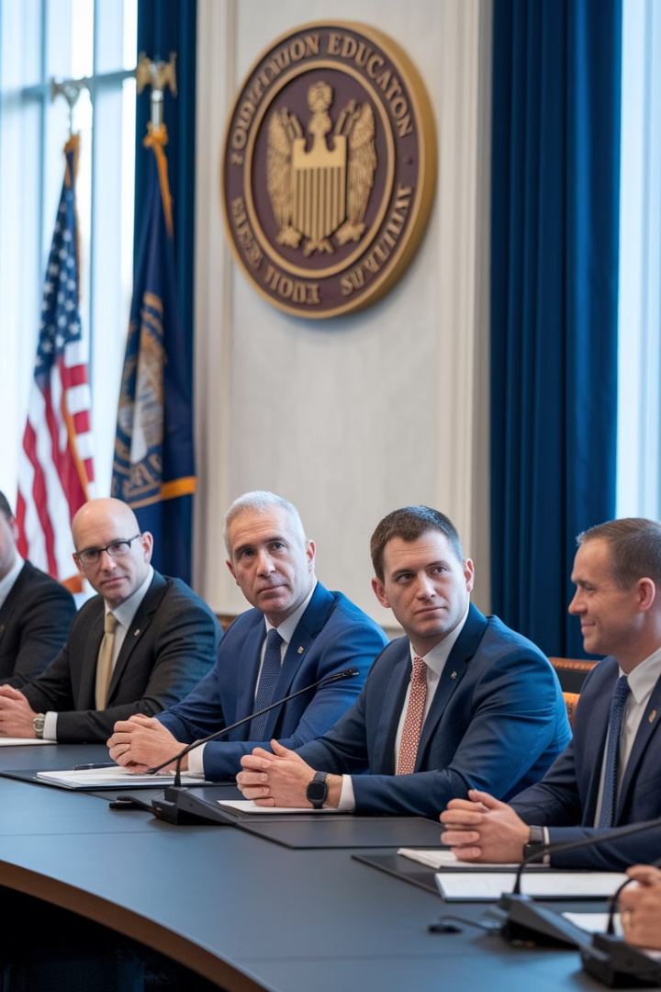



The Power of State Agency Support
Legitimacy
Official endorsement increases credibility
Integration
Embed in certification requirements
Alignment
Connect with state CTE policy goals
Notes:
•Gains legitimacy and visibility
•Encourages integration into PD or licensing pathways
•Aligns with state workforce and education goals
DISCUSSION: Has your state CTE authority ever endorsed a PD resource before? What process was used?

Slide 49






Partnering to Develop State-Specific Courses
Co-branded leadership
Position your association as a PD leader
Local standards
Align with state frameworks
Customized content
Address state-specific needs
Notes:
•Address state-specific needs (WBL, Perkins V, equity, etc.)
•Showcases your association as a solutions leader
•Increases local relevance of CTE Learn
•
Focus Group Prompt:
What are priority issues in your state that could be addressed through a custom CTE Learn course?

Slide 50

CTE Learn for Teacher Licensure
Agency Endorsement
Secure official memo supporting CTE Learn
Recertification Hours
Course hours count toward requirements
Increased Value
Practical benefit drives educator adoption
Notes:
•Recognized for relicensure credits in some states
•Provides incentive for educator engagement
•Requires collaboration with credentialing authorities
DISCUSSION: What’s the process in your state for approving PD for licensure renewal? Who needs to be involved?

Slide 51
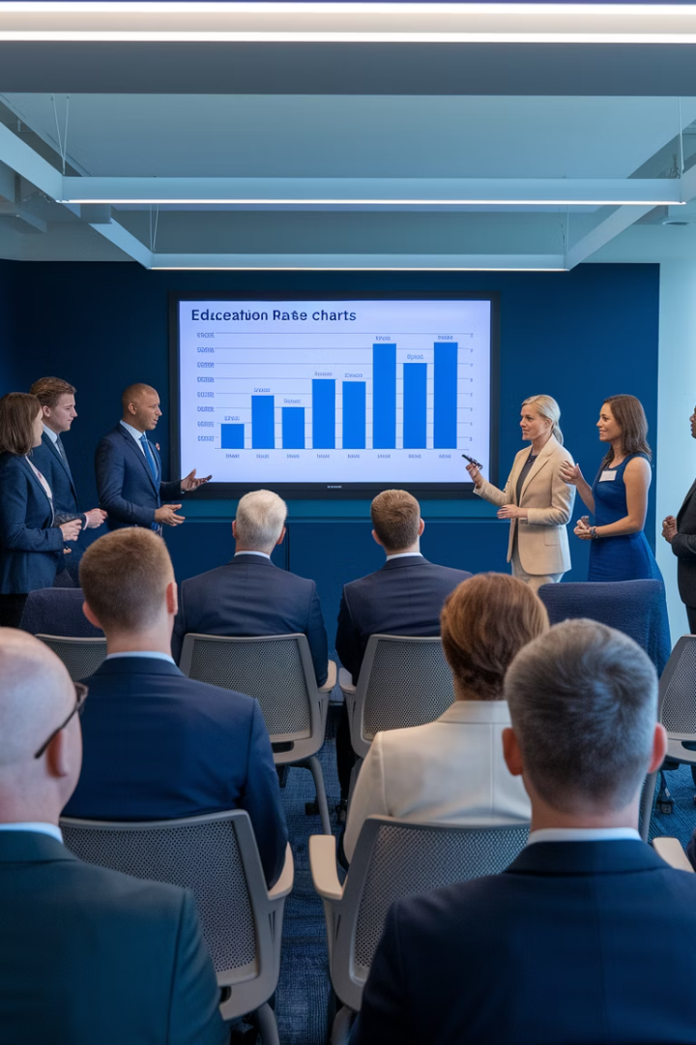
Making the Case – Winning Strategies
Leverage Relationships
Address Priorities
Show alignment with equity and workforce goals
Connect with state CTE leaders personally
Bring Evidence
Share usage data and testimonials
Notes:
•Lead with alignment to state policy goals
•Use data: usage, testimonials, cost efficiency
•Frame as a strategic professional learning investment
DISCUSSION: What value propositions would resonate most with your state’s CTE leadership?

Slide 52

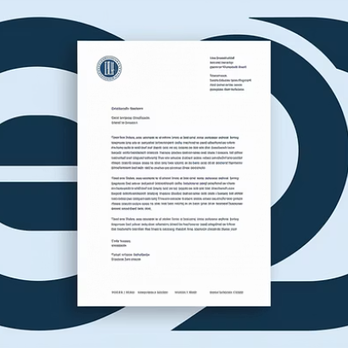
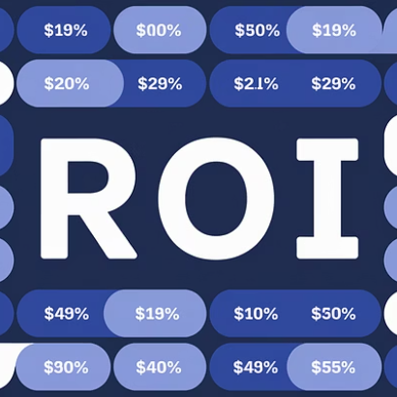

Support Resources Available
Pitch decks and presentations ready to customize
Sample memos and official communications
Success stories from other states
Notes:
•MaxKnowledge and / or ACTE can provide pitch tools, MOUs, and crosswalks
•Share success stories from other states
•Offer tailored support based on your feedback
DISCUSSION: What tools or support would help you in approaching your state agency?
What are your biggest barriers in promoting or integrating your CTE Learn platform?

Slide 53
CareerPrepped Update & Wrap Up
Tarlon & Gary

Slide 54
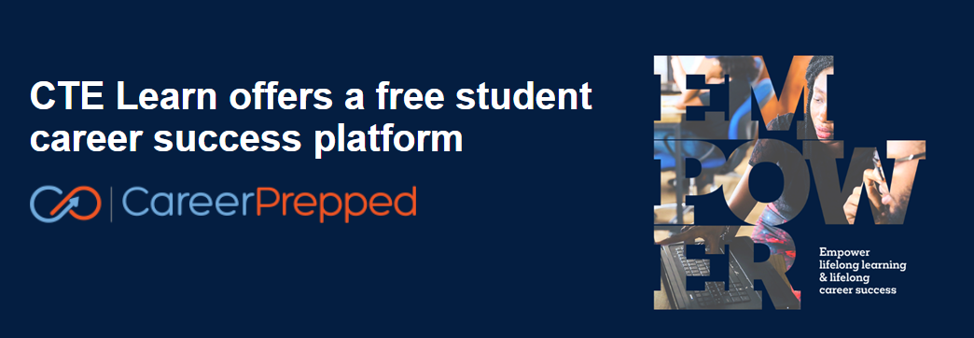
CareerPrepped Update

Slide 55

NEW reporting features built with Nevada DE
Creates report of students w/ Nevada‑defined WBL experiences
Reports students who earned Nevada-designated IRCs
Ready for any other state-wide adoptions
These same reports can be tailored to any state – at no cost.
State CTE Directors can email roberts@mail.ctelearn.org to discuss.
Notes:
Before we do our wrap up, I want to quickly share an exciting update to CareerPrepped, CTE Learn's free career success platform for students.
In collaboration with the Nevada Department of Education, we’ve just launched new reporting tools that allow Nevada administrators to easily track student participation in work-based learning and industry-recognized credential attainment—based on the state’s own definitions.
Nevada expressed interest in promoting statewide adoption of CareerPrepped to support their districts and schools with its full suite of free career tools. As we learned more about Nevada’s needs, they shared that WBL and IRC reporting was one of the biggest challenges for schools across the state. So we worked closely with their team to make the reporting process simple, student-driven, and fully aligned with their state requirements.
These features are now live for Nevada DE's CareerPrepped account - and the great news is that we can do the same for any state. If your state has defined WBL experiences or IRCs and wants to streamline WBL and IRC outcomes reporting, we’d love to connect with your State CTE Director to explore providing these same capabilities.
State CTE Directors can simply reach out to our Chief Product Officer, Robert Pearl Starks via his email in the slide.

Slide 56
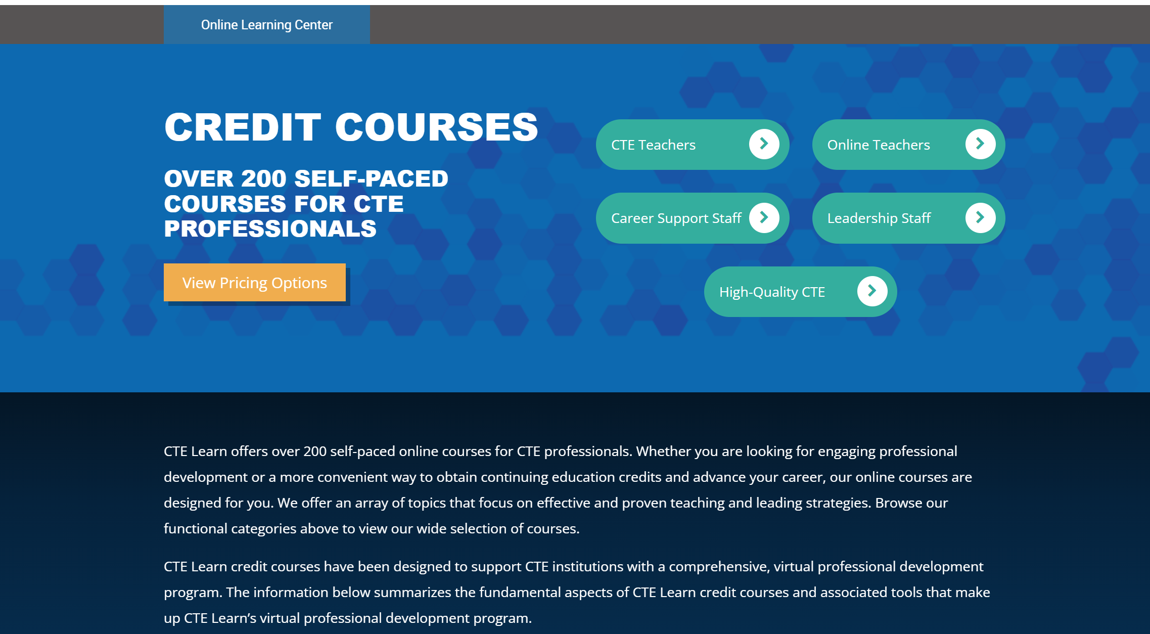
Notes:
Thank you all so much for joining us today. We hope you found real value in the sessions and left with fresh ideas and inspiration.
From why it’s important to promote your CTE Learn site, to the many ways you can promote it, to innovative strategies, success stories, creating state-specific courses and offerings, and even how to connect with state departments of education—we covered a lot.
Our goal today was to give you practical tools, spark new thinking, and help you feel more confident about how to take full ownership of your online learning center.
At the end of the day, this platform is yours. We’re here to support you, help increase visibility, grow usage, and really make your portal feel like a powerful, customized resource for your members.
Thank you again for being here—and as always, don’t hesitate to reach out if we can help in any way.
Link to presenters emails: https://www.dropbox.com/scl/fi/vchr3mhslko969v6cfs3x/Presenter-emails.docx?rlkey=fqqlwyk6ao1g1huyhwy9yksoo&st=2336ygf0&dl=0

