Slide 1


State Association Leadership Training Program
Internet: MarriottBonvoy_Conference
Internet password: acteseminar25
March 16, 2025

Slide 2

Introductions –
NAME
STATE ASSOCIATION
LEADERSHIP POSITION
Internet: MarriottBonvoy_Conference
Internet password: acteseminar25
Notes:
What advice would you give to new state leaders just stepping into their roles?

Slide 3
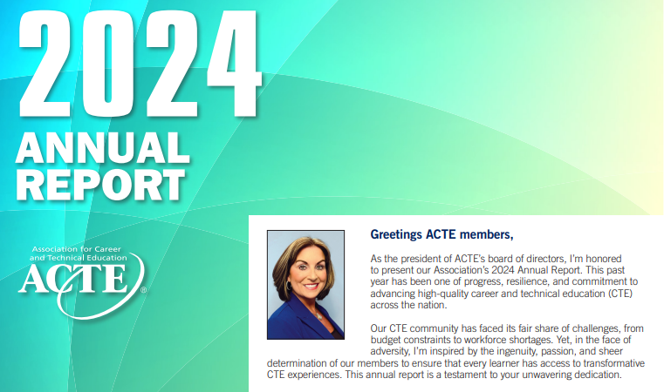
Notes:
Explore this resource. What was something you didn’t know?

Slide 4
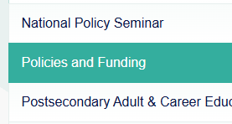
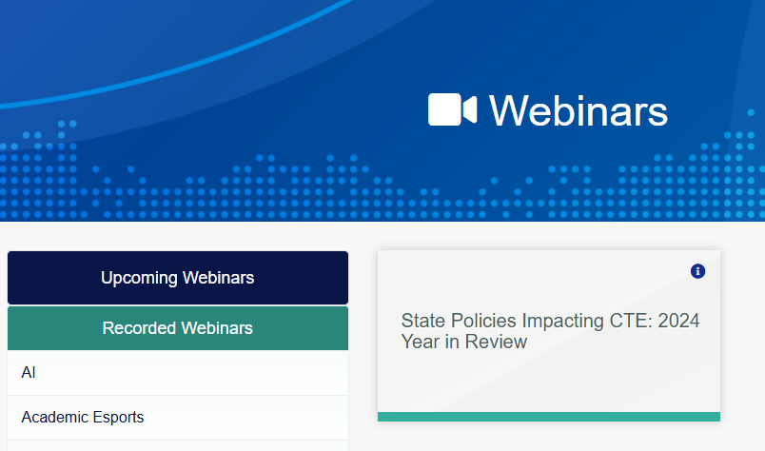

Slide 5

www.Acteonline.org
Press Releases

Slide 6
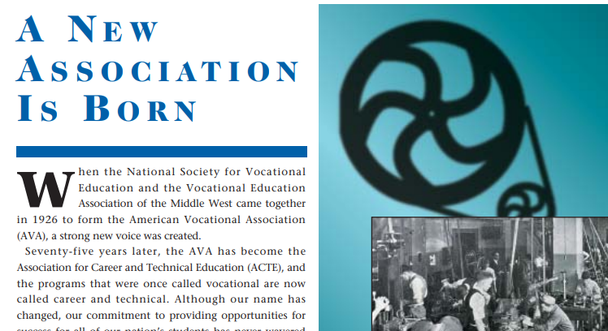
Notes:
The Association for Career and Technical Education® (ACTE) is the largest national education association dedicated to the advancement of education that prepares youth and adults for careers. Founded in 1926 when a Coca-Cola cost a nickel and Calvin Coolidge was president, ACTE emerged 10 years after the federal government began funding “vocational education” through the Smith-Hughes Act.
Career and technical education (CTE) as we know it today has its roots in the founding of the United States. From the start, a strong knowledge base and skill set for citizens were considered important. ACTE is committed to:
Enhancing the job performance and satisfaction of its members and the CTE community
Increasing public awareness and appreciation for CTE
Assuring growth in local, state and federal funding for these programs by communicating and working with legislators and government leaders
Take a look back at ACTE’s history through the years from the 75th Anniversary issue of Techniques magazine, published in February 2002, as we approach our 100-year anniversary in 2026!

Slide 7
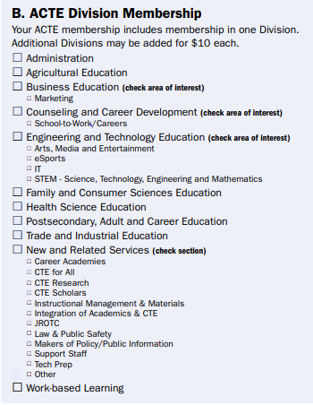
Notes:
NRS Section Changes: CTE Scholars to Innovative Teaching and Learning (ITL) Tech Prep to unify with the Academic Integration Section

Slide 8

Roundtable Topic Discussions

Slide 9
Enhancing Association Communications –
Debbie Nelson (CO) & Julia Kendrick
Membership Growth & Retention –
Becky Cox (UT) & Kelli Diemer
Building Strong State Association Boards –
Tina Statucki (NV)
Successful State Conference Planning –
Glenda Paxton
Notes:
Participants will have the opportunity to engage in three diƯerent roundtable discussions, each focused on a key topic relevant to state associations. Each table will have a designated topic leader who will provide prompts to guide meaningful conversation. Additionally, ACTE representatives at each table will highlight available resources and support.

Slide 10
Time for Lunch!
12 pm – 1:30 pm
Internet: MarriottBonvoy_Conference
Internet password: acteseminar25

Slide 11
Annual Report
Reaffirmation of Existence and Commitment
  State Associations must reaffirm their existence and commitment to ACTE annually through an annual report.
  Failure to submit the report results in probation, granting a one-year extension to comply
  If no report is submitted after the probationary period, the state association is disaffiliated from ACTE

Slide 12
Quality Association Standards (QAS)
Purpose of the QAS:
  Provide benchmarks for state associations to assess performance levels.
  Help evaluate the quality of service offered to members and prospective members.
Key Objectives:
  Aid states in assessing their organizational structure.
  Determine whether leadership is delivering minimum, average, or superior programs for members.
Clarifications:
  QAS is not a competition between states or a tool to create a “class system” of associations.
  It is not designed to evaluate the performance of a state’s executive director or volunteer leaders.
Notes:
The purpose of the Quality Association Standards (QAS) is to provide benchmarks for state associations to determine levels of performance and satisfactory service to their members and prospective members. QAS should be useful to states in evaluating their basic organization and whether their leadership is providing minimum, average or superior programs for the membership. It’s not intended to be a competition between states and/or to establish a “class system” of state associations, nor is it a system for rating the performance of a state’s executive director or volunteer leaders.

Slide 13

Quality Association Standards Timeframe & Award Levels
Application Timeframe:
Prior July 1 – June 30
Submission Deadline: October 15
Award Levels:
Gold 🏆 – All criteria met (100%)
Silver 🥈 – No more than 2 items in process and 2 items not met (88%)
Bronze 🥉 – No more than 3 items in process and 4 items not met (78%)

Slide 14
QAS Application Process & Quality Association Recognition
Process:
1️⃣ ACTE reviews completed applications
2️⃣ Applications are forwarded to Region Vice Presidents for final approval
3️⃣ Approved states receive Quality Association Recognition
Recognition:
🎉 States earning this recognition will be honored at the ACTE CareerTech VISION State Leader Breakfast

Slide 15
Time for Sharing!
2:15 pm – 3:00 pm
Notes:
2:15 – 3:00 p.m. Table sharing
3:00 – 4:00 p.m. State Chapter Module (SCM) and Chapter Payment Portal (CPP

Slide 16
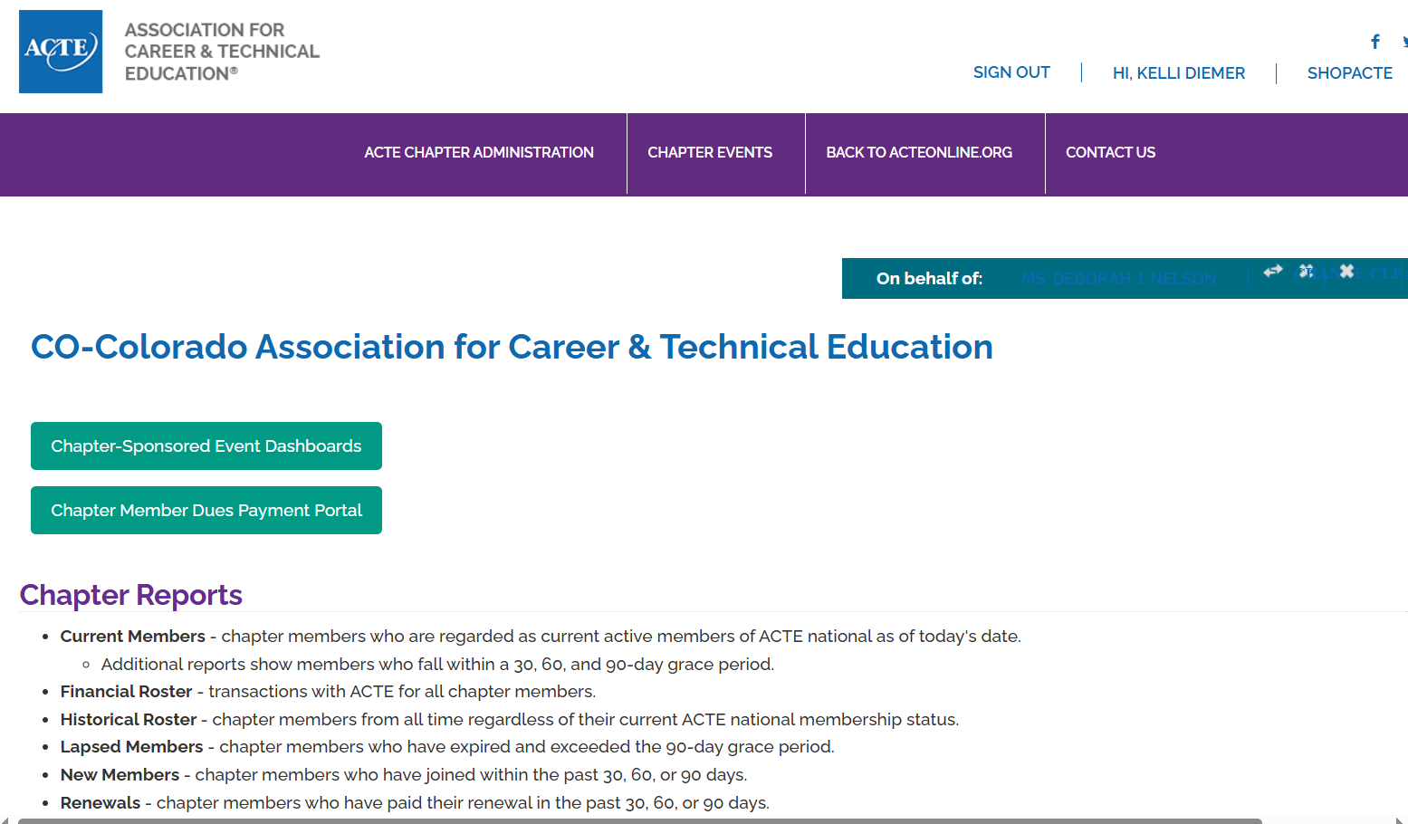
State Chapter Module

Slide 17
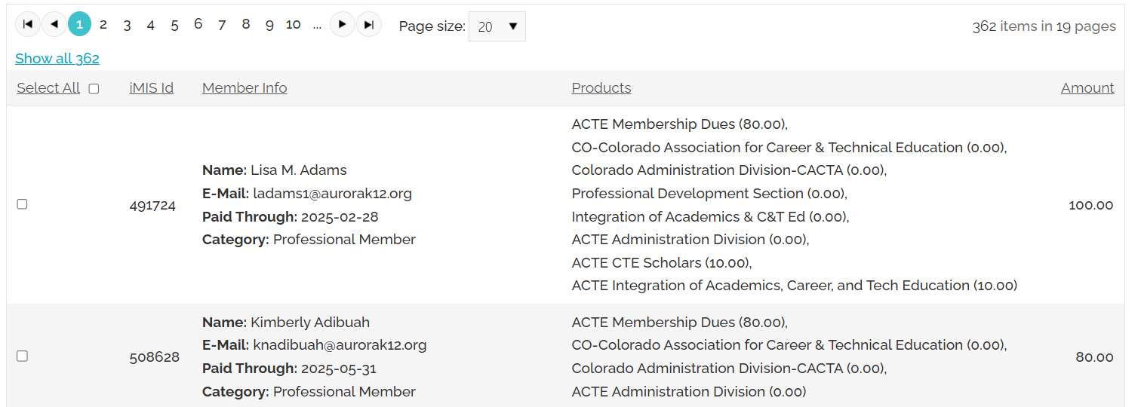
Chapter Payment Portal

Slide 18
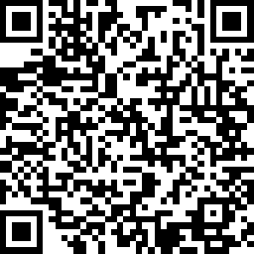
State Association Leadership Training Survey
https://www.surveymonkey.com/r/NPS25_SALT

Slide 19

Tuesday, Dec. 9, 2025
Sunday, Mar. 22, 2026

