Slide 1
State Association Leadership Training Program
March 17, 2024

Slide 2
Introductions –
NAME
STATE ASSOCIATION
WHAT THREE WORDS WOULD DESCRIBE YOUR LEADERSHIP TEAM?

Slide 3
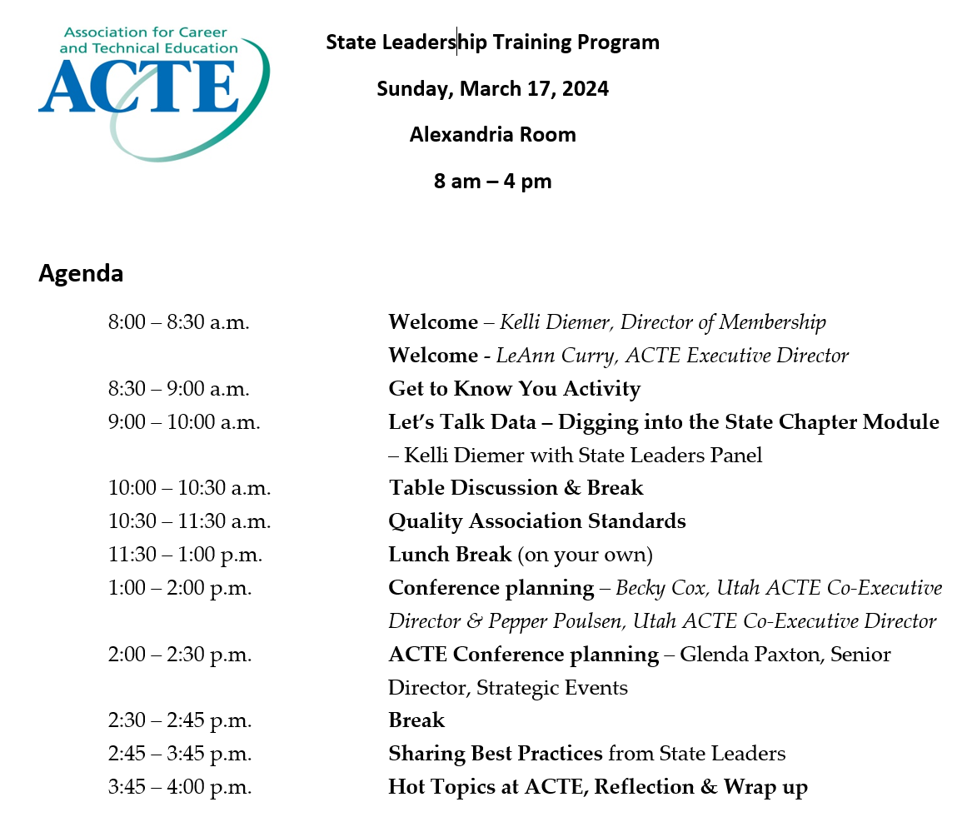

Slide 4
Get to Know You !
Share a success story about your state association.

Slide 5
Web.acteonline.org
Log into your profile.
Web.acteonline.org/scm

Slide 6
Quality Association Standards
Criterion Six: Membership Development and Retention
The association must demonstrate that its current membership/potential membership ratio is reasonable. It must have an effective and continuing program of membership retention and recruitment.
Quality Association Standards
Criterion Four: Programs, Services and Activities
There must be evidence that the association’s programs, services and activities meet member and other targeted groups/needs, are formally planned, funded, coordinated, implemented, monitored, and evaluated, ad that sufficient human resources are available to implement, main and evaluate these programs, services and activities.

Slide 7
creative
CONFERENCE
PLANNING

Slide 8
Becky Cox & Pepper Poulsen
CO-EXECUTIVE DIRECTORS
UTAH ACTE

Slide 9
Utah ACTE
CONFERENCE
Date
Place
Who
FIRST WEEKEND IN FEBRUARY
SCHOOL USE
BOARD DRIVEN
We use a comprehensive High School. Loweers costs and allows for hands on labs for instruction. We do northern Utah 2 years, then go to southern Utah on the 3rd year.
The executive committee plans the schedule, general sessions, meals, etc but the board plans the majority of the sessions. These are content specific.
Our State Office of Education does Summer Conferences so we do a Winter or Mid-Winter Conference. Friday Night and Saturday.

Slide 10
This year
NEW DIRECTION
This year we decided not to have a keynote speaker and to give that time back to the divisions for an additional session. We also were focusing on our strategic plan and decided to create friday night workshops related to out stratigic plan.

Slide 11
Group Activity
USING ACTE’S STRATIGIC PLAN CREATE CONFERENCE SESSIONS THAT ALIGN TO THE
STRATIGIC PLAN

Slide 12
What we came up with

Slide 13
Next Steps
We then went back to our full board and asked each division to take the topics and find a presenter for that workshop. We had a list of presenter ideas they could use.

Slide 14
Here it is
Here are the amazing workshops were were able to offer - most directly relating to our stratigic plan.

Slide 15
