Slide 1
BREAKOUT SESSION Work Based Learning (WBL)
Notes:
Tom Knight and Celena Mills

Slide 2
WBL Continuum
Notes:
So, let’s take a look at the continuum. First, it’s important to note that this is a continuum and why that title is so important. Every student that you work with is different, has different needs and skills, and will develop at a different pace. The idea of a continuum acknowledges that there can be several points along the path and that not every student will move in lockstep, nor will they all utilize all the different opportunities for various reasons. What is important is that we aim to build a full continuum so that we can offer a variety of opportunities to meet the needs of all of our learners.

Slide 3
WBL Continuum
Involves an Industry Partner or Employer?
Centers Around CTE Task or Competency?
Sustained or On-going?
Notes:
Finally, before we can talk about the categories in the continuum, we need to have a shared understanding of the required components of WBL that are outlined in Perkins V. All three of these components must be in place for the experience to be classified as WBL.
Perkins V describe WBL as …sustained interactions with employers or community professionals in real workplace settings, to the extent practicable, or simulated environments at an educational institution that foster in-depth, first-hand engagement with the tasks required of a given career field, that are aligned to curriculum, instruction, and CTE Program standards.
So, to be WBL the experience must involve an employer, center around a task or competency in your CTE program, and, to reach higher levels of rigor, the opportunity must be for a sustained period of time or be part of an ongoing relationship.

Slide 4
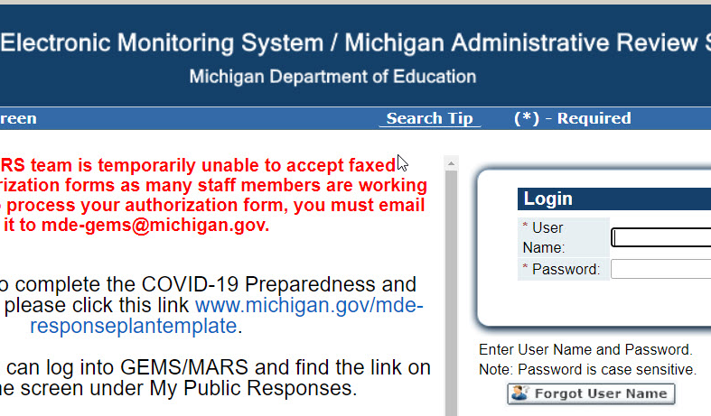
Notes:
Now that we’ve reviewed the continuum, let’s talk a minute about how you need to record WBL experiences. There are two systems…you will record qualitative, program-level data in the CTE Portal and quantitative student-level data in CTEIS.

Slide 5
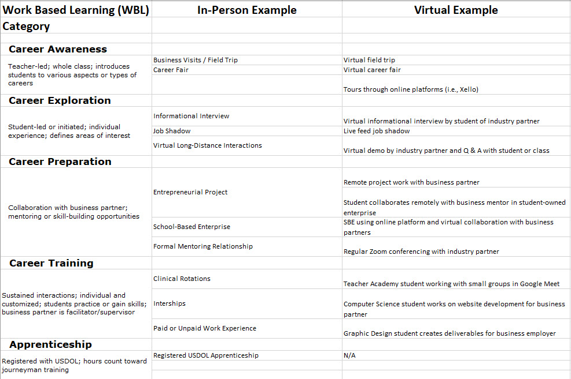
Continuum Planning Tool Examples

Slide 6
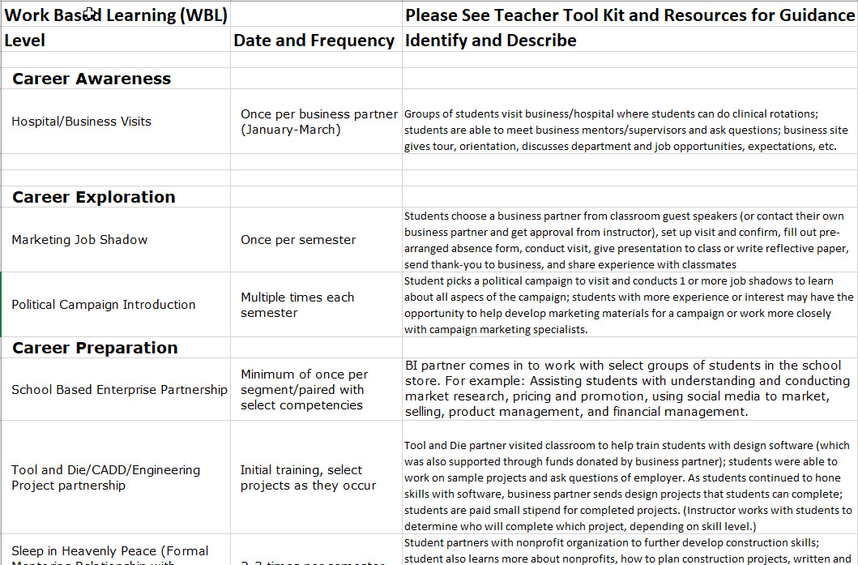
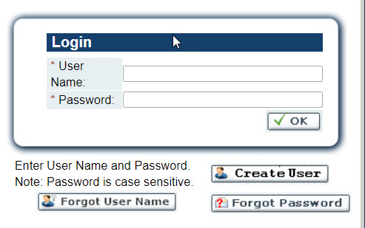
Notes:
In the CTE portal you will simply describe all the WBL opportunities that you have available for students throughout your program. This information becomes part of your TRAC and CIP Self-Review process each year. If you can keep most of the same opportunities from year to year, then you can simply add to this as you add new experiences for students. This is a good way for you to see, at a glance, if you are offering WBL across the continuum or if there are places for you to grow those offerings for students. Now, just because something is on here doesn’t mean that all your students will partake in it, but just that it’s available and you’re offering it.

Slide 7
Q and A
Notes:
Dana Hughes

Slide 8
Contact Information
Celena Mills
Office of Career and Technical Education
millsc1@michigan.gov
Notes:
In this remote environment the best way to contact me is through email, although I’m happy to chat by phone or virtual platform too. I’m looking forward to meeting up live at our virtual session in October!

