Slide 1
BREAKOUT SESSION Syllabus & Instructional Design
Notes:
Deb Miller and Pat Yanik

Slide 2
CTE PROGRAMS VS. CTE COURSE
A CTE Program is a compilation of several CTE courses and can be taught in 1 year, 2 year, etc.
CTE Programs fall within a state defined CIP Code
The state defines the segments/standards or competencies for each CIP Code
The State determines Perkins courses and districts define what courses make up the program
Districts define what segments/standards or competencies are taught in each course

Slide 3
Course title
Instructor’s name and school contact information
Course dates
Course description
Special features of the course
Academic Credits
Postsecondary Connections
Post Secondary Recognized Credentials, Certifications, and/or Licensures
Off-site Delivery
Work-Based Learning
Safety Training
Student Leadership (CTSO) opportunities
Syllabus
Notes:
More information can be found in the CTE Teacher Technical Tool Kit. https://www.michigan.gov/documents/mde/CTE_Teacher_Technical_Tool_Kit_698712_7.pdf

Slide 4
Syllabus
Course Outline with topics to be covered and CTE segments/competencies to be covered in the course.
Resources
Textbooks
Software
Special facilities
Materials
Reference New CTE Teacher Technical Toolkit for sample documentation.

Slide 5
Syllabus Sample
Reference New CTE Teacher Technical Toolkit for sample documentation.

Slide 6
A CTE program is a sequence of courses
Each CTE program is composed of 12 curricular segments or Perkins competencies
Segments/competencies consist of standards and performance elements
Instructional Design

Slide 7
CTE students are identified as Participants, Concentrators, Completers based on the number of completed segments/competencies
Participant – a student who has successfully completed, with a grade of C (2.0) or better, courses totaling 4 to 7 segments of instruction – regardless of the number of courses taken.
Concentrator – a student who has successfully completed, with a grade of C (2.0) or better, courses totaling 8 to 11 segments of instruction – regardless of the number of courses taken.
Completer – a student who has successfully completed, with a grade of C (2.0) or better, courses totaling all 12 segments of instruction.
Instructional Design Segments

Slide 8
INSTRUCTIONAL DESIGN & CTE STANDARDS
CTE STANDARDS
INSTRUCTIONAL DESIGN
Gap Analysis
Identifies what segments, performance elements, and skills are associated with each CIP Code.
Segmenting Sheet
Identifies how the segments are spread throughout each course in your program.
Segments can not be reported more than once in a program.

Slide 9
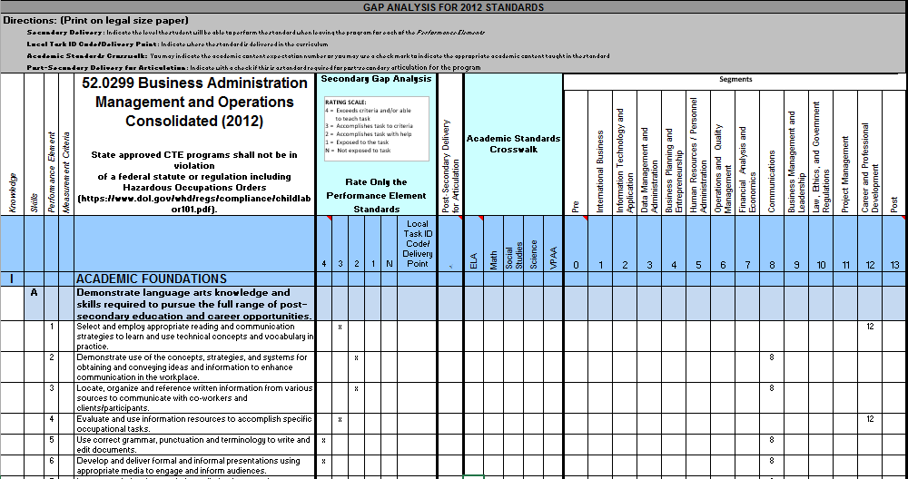
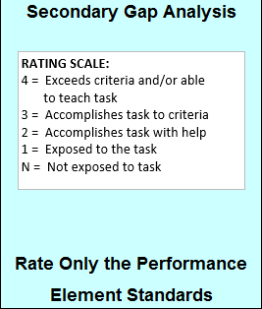
Gap Analysis Document - Students are expected to demonstrate to
the Performance Element level.

Slide 10
Gap Analysis Document - 12 Segments

Slide 11
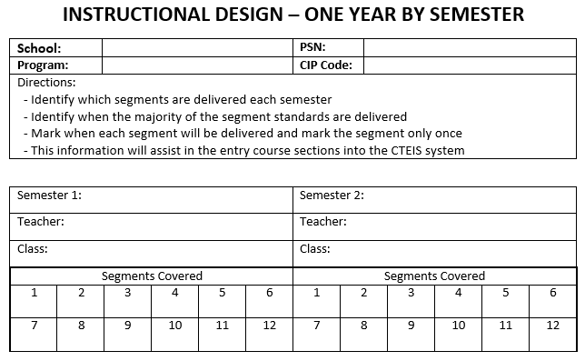
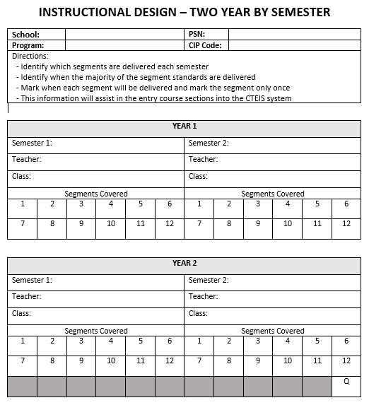
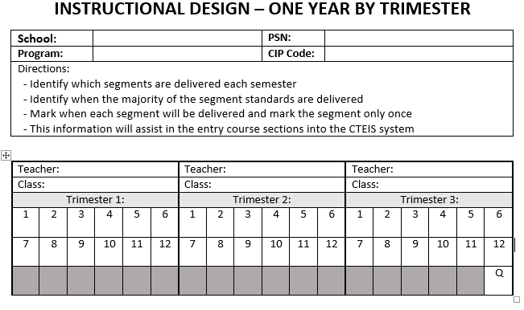

Slide 12
CTE students are identified as Participants, Concentrators, Completers based on the number of completed segments/competencies
Participant – a student who has successfully completed, with a grade of C (2.0) or better, courses totaling 4 to 7 segments of instruction – regardless of the number of courses taken.
Concentrator – a student who has successfully completed, with a grade of C (2.0) or better, courses totaling 8 to 11 segments of instruction – regardless of the number of courses taken.
Completer – a student who has successfully completed, with a grade of C (2.0) or better, courses totaling all 12 segments of instruction.
Instructional Design
Competencies

Slide 13
Instructional Design Example
Notes:
The fifth tab in each CIP Overview is an instructional design example. The information is fictional and the tab simply exists for teachers to be able to see how to fill out the instructional design form.

Slide 14
Instructional Design Form
Notes:
The sixth tab is the customized instructional design form created specifically for that CIP. The CIP code and program name have been pre-populated, as well as the competency codes.

Slide 15
Instructional Design Form
Notes:
Teachers will fill out the information in each column to reflect their local courses.

Slide 16
Instructional Design Form
Notes:
Instructions to assist staff in filling out form are on the top of each form. The pre-printed sections are noted, and the numbers on the form correspond with the numbers in the cells. Cell numbers are also used for further clarity.

Slide 17
Instructional Design Form
Notes:
Advanced classes, with content above and beyond the competencies, are listed under #12 on the form. These local classes, previously labeled as Q under Perkins IV, will now use a Z code. The instructional design form includes a section where these courses can be described.

Slide 18
Additional Resources
Credential Tip Sheets
FAQs
www.Michigan.gov/OCTE
Notes:
All credential tip sheets, most CIP Overview documents, and most FAQs have been posted on the website under CTE Instructional Resources, by Career Cluster. We are working to finalize the last few items that are still outstanding. Some programs may also have additional resources yet to come that will be added to your cluster tab, including any new tip sheets or information for credentials that may be added in the future. All new credentials will be aligned to the current competencies and PCCs.
Videos of today’s session will be available on the website but could take around 3 weeks or more to appear. We will be sending a copy of these presentation slides to CEPDs.

