Slide 1
Welcome
New CTE Teacher Workshop
October 13, 2021
8 a.m. – 2 p.m.
Notes:
Lori Johnson

Slide 2
Welcome and Introductions
Jim Berry
MI ACTE President
8:00 a.m. – 8:05 a.m.
Notes:
Jim Berry

Slide 3
OCTE Welcome and Updates
Dr. Brian Pyles
OCTE Director
8:05 a.m. – 8:15 a.m.
Notes:
Jim Berry

Slide 4
CTE Program Overview
Deb Miller
8:15 a.m. – 8:25 a.m.
Notes:
Deb Miller

Slide 5
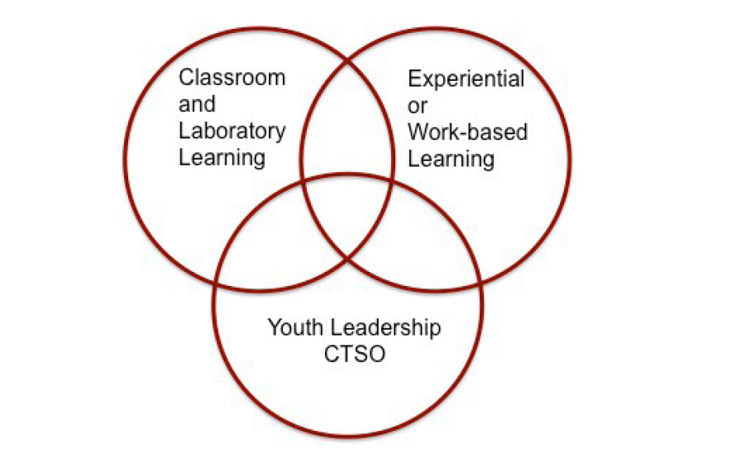
CTE CORE COMPONENTS
Notes:
Deb Miller

Slide 6
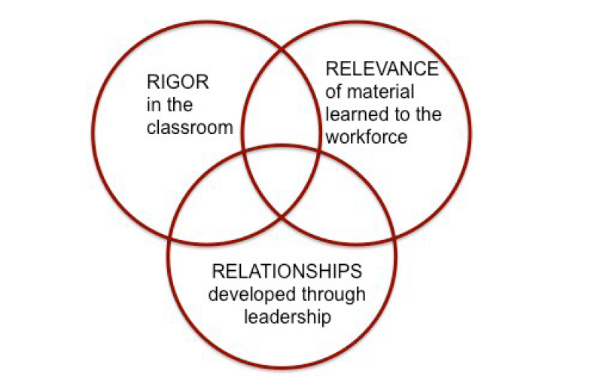
CTE CORE COMPONENTS
Notes:
Deb Miller

Slide 7
CTE Program Requirements
Program Teacher Certification
Program Teacher Professional Development
Program Advisory Committee: Industry Experts Providing Input to Program
Implementation of Program Standards/Course Content
Post-Secondary Industry Recognized Credential(s)
Strategies to Eliminate Barriers to Program Access
Secondary-Postsecondary Connections
Notes:
Deb Miller

Slide 8
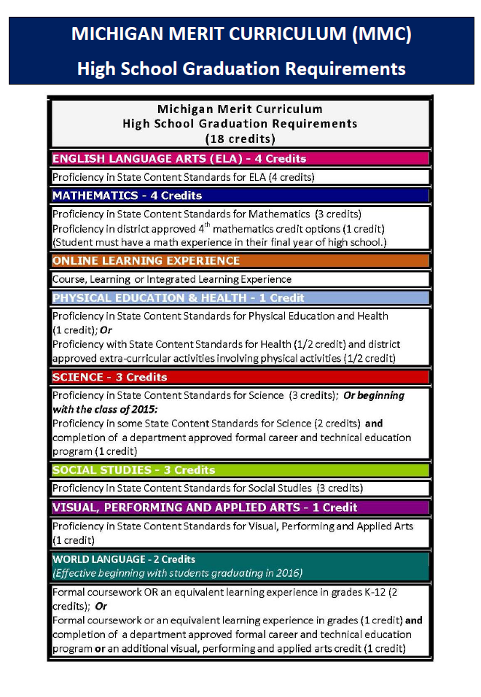
Academics in CTE
Notes:
Deb Miller

Slide 9
Introduction to CTE Teacher Tool Kit
Mark Forbush
8:25 a.m. – 8:50 a.m.
Notes:
Mark Forbush

Slide 10

Purpose
Guidance for New CTE Teachers
Quick Reference Guide to Important CTE Information
Sample Documents, Support Materials, Other Resources
CTE Teacher Technical Tool Kit Link
Notes:
Mark Forbush

Slide 11
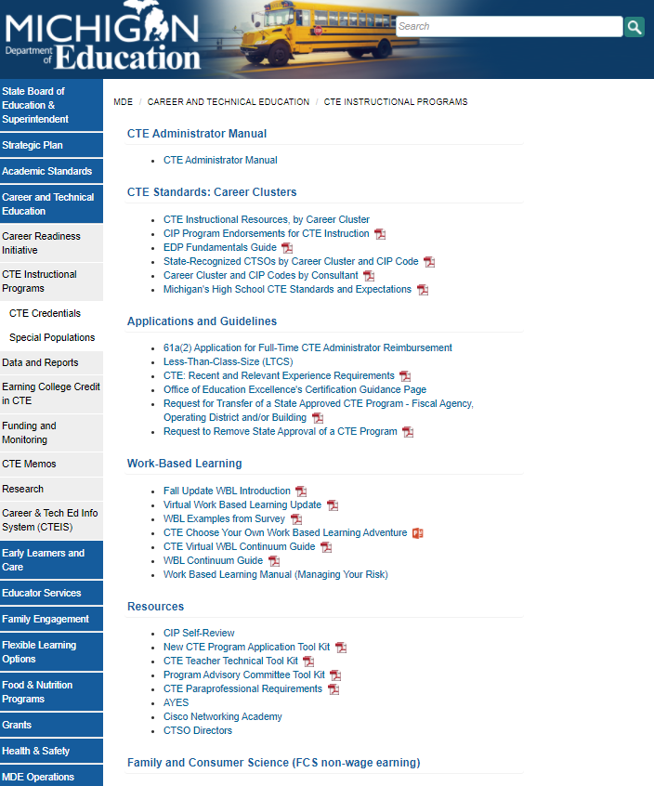
OCTE Resources
MDE OCTE Resources Link
Notes:
Mark Forbush

Slide 12
Mini-Session 1
ACTE & MI ACTE Websites/Resources
Mikki Spagnoli
8:50 a.m. – 9:00 a.m.
Notes:
Mikki Spagnoli

Slide 13

ACTE and MI ACTE
Membership
Resources
Recognition
Advocacy
Curriculum
Professional Development
MI ACTE Website Link
ACTE Website Link
Notes:
Mikki Spagnoli

Slide 14
Mini-Session 2
Classroom Management Tips & Resources
Jim Berry
9:00 a.m. – 9:30 a.m.
Notes:
Jim Berry

Slide 15
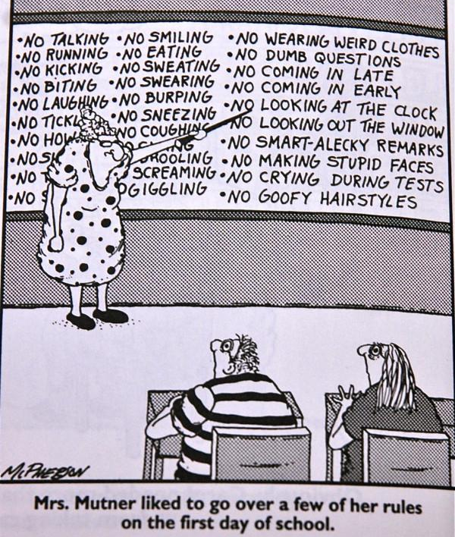
Classroom Management Tips & Resources
Presentation Link
Notes:
Jim Berry

Slide 16
Mini-Session 3
CIP Self-Review/CTE Portal
Tom Knight and Kathleen Szuminski
9:30 a.m. – 9:45 a.m.
Notes:
Tom Knight and Kathleen Szuminski

Slide 17
What is a CIP Self-Review?
Organizational tool for CTE programs
Provides focus for continuous program improvement
Notes:
Tom Knight and Kathleen Szuminski

Slide 18
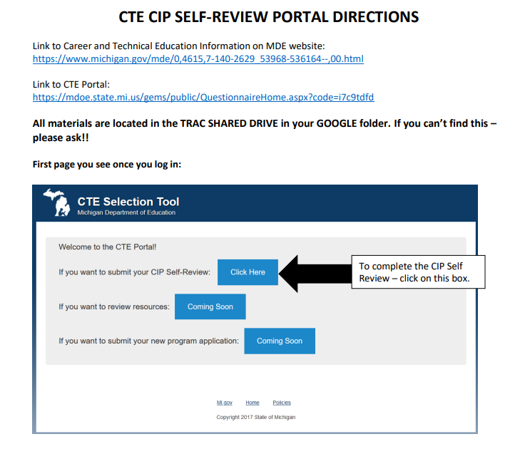
CIP Self-Review Portal
CTE CIP Self-Review Portal Directions Link
Notes:
Tom Knight and Kathleen Szuminski

Slide 19
Mini-Session 4
Perkins V Credentials/Certifications
Celena Mills and Mikki Spagnoli
9:45 a.m. – 10:00 a.m.
Notes:
Celena Mills and Mikki Spagnoli

Slide 20
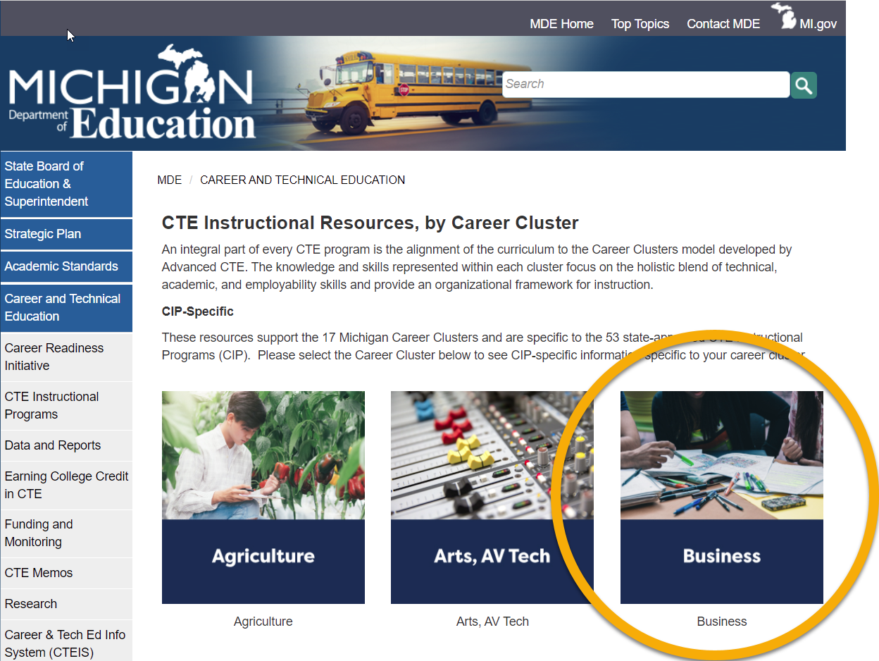
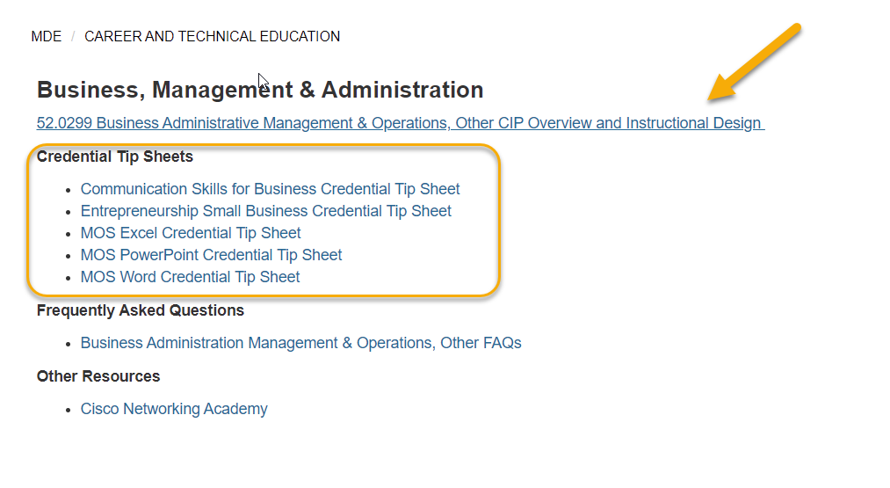
Information
(Student) Competitive Advantage
Perkins Program Quality Indicator (5S1)
Approved List
Career Pathways Grant
CIP Self-Review & Instructional Design Changes
Resources
Professional Development Opportunities
MDE - CPG TA Sessions Resources and Recordings (michigan.gov)
MDE - CTE Memos (michigan.gov)
Notes:
Celena Mills and Mikki Spagnoli

Slide 21
BREAKOUT SESSIONS INFORMATION
Jim Berry
Notes:
Jim Berry

Slide 22
Breakout Session Times
Breakout Session | Time
Session 1 | 10:15 a.m. – 10:45 a.m.
Session 2 | 10:45 a.m. – 11:15 a.m.
Session 3 | 11:15 a.m. – 11:45 a.m.
LUNCH | 11:45 a.m. – 12:30 p.m.
Session 4 | 12:30 p.m. – 1:00 p.m.
Session 5 | 1:00 p.m. – 1:30 p.m.
LARGE GROUP SESSION AT 1:30 P.M.
Notes:
Jim Berry

Slide 23
Breakout Session Topics and Rooms
Session Topic | Room
Syllabus & Instructional Design | Innovation Room
Program Advisory Committee Tool Kit | Leadership A Room
Work-Based Learning (WBL) | Leadership B Room
Leadership & CTSOs | Leadership C Room
Special Populations | Howell Room
LARGE GROUP SESSION AT 1:30 P.M.
Notes:
Lori Johnson

Slide 24
BREAK
10:00 a.m. – 10:15 a.m.
Notes:
Jim Berry

Slide 25
11:45 a.m. – 12:30 p.m.
LUNCH
Notes:
Jim Berry

Slide 26
Mini-Session 5
MDE and OCTE Websites/Resources
Candace Vinson
1:30 p.m. – 1:45 p.m.
Notes:
Candace Vinson

Slide 27

CIP SELF REVIEW Link
CTE INSTRUCTIONAL PROGRAMS Link
COVID-19 RESOURCES Link
COVID-19 RESOURCES (Specific to CTE) Link
Notes:
Candace Vinson

Slide 28
Wrap-Up, Survey, and Q/A
1:45 p.m. – 2:00 p.m.
SURVEY - https://tinyurl.com/ck36a7md
Notes:
Jim Berry and Jamie Engel

Slide 29
Thank
YOU!
CONTACT INFORMATION
Jim Berry
MI ACTE President
jberry@sjschools.org
Jamie Engel
MI ACTE President-Elect
jengel@inghamisd.org
Notes:
Jim Berry and Jamie Engel

