Slide 1
ACTE Inclusion, Access, Equity & Diversity Advisory Group acteonline.org/iaed
Contribute resources to the ACTE IAED website
Submit recommended IAED speaker names
Sign up to be a part of ACTE's IAED Advisory Group
Recommend ideas for the Techniques 2021-22 editorial calendar and IAED column

Slide 2
2021-22 Techniques Editorial Themes Focus on IAED in CTE acteonline.org/techniques
Each of the 4 print issues will focus on inclusion, access, equity and diversity
What do they mean?
What steps must CTE take to improve the learning experience and outcomes for all students?
Additional themes in digital editions include:
Teachers Inspire
Tech Evolves
Students Lead
CTE Connects

Slide 3
ACTE’s IAED Webinar Series acteonline/webinars
Empowering Girls and Women in CTE, July 13, 4:00 p.m. ET
Ensuring Your Classroom is Providing Equity for All CTE Students, Aug. 5, 2:00 p.m. ET
Making CTE Classrooms More Inclusive for LGBTQ+ Students (TBD in September)
Part 2: Confronting Isms in the Classroom, Oct. 5, 2:00 p.m. ET
For archived IAED webinars to view on-demand, visit acteonline.org/webinars/iaed-webinars
ACTE created a webinar series on Inclusion, Access, Equity and Diversity (IAED) to identify IAED best practices and topics of discussion. Don’t miss content at the forefront of IAED in CTE and plan to attend this series of webinars today!

Slide 4
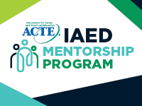
ACTE Inclusion, Access, Equity & Diversity Mentorship Program acteonline.org/iaed/iaed-mentorship-program
Professional development opportunities to help cultivate diverse & inclusive CTE work environments
Demonstrate your commitment to IAED by intentionally mentoring people who are not like yourself
Become a more empathetic leader
Application period: Aug. 1-Sept. 30
ACTE’s IAED Mentorship Program is also looking for mentors!
Application period: June 1-Aug. 31

Slide 5
IAED Mentorship Program acteonline.org/iaed/iaed-mentorship-program

Slide 6
IAED Mentorship Program acteonline.org/iaed/iaed-mentorship-program

Slide 7
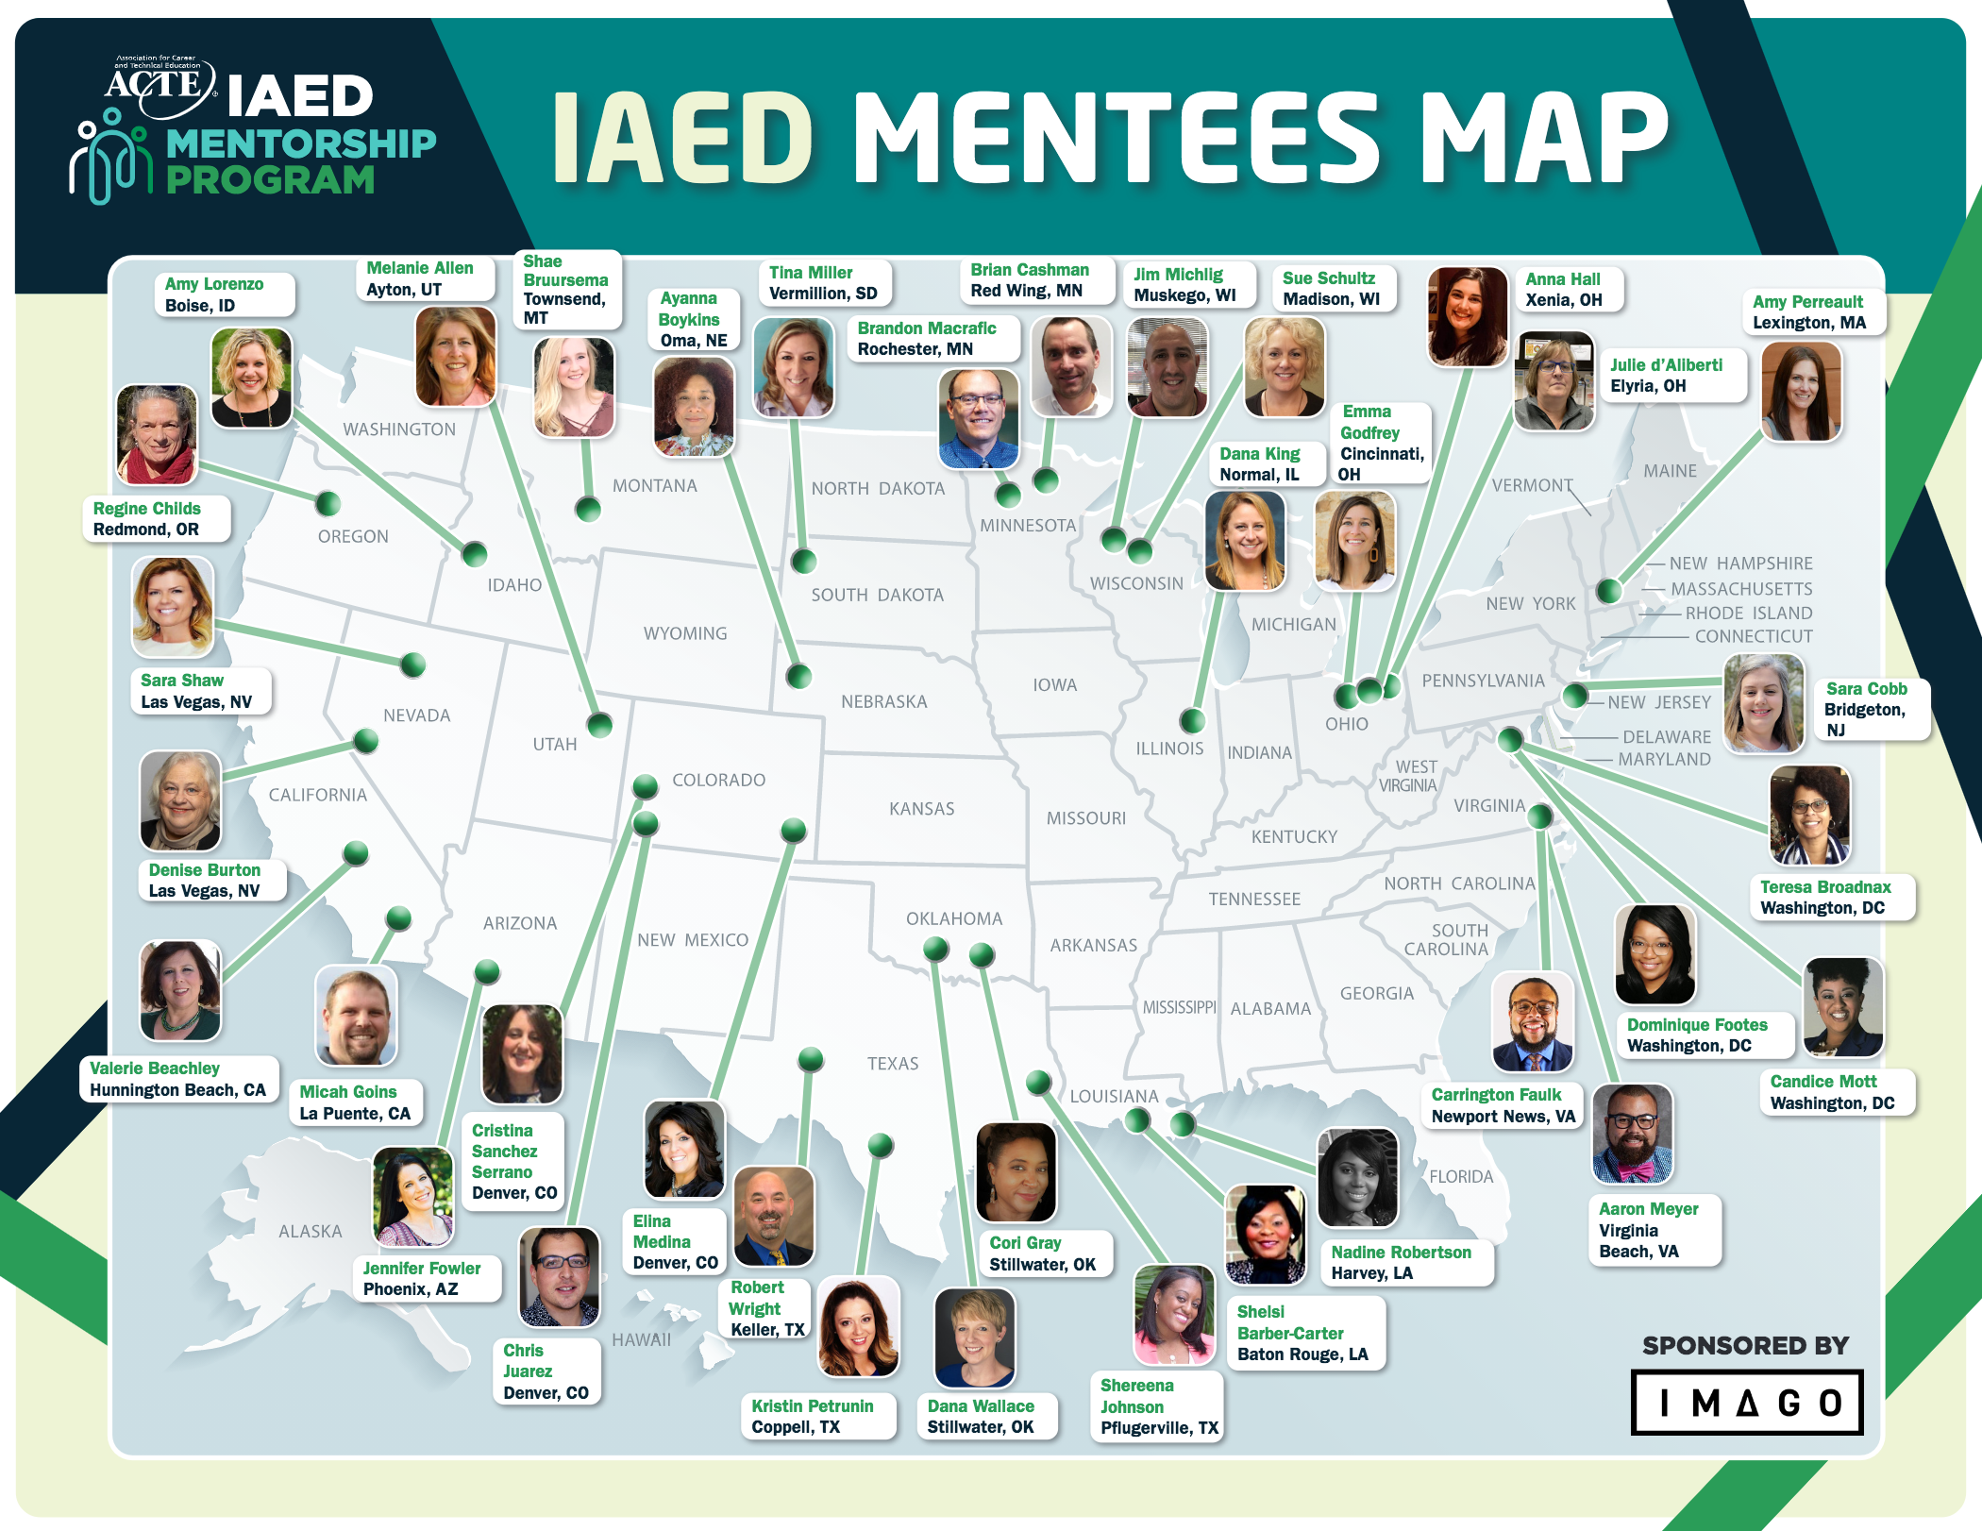
IAED Mentorship Program acteonline.org/iaed/iaed-mentorship-program

