Slide 1
Starting Early – Introducing Career Development in the Early Grades
January 19, 2021

Slide 2

www.acteonline.org/why-cte/student-career-development/
Starting early: How to introduce career development at earlier ages and stages to ensure effective academic and career development in high-school.
Delivering real-world experiences: the importance of work-based learning and how to deliver an organized, efficient, high-quality WBL experience to properly prepare students for the workplace.
Unifying your district: How to align counseling and CTE to level-up your student career development activities and develop a cohesive strategy for student success.
Connecting SEL to career success: The role social-emotional learning plays and how to incorporate it into your career development practice.
Technology to deliver equity: How to utilize technology to give all students timely, relevant, and accurate information about future options.

Slide 3
Today’s guests…
Nicole Cobb, Ed.D., Vice President, ACTE Counseling and Career Development Division; Associate Professor of Practice, Department of Human and Organizational Development, Vanderbilt University, Nashville, TN (moderator)
Brian Bontempo, Ed.D., Superintendent, Auburn Career Center and Ohio Technical Center, Concord, OH
Caroline Cockman, School Counselor, Apex Elementary School, Apex, NC
Dana Jackson, Executive Director, Counseling Services and College Access, Grand Prairie Independent School District, Grand Prairie, TX

Slide 4
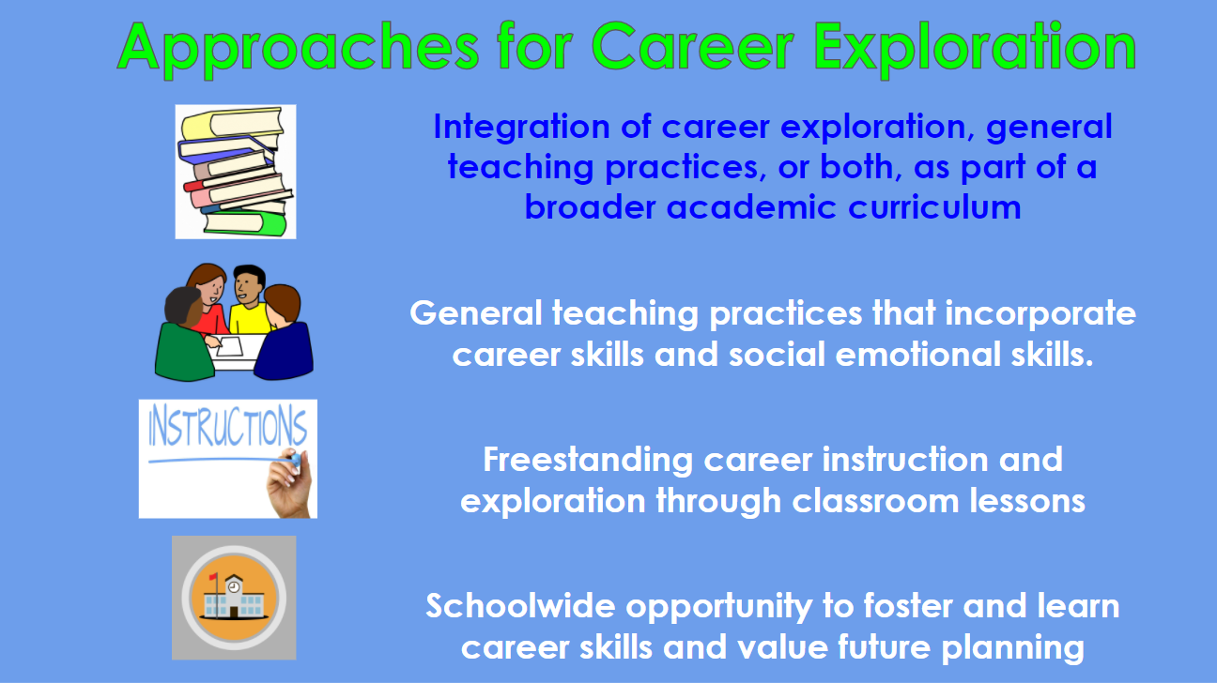

Slide 5
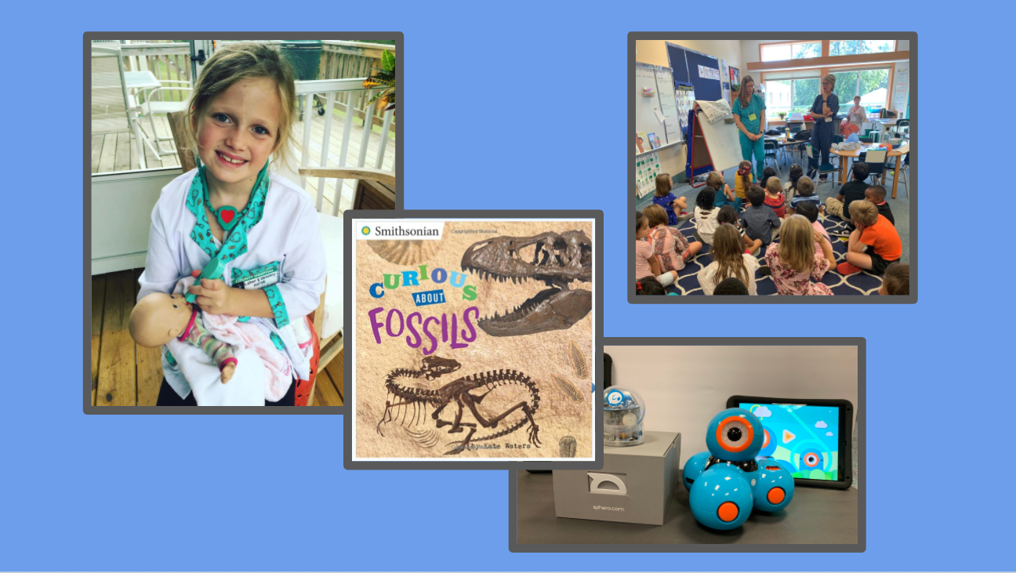

Slide 6
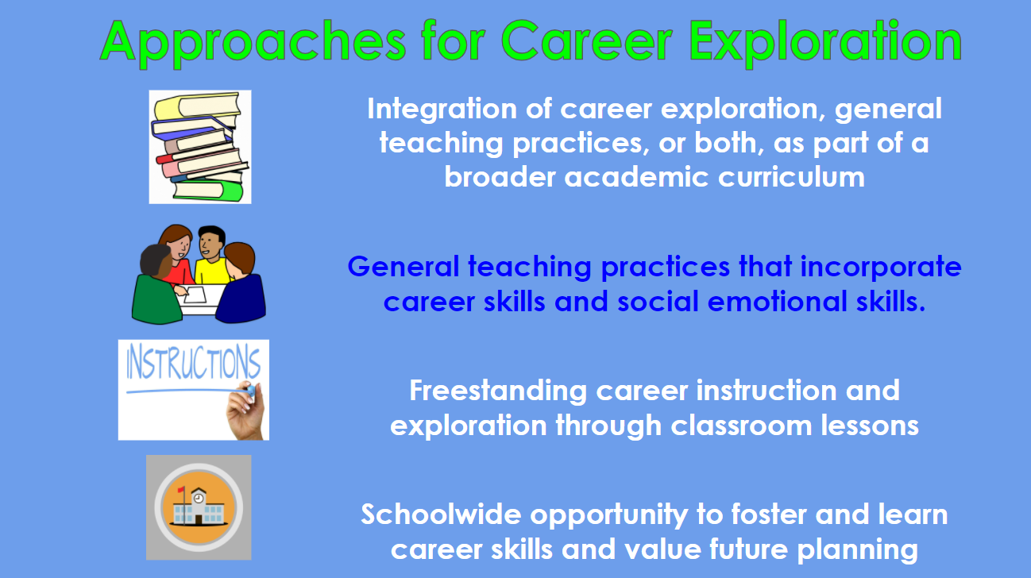

Slide 7
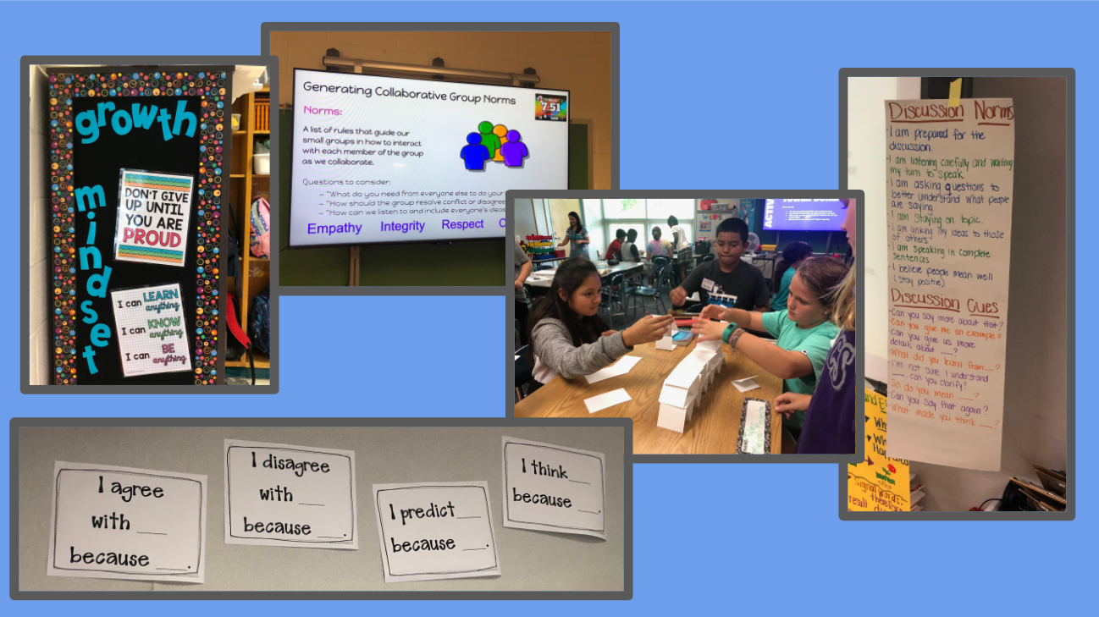

Slide 8
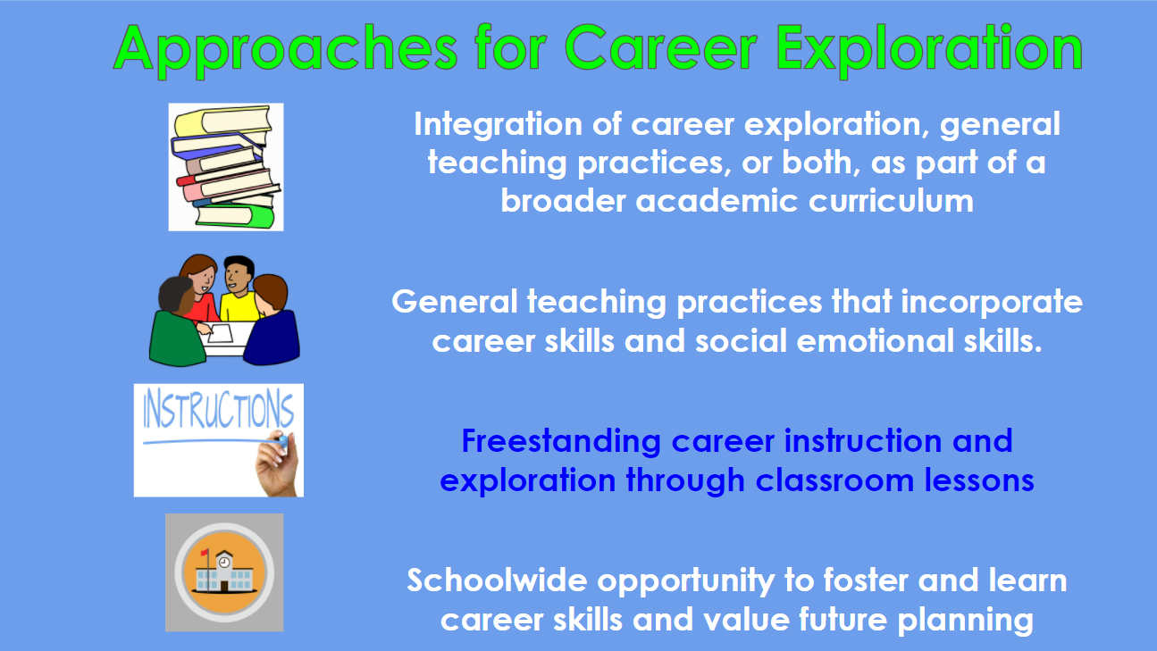

Slide 9


Slide 10
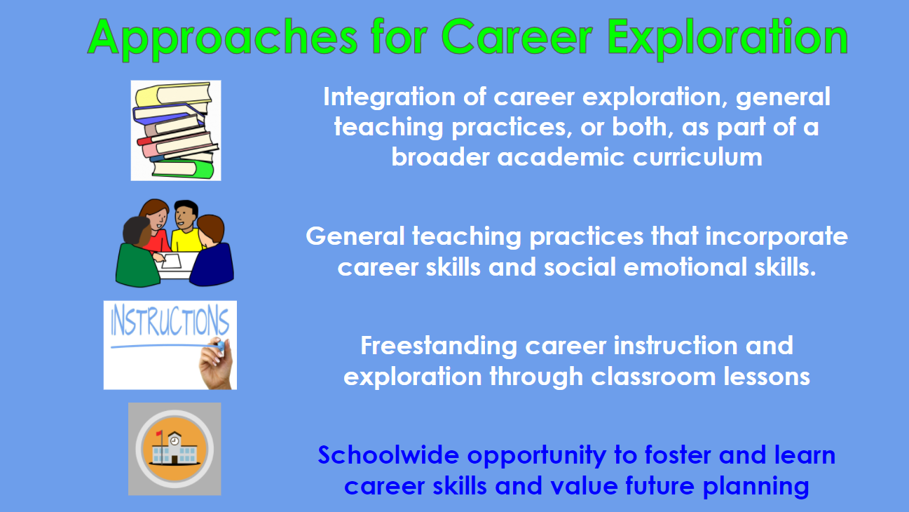

Slide 11
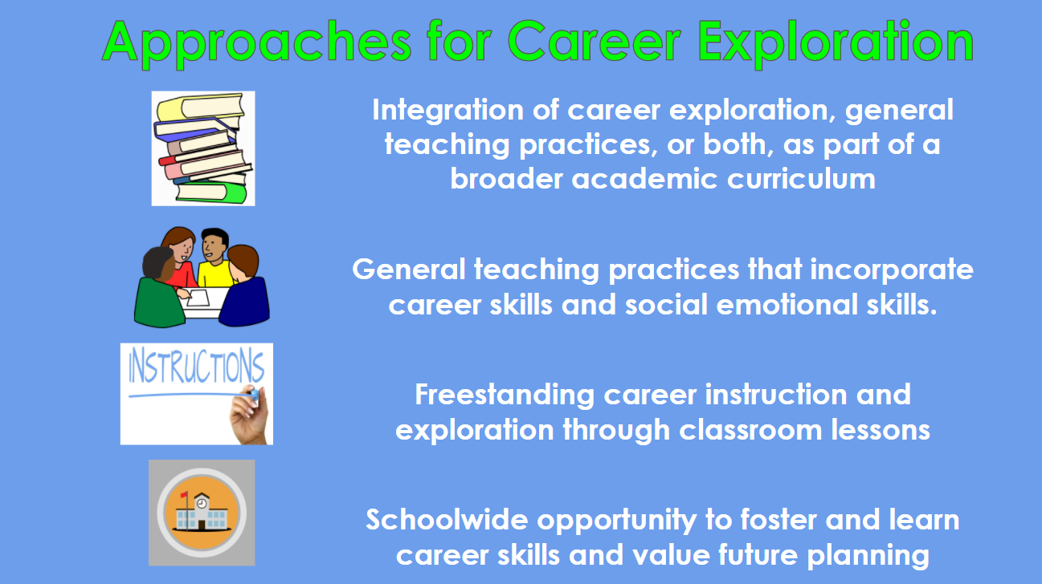

Slide 12
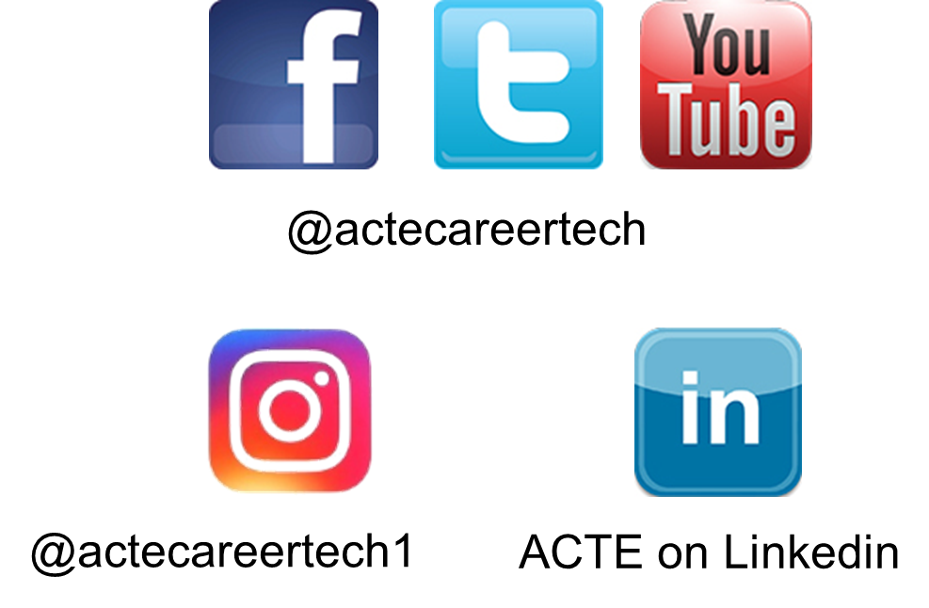
Contact Information
Nicole Cobb, Ed.D., Vice President, ACTE Counseling and Career Development Division; Associate Professor of Practice, Department of Human and Organizational Development, Vanderbilt University, Nashville, TN nicole.a.cobb@Vanderbilt.Edu
Brian Bontempo, Ed.D., Superintendent, Auburn Career Center and Ohio Technical Center, Concord, OH bbontempo@auburncc.org
Caroline Cockman, School Counselor, Apex Elementary School, Apex, NC caroline.r.cockman@gmail.com
Dana Jackson, Executive Director, Counseling Services and College Access, Grand Prairie Independent School District, Grand Prairie, TX Dana.Jackson@gpisd.org
Stephen DeWitt, ACTE Deputy Executive Director, sdewitt@acteonline.org

