Slide 1
NEW CTE TEACHER WORKSHOP
November 17, 2020
8 a.m. – 12 noon

Slide 2
WELCOME and INTRODUCTIONS
New CTE Teacher Workshop Notes
Doug Bush
President, MI ACTE
Notes:
Doug

Slide 3
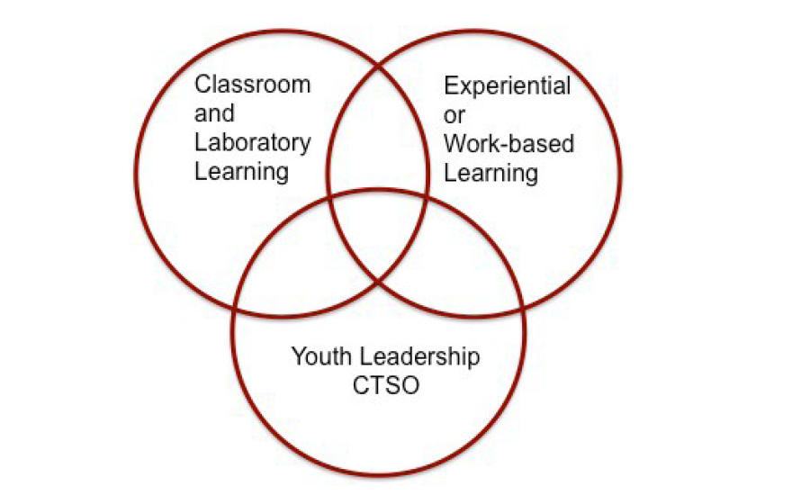
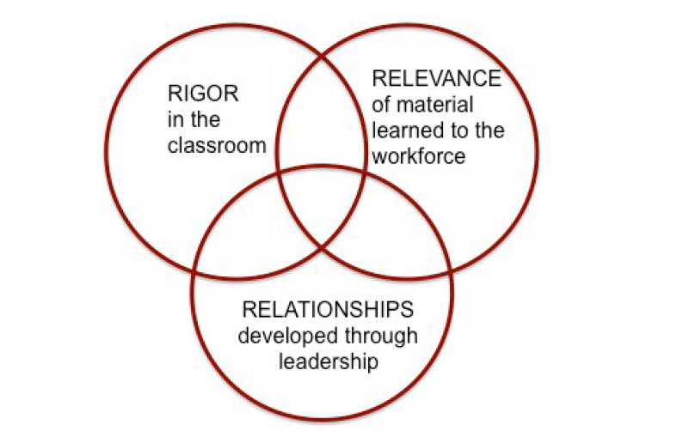
CTE PROGRAM OVERVIEW Deb Miller
November 17, 2020
November 17, 2020
8:10 a.m. – 8:20 a.m.
CTE CORE COMPONENTS
CTE CORE COMPONENTS
Notes:
Deb Miller

Slide 4
CTE PROGRAM OVERVIEW Deb Miller
November 17, 2020
November 17, 2020
8:10 a.m. – 8:20 a.m.
Program Advisory Committee: Industry Experts Providing Input to the Program
Implementation of Program Standards/Course Content
Strategies to Eliminate Barriers to Program Access
Secondary-Postsecondary Connections
CTE PROGRAM REQUIREMENTS
Program Teacher Certification
Program Teacher Professional Development
Notes:
Deb Miller

Slide 5
CTE PROGRAM OVERVIEW Deb Miller
November 17, 2020
November 17, 2020
8:10 a.m. – 8:20 a.m.
ACADEMICS IN CTE
Notes:
Deb Miller

Slide 6
November 17, 2020
November 17, 2020
8:20 a.m. – 8:45 a.m.
INTRODUCTION TO CTE TEACHER TOOLKIT
Mark Forbush
PURPOSE
Guidance for New CTE Teachers
Quick Reference Guide to Important CTE Information
Sample Documents, Support Materials, Other Resources
Notes:
Mark Forbush

Slide 7
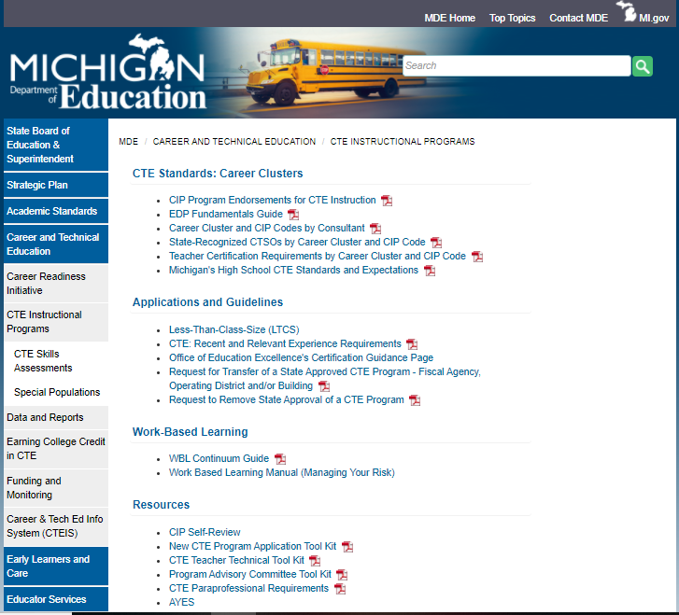
November 17, 2020
November 17, 2020
8:20 a.m. – 8:45 a.m.
INTRODUCTION TO CTE TEACHER TOOLKIT
Mark Forbush
CTE Teacher Technical Tool Kit
https://www.michigan.gov/mde/0,4615,7-140-2629_53968---,00.html
Notes:
Mark Forbush

Slide 8
MINI-SESSION 1 ACTE & MI ACTE Websites/Resources Mikki Spagnoli
November 17, 2020
November 17, 2020
8:45 a.m. – 8:55 a.m.
Michigan Association of CTE
https://www.acteonline.org/michigan-association-for-career-and-technical-education/
Resources & Information
Membership
Resources
Recognition
Advocacy
Curriculum
Professional Development
Association of CTE (ACTE)
https://www.acteonline.org/
Notes:
Mikki Spagnoli

Slide 9
BREAKOUT ROOMS
November 17, 2020
November 17, 2020
Session 1 8:55 a.m. – 9:20 a.m.
Session 2 9:20 a.m. – 9:45 a.m.
You will stay in your breakout room and the presenters will rotate through each room.
Session 3 9:55 a.m. – 10:20 a.m.
Session 4 10:20 a.m. – 10:45 a.m.
Session 5 10:55 a.m. – 11:20 a.m.
Notes:
Lori Johnson

Slide 10
BREAKOUT ROOM TOPICS
November 17, 2020
November 17, 2020
Program Advisory Committee Toolkit
Syllabus & Program Instructional Design
Work-Based Learning (WBL)
Leadership & CTSOs (Career and Technical Student Organizations)
Special Populations
You will stay in your breakout room and the presenters will rotate through each room.
Notes:
Lori Johnson

Slide 11
9:45 a.m. – 9:55 a.m.
November 17, 2020
November 17, 2020
Notes:
Lori Johnson

Slide 12
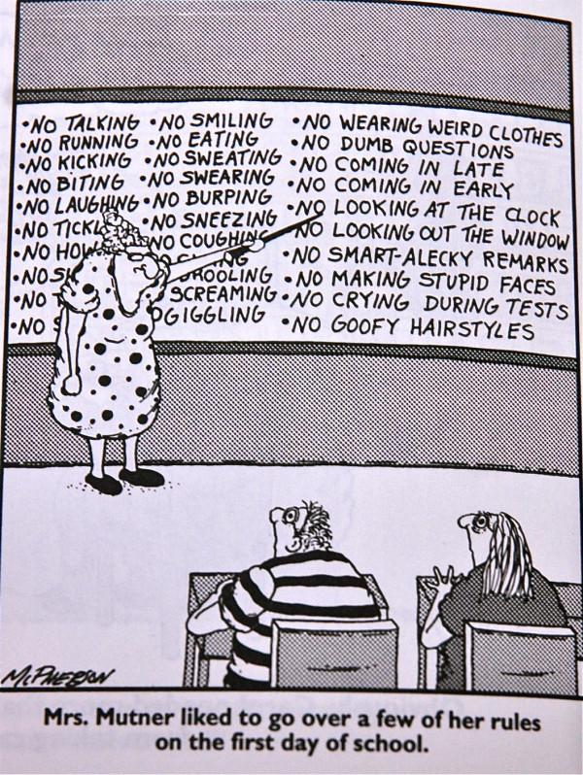
MINI-SESSION 2 Classroom Management Tips/Resources Jim Berry
November 17, 2020
November 17, 2020
10:45 a.m. – 10:55 a.m.
It's All in How You Start
Classroom Management vs. Discipline
The Key is Consistency
Responsibilities & Expectations
Classroom Management Plan
Starting Class: Greeting Students, Bell Ringers, "Do Now," Entry Tickets, & Team Building
Procedures: Attendance, Tardies, Leaving Class, Google Classroom, and More
Cell Phones: Red / Yellow / Green Cards
Communication: Student Information Systems, Parents, Students & Staff
Emergency Procedures & Expectations
Student Engagement (Kagan, etc.)
4 PLC Questions
Resources
Notes:
Jim Berry

Slide 13
MINI-SESSION 3 MDE and OCTE Websites/Resources Candace Vinson
November 17, 2020
November 17, 2020
10:45 a.m. – 10:55 a.m.
CIP Self Review: https://www.michigan.gov/mde/0,4615,7-140-2629_53968-536164--,00.html
CTE Instructional Programs:
https://www.michigan.gov/mde/0,4615,7-140-2629_53968---,00.html
COVID-19 Resources:
https://www.michigan.gov/mde/0,4615,7-140-37818_53456---,00.html
COVID-19 Resources (specific to CTE):
https://www.michigan.gov/mde/0,4615,7-140-37818_53456-522648--,00.html
Notes:
Candace Vinson

Slide 14
RESOURCES
November 17, 2020
November 17, 2020
Located at the MI ACTE Website
Workshop Agenda
Workshop PowerPoint Slides
Career Clusters/Consultant Codes
CEPD Map
CIP Self Review
CTE Administrator Manual
New CTE Teacher Technical Toolkit
PD Calendar
Program Advisory Toolkit
State Recognized CTSOs by Cluster and CIP Code
Notes:
Doug Bush

Slide 15
RESOURCES
November 17, 2020
November 17, 2020
MI ACTE
www.miacte.org
Michigan Department of Education, Office of CTE
www.Michigan.gov/octe
Michigan Career Placement Association
www.Micareerplacement.org
Notes:
Doug Bush

Slide 16
WRAP UP and Q & A 11:30 a.m. – 12 noon
November 17, 2020
CONTACT INFORMATION
Doug Bush
MI ACTE President
dbush@giresd.net
Jim Berry
MI ACTE President-Elect
jberry@sjschools.org
Notes:
Doug Bush and Jim Berry

