Slide 1
BREAKOUT SESSION Leadership and Career and Technical Student Organization (CTSO)
Notes:
Candice Vinson

Slide 2
Important Concepts for Student Leadership
Understanding leadership
Communication and speaking to groups
Managerial leadership skills
Personal development
Career success
Notes:
Candace Vinson - Reference pages 17-18 in New CTE Teacher Technical Tool Kit

Slide 3
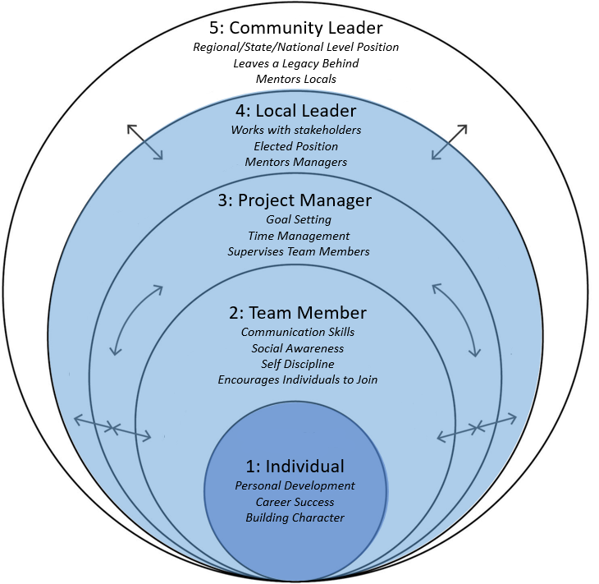
CTE Teacher Technical Tool Kit
Better guidance for student leadership
List of approved CTSOs
Coaching students from ME to WE
Notes:
https://www.michigan.gov/documents/mde/CTE_Teacher_Technical_Tool_Kit_698712_7.pdf
Could talk here about the new director for Skills USA and some of the additional resources the CTSOs have for COVID, lots of great leadership available virtually

Slide 4
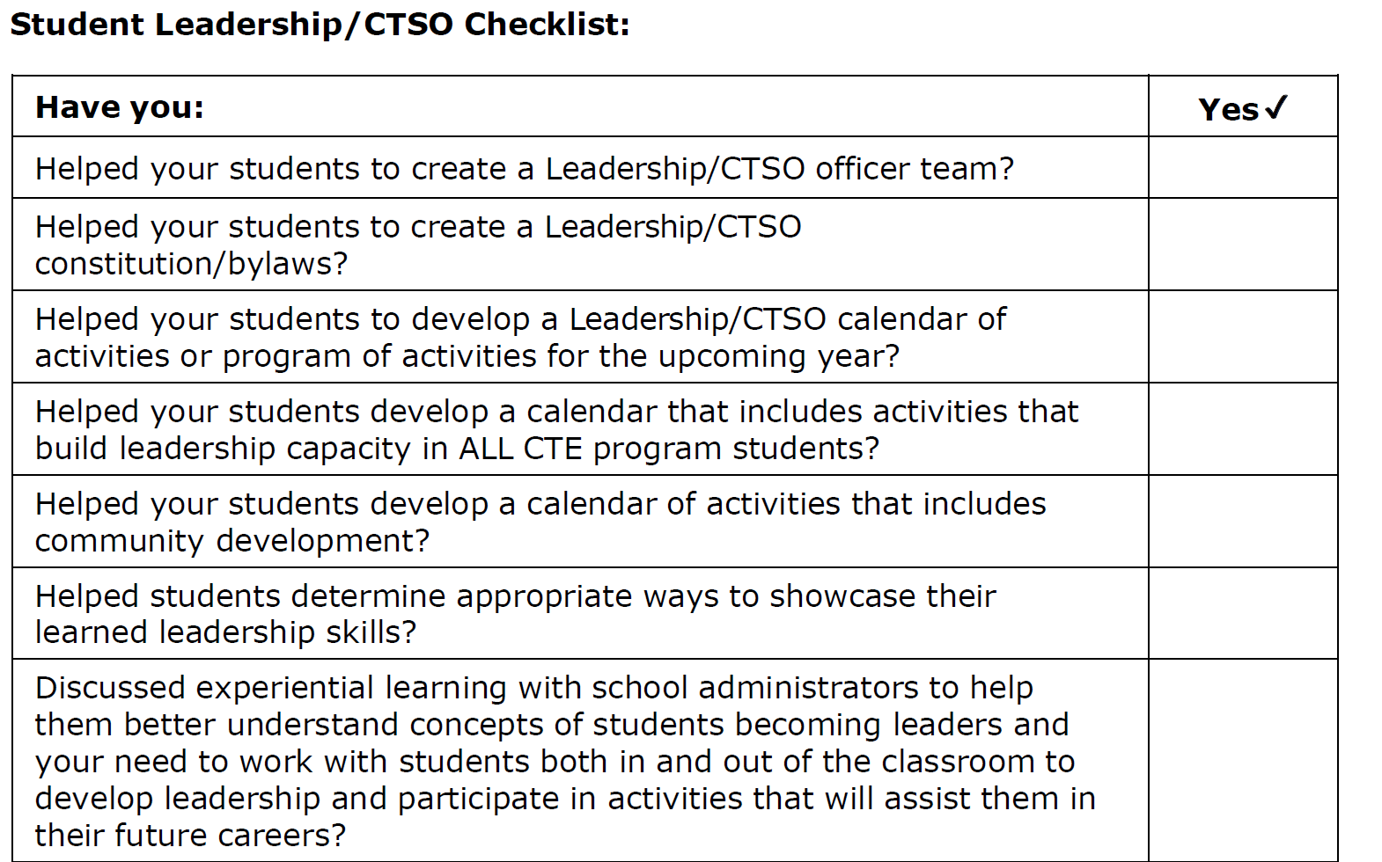
Student Leadership
CTSO Checklist
Notes:
Candice Vinson - Reference page 19 of New CTE Teacher Technical Tool Kit

Slide 5
Q and A
This Photo by Unknown Author is licensed under CC BY-NC
Notes:
Candice Vinson - Reference page 19 of New CTE Teacher Technical Tool Kit

