Slide 1
NEW CTE TEACHER WORKSHOP
DECEMBER 17, 2019
Presented by MI ACTE and OCTE

Slide 2
WELCOME and INTRODUCTIONS
Notes:
Lori Johnson (Welcome), Brian Pyles (OCTE), Doug Bush (MI ACTE)

Slide 3
New CTE Teacher Technical Tool Kit
Guidance for New Teachers in CTE
Quick Reference Guide to Important CTE Information
Sample Documents, Support Materials, Other Resources
Notes:
Mark Forbush

Slide 4
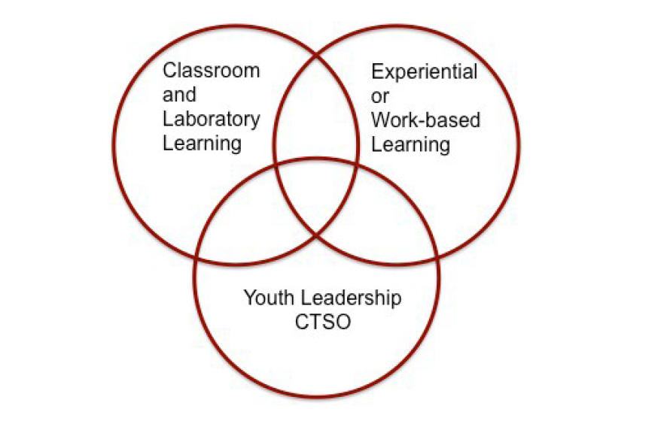
Core Components in all CTE Programs
Notes:
Mark Forbush

Slide 5
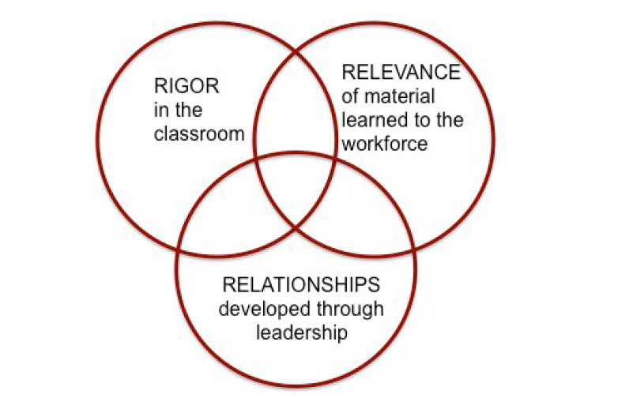
Core Components in all CTE Programs
Notes:
Mark Forbush

Slide 6
What Makes CTE Unique and Relevant?
CTE Program Requirements
Program Teacher Certification
Program Teacher Professional Development
Program Advisory Committee: Industry Experts Providing Input to the Program
Implementation of Program Standards/Course Content
Strategies to Eliminate Barriers to Program Access
Secondary-Postsecondary Connections
Notes:
Mark Forbush

Slide 7
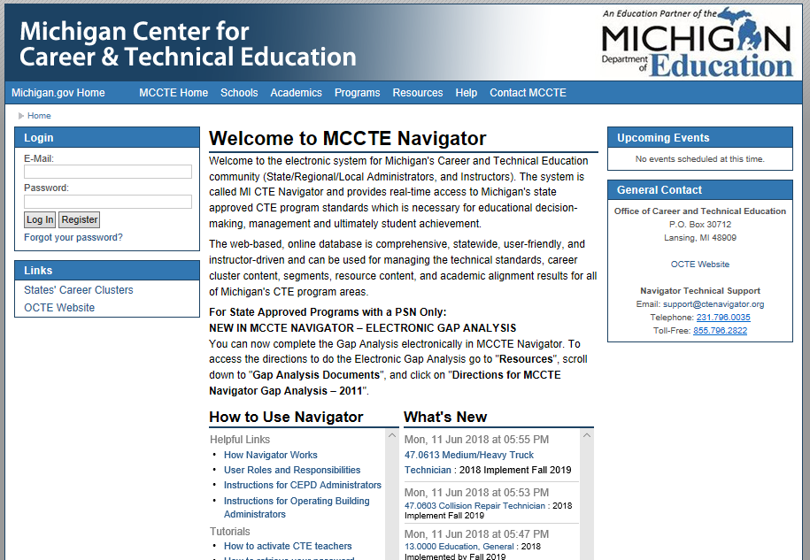
Michigan Center for CTE (MCCTE) Navigator
www.ctenavigator.org
Notes:
Tom Knight – Show items under each tab but do not go into detail and do not go out to live website

Slide 8
Academics in CTE
Notes:
Tom Knight - method of promoting programs and method of providing students flexibility with fulfilling graduation requirements

Slide 9
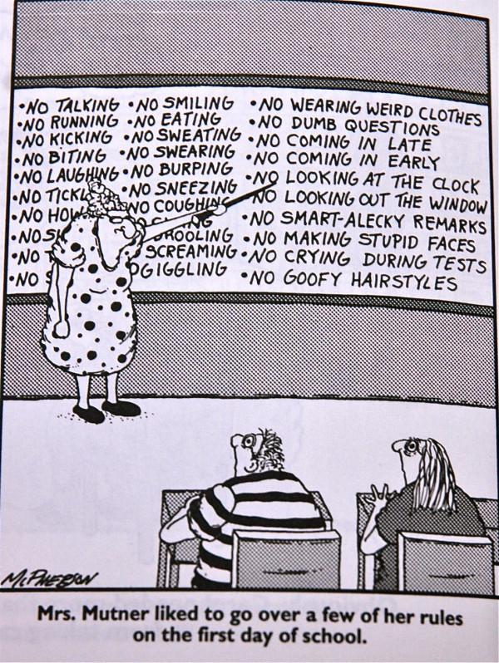
What is Classroom Management?
Teacher Advice: Classroom Management Video
Notes:
Candace Vinson

Slide 10
What is Classroom Management?
GROUP ACTIVITY
At your table, share two effective classroom management strategies.
Appoint two people from your group and have each person share a best strategy from the table discussion.
Notes:
Candace Vinson

Slide 11
Notes:
Lori Johnson

Slide 12
Notes:
Lori Johnson

Slide 13
Small Group Presentations
TOPIC | PRESENTER
Program Advisory Committee Tool Kit | Mark Forbush
Program and Instructional Design/Syllabus | Tom Knight
Understanding the Michigan Merit Curriculum (MMC) | Celena Mills
Work-Based Learning (WBL) | Dana Hughes
Leadership and Career and Technical Student Organization (CTSO) | Candice Vinson
Special Populations Students (SPOPS) | Lee Greenacre
Notes:
Lori Johnson

Slide 14
Small Group Presentation Program Advisory Committee Tool Kit Mark Forbush
Notes:
Mark Forbush

Slide 15
Program Advisory Committee Tool Kit
When you think of Advisory Committee -
THINK PROGRAM ADVOCACY!
Notes:
Mark Forbush

Slide 16
Program Advisory Committee Tool Kit
Give members something to do.
Program advisory committee members will…
need to feel more engaged than just listening to a report.
need to have ownership.
be your best community advocate.
connect you with resources for your program.
Involvement will increase program advisory committee attendance.
Notes:
Mark Forbush

Slide 17
Program Advisory Committee Requirements
Program advisory committee chair must be from business and industry.Membership must include representatives from the appropriate program-specific business, industry, and postsecondary representation, and a parent representative.
The majority of the membership must be from business and industry.
Representation on the committee should reflect persons from all genders, and racial and ethnic minorities represented within the community.
Additional non-voting members may include administrators, counselors, students, academic teachers, or a Special Populations SPOPS coordinator.
Notes:
Mark Forbush

Slide 18
Program Advisory Committee
REQUIRED DOCUMENTATION
Committee Roster
Meeting Agenda
Meeting Minutes
Reference Program Advisory Committee Tool Kit for sample documentation.
Notes:
Mark Forbush - Reference Appendix G and H in tool kit

Slide 19
Small Group Presentation Program and Instructional Design Tom Knight
Notes:
Tom Knight

Slide 20
Program and Instructional Design
A CTE program is a sequence of courses
Each CTE program is composed of 12 curricular segments
Segments consists of standards and performance elements defined in the program gap analysis
CTE students are identified as Participants/Enrollees, Concentrators, Completers based on the number of completed segments
Participant/Enrollee – completes 6 or fewer segments of a program
Concentrator – successfully completes with a C or better 7 but fewer than 12 segments of a program
Completer – successfully completes with a C or better all 12 segments of a program
Notes:
Tom Knight - Explain the connection to Perkins and CPI measurements for completer, stress importance of concentrator and completer students.
Concentrator/Completer –completion of an assessment if applicable

Slide 21
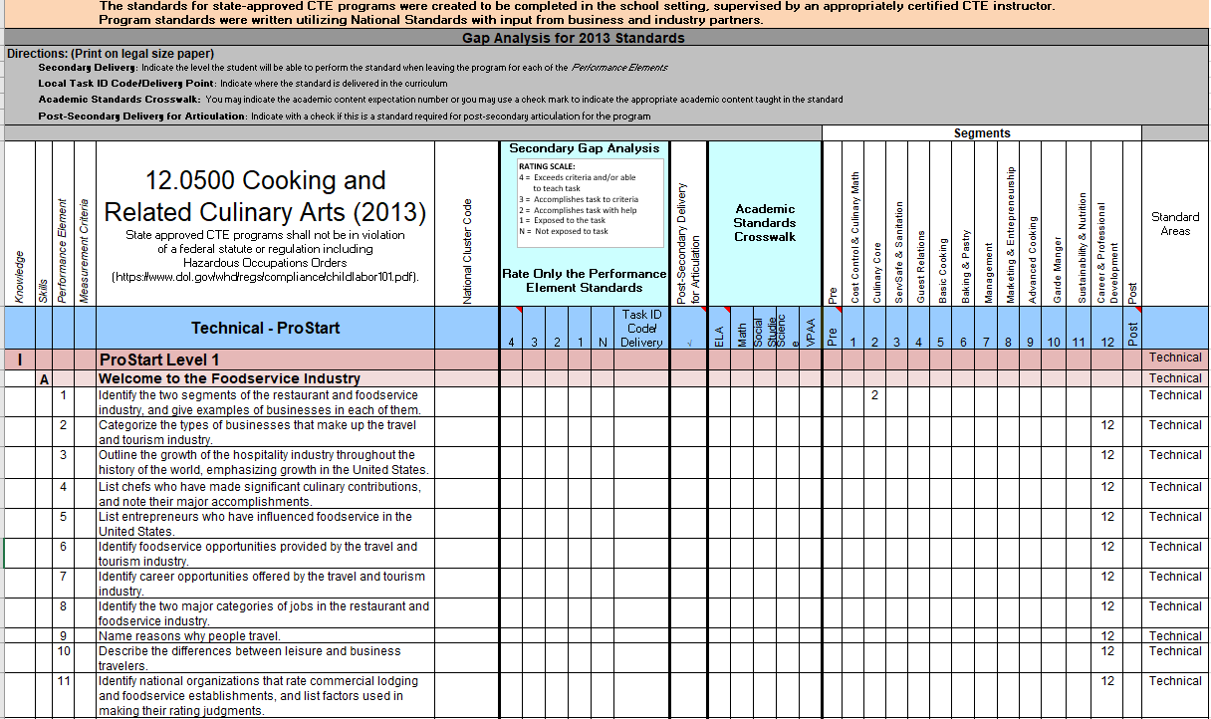
Gap Analysis Document
12 Segments
Students are expected to demonstrate to the Performance Element level.
Notes:
Tom Knight

Slide 22
Notes:
Lori Johnson

Slide 23
Small Group Presentation Syllabus Tom Knight
Notes:
Tom Knight

Slide 24
Syllabus
Course title
Instructor’s name and school contact information
Course dates
Course description
Special features of the course
Academic Credits
Postsecondary Connections
Available Certifications and or Licensures
Off-site Delivery
Work-Based Learning
Safety Training
Student Leadership (CTSO) opportunities
Notes:
Tom Knight - Reference pages 39-48 of New CTE Teacher Technical Tool Kit for samples of syllabi (appendix E)

Slide 25
Syllabus
Course Outline with topics to be covered and CTE segments to be covered in the course.
Resources
Textbooks
Software
Special facilities
Materials
Reference New CTE Teacher Technical Tool Kit for sample documentation.
Notes:
Tom Knight

Slide 26
Small Group Presentation Understanding the Michigan Merit Curriculum (MMC) Celina Mills
Notes:
Celina Mills

Slide 27
Small Group Presentation Work-Based Learning (WBL) Dana Hughes
Notes:
Dana Hughes

Slide 28
Work-Based Learning
Notes:
Dana Hughes - Reference page 20-22 in New CTE Teacher Technical Tool Kit

Slide 29
Work-Based Learning Opportunities
One work-based learning opportunity for each student in the program
Per the CTE Administrative Manual (2017) opportunities may include
Workplace Tour/Field Trip to program specific business/industry
Job Shadow
Volunteering
Mentoring
See the Michigan Career Placement Association website for additional work-based learning information.
Notes:
Dana Hughes - Reference pages 20-21 for additional opportunities. Explain that guest speakers and career fairs are great opportunities; however, they should be focused on a WBL continuum.

Slide 30
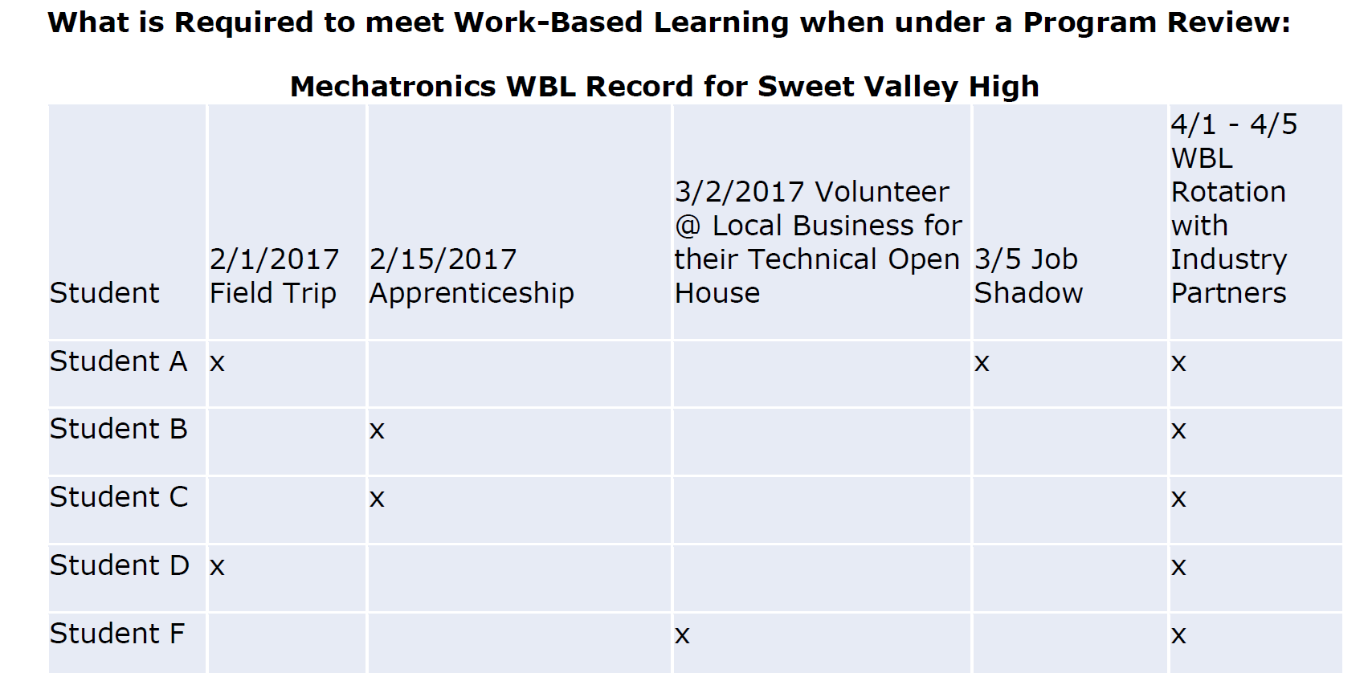
Work-Based Learning Documentation
Notes:
Dana Hughes

Slide 31
Notes:
Lori Johnson

Slide 32
Small Group Presentation Leadership and Career and Technical Student Organization (CTSO) Candice Vinson
Notes:
Candice Vinson

Slide 33
Important Concepts for Student Leadership
Communications and Speaking to Groups
Managerial Leadership Skills
Personal Development
Career Success
Notes:
Candace Vinson - Reference pages 17-18 in New CTE Teacher Technical Tool Kit

Slide 34
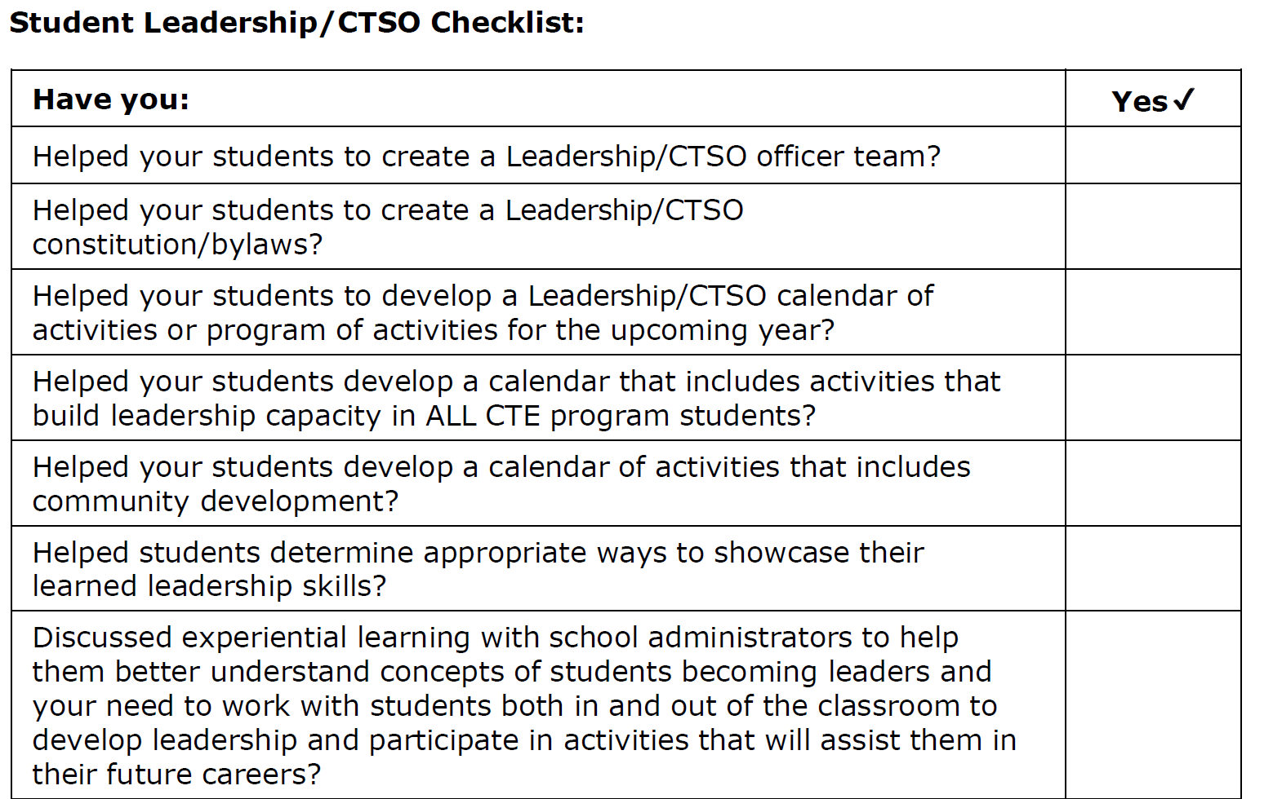
Student Leadership/CTSO Checklist
Notes:
Candice Vinson - Reference page 19 of New CTE Teacher Technical Tool Kit

Slide 35
Small Group Presentation Special Populations Students (SPOPS) Lee Greenacre
Notes:
Lee Greenacre

Slide 36
Special Populations Students
Student who have special learning needs are considered special populations students in CTE and are defined by Perkins IV as:
Individuals with disabilities
Individuals from economically disadvantaged families, including foster children
Individuals preparing for nontraditional training and employment
Single parents, including single pregnant women
Displaced homemakers
Individuals with Limited English Proficiency (LEP)
Notes:
Lee Greenacre - Displaced homemakers is focused on postsecondary; OCTE Administrative Guide resource and key components

Slide 37
Special Populations Students
Individualized Education Program/Plan (IEP)
The Individual with Disabilities Education Act (IDEA) is a federal law that makes available a free appropriate public education to children found eligible of having a disability.
IEPs are created for youth who face challenges such as academic and/or economic disadvantages/disabilities.
An IEP outlines required accommodations to assist your student to be successful.
An instructor is legally responsible to follow the accommodations in an IEP.
Notes:
Lee Greenacre - Provides examples of IEP accommodations, seek out assistance for accommodations (other teachers, special education staff, administrators)

Slide 38
Special Populations Students
Section 504 Plan
Section 504 is a civil rights law that prohibits discrimination against individuals with disabilities not identified as IEPs. A student with a 504 plan, may require accommodations and modifications.
Notes:
Lee Greenacre

Slide 39
Wrap-Up and Questions Workshop Survey
Notes:
Lori Johnson and Michelle Radcliffe

Slide 40
Resources – Found at MI ACTE Site
Workshop Agenda
Workshop PowerPoint Slides
Career Clusters and CIP Codes by Consultant
CEPD Map
CIP Self Review
CTE Administrator Manual
New CTE Teacher Technical Tool Kit
PD Calendar
Program Advisory Tool Kit
State Recognized CTSOs by Cluster and CIP Code
Notes:
Lori Johnson

Slide 41
Resources
MI ACTE
www.miacte.org
Michigan Department of Education, Office of CTE
www.Michigan.gov/octe
Michigan Center for CTE (MCCTE)
www.ctenavigor.org
Michigan Career Placement Association
www.Micareerplacement.org
Notes:
Lori Johnson

