Slide 1
AWARDS
101
Overview of the ACTE Awards
Basic Processes & Tips

Slide 2
ACTE’s Awards
The ACTE® Excellence Awards recognize excellence and dedication within the field of career and technical education among ACTE members. Recipients of these awards are exceptional individuals who have contributed to the success of CTE through the quality of their work and their involvement in the CTE community.
There are eight (8) Excellence Awards:
ACTE Teacher of the Year
ACTE New Teacher of the Year
ACTE Administrator of the Year
ACTE Postsecondary Teacher of the Year
ACTE Teacher Educator of the Year
ACTE Career Guidance Award
ACTE Carl Perkins Community Service Award
Information on each can be found on the ACTE Awards Portal.

Slide 3
The Nomination Process
Nominations begin at the state level; deadlines vary by state
State winners are eligible to progress onto their Region level (only one winner per category). They must be ACTE members and have their nominations submitted on the Awards Portal by March 1.
Region winners are announced at their respective conferences. Winners move forward automatically for consideration at the national level.
National winners are announced at ACTE’s CareerTech VISION.

Slide 4
The Online Process
All state and Region award candidates must submit their nominations online via the ACTE Awards Portal:
The Portal is also equipped to host the state-level awards as well! The Awards Portal automates several steps of the nomination and review process, saving award chairs time.
https://acte.secure-platform.com

Slide 5
Where do nominations come from?
ACTE allows self-nominations for the awards, as well as nominations from peers. For the most part, candidates are either directly nominated or encouraged to nominate by a colleague, supervisor, or peer.
States solicit nominations from:
Board of Directors
Administrators
Past award winners
Division leaders: several states charge their Divisions with putting forth a candidate in each award category. Some Divisions hold their own contests/review processes to select a candidate; others seek out a single nominee to put forward.

Slide 6
Helpful tips to access the portal and fill out the application:
ACTE Awards Portal: https://acte.secure-platform.com
Upon accessing the awards portal, you will need to login. If you are new to the site, you need to create a login and password. This login and password will allow you to login to additional sites at acteonline.org.

Slide 7
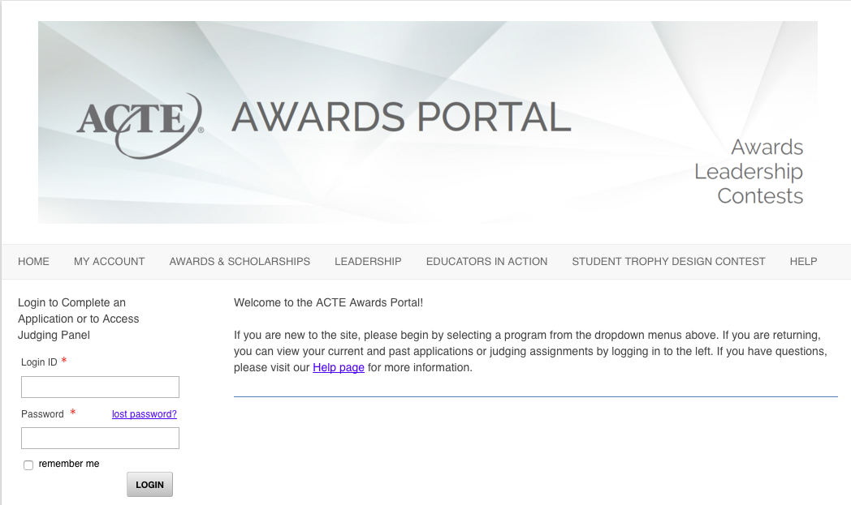
Login Page

Slide 8
Select the award category for which you are applying, or click on ‘Learn more about the Excellence Awards here’ link.

Slide 9
The ‘Learn more about the Excellence Awards here’ link allows you to ‘View the Guidelines’ to see what the criteria is for that award, or to start the application by clicking on ‘Submit a Nomination’.

Slide 10
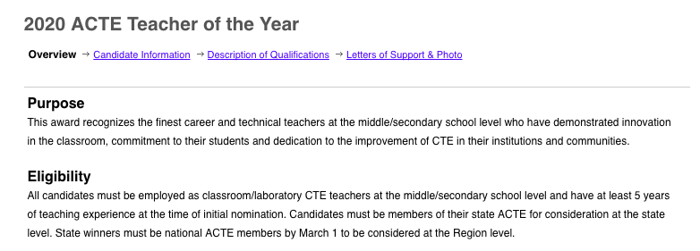
The first page of the award application is an overview of the award. Make sure you are in the category year 2020.

Slide 11
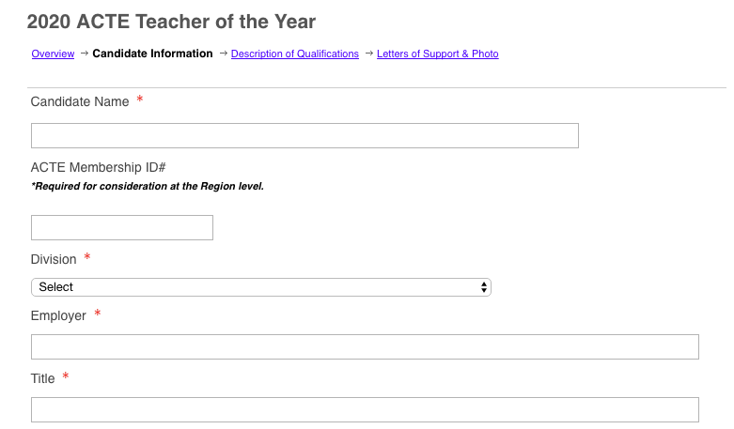
Provide the candidate information on the second page of the award application.

Slide 12
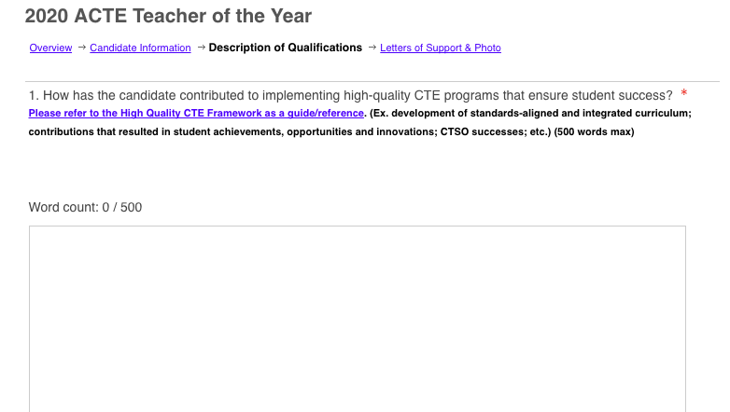
Answer the questions as instructed in the Description of Qualifications page.

Slide 13
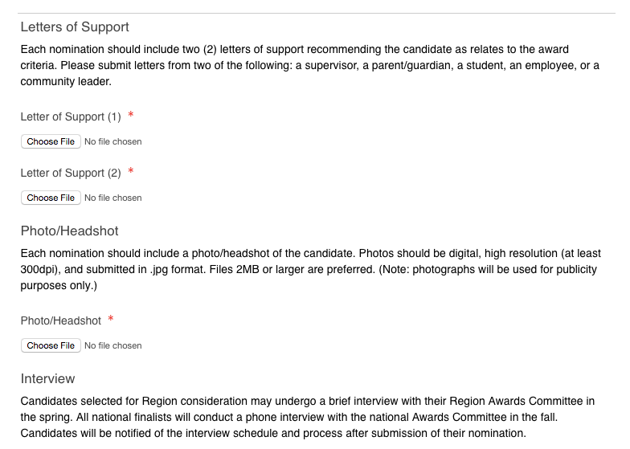
You must have two Letters of Support and upload a photo of yourself/candidate.

Slide 14
For the state award, you will not be interviewed. However, should you continue on at the national level, you will be interviewed. The Awards Portal is used for our state, regional, and national award candidates. Once you complete the initial application, it is used for the regional and national level. You may update the award if you want.

Slide 15
You do not have to complete the award application in one sitting. You can ‘Save’ and work on it another day as long as it is completed March 1, 2018.

Slide 16
If you have questions, please contact:
Murleen Bellinger
actenebraska@gmail.com
402-480-9577

