Slide 1
S.O.S Saving Our (Soft) Skills
Presented by:
Mrs. Tracy Kern
Harrisburg CTE and FACS Teacher
http://bit.ly/RegionVSoftSkills

Slide 2
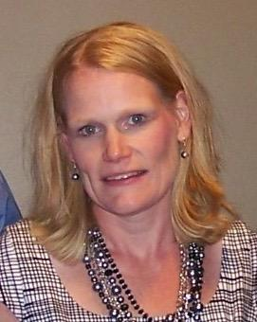
About Me
Professional:
I’m on my 23rd year of teaching.
Harrisburg High School – 18 years.
HHS CTE Department Head
Advise the Harrisburg FCCLA
Advise the Harrisburg Educators Rising
South Dakota Association of Career and Technical Education Past-President

Slide 3
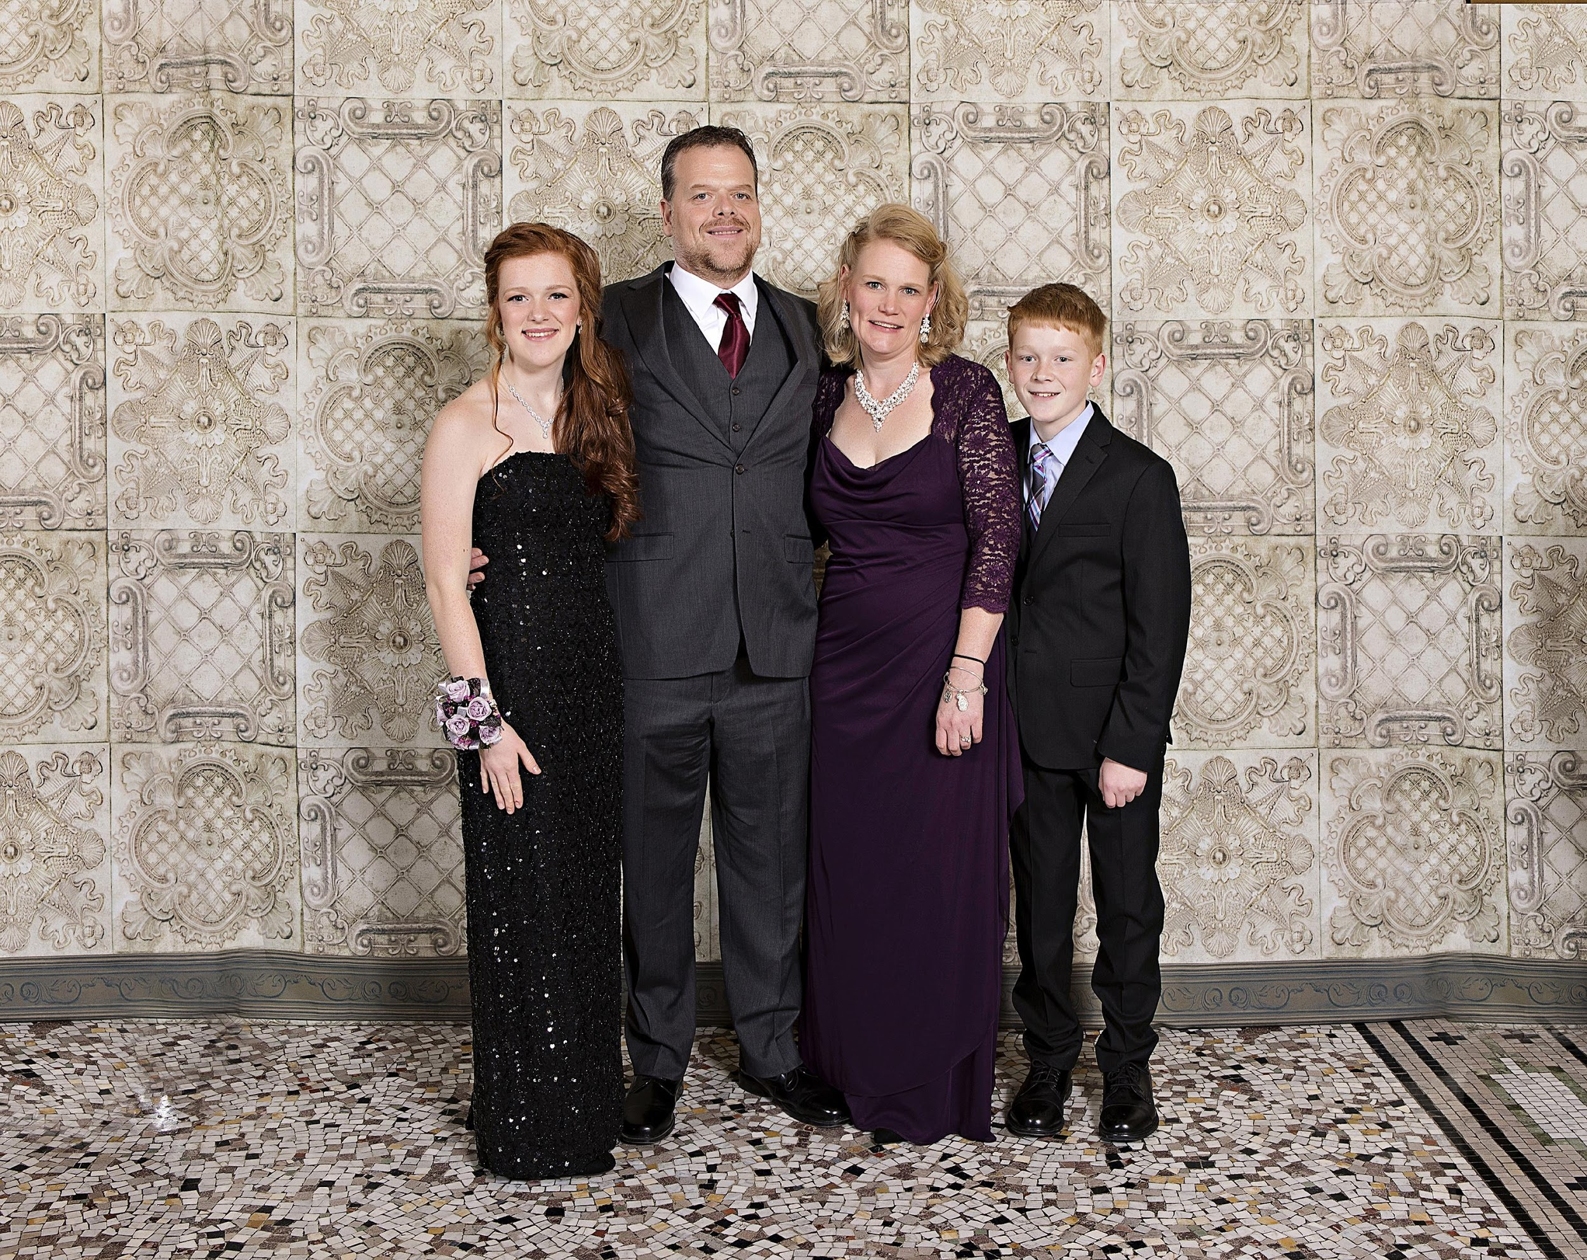
About Me
Personal:
Married to husband Paul for 17 years.
Security Analyst for MetaBank Payment Systems.
Daughter – sophomore who loves theater, her flute, HOSA, and singing.
Son - 7th grader who loves his saxophone, guitar, cross country, robotics, Boy Scouts and basketball.

Slide 4
How Can Educators Reverse the Trend of Declining Soft Skills in the American Workplace?

Slide 5
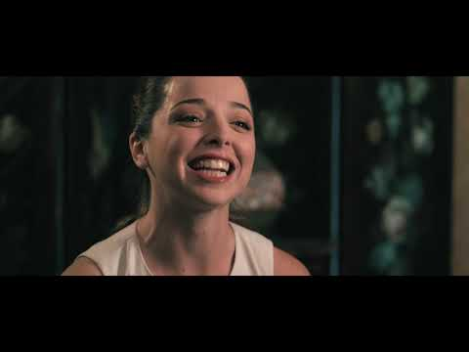
Exaggerated or Not?

Slide 6
Why…………..
Absenteeism | Know-it-all Syndrome | Poor communication skills
Bad attitude | Lack of maturity | Substance abuse
Cell phone usage | No desire to work | Tardiness
Inappropriate remarks or language | Not adaptable to a new situation | Wanting to work on a certain shift

Slide 7
Soft Skills Definition
Skills, behaviors, attitudes, personal qualities needed to work and live.
Complement other skills such as technical, vocational, and academic skills.
Different from hard skills which are quantifiable and measurable.
Lippman, L. H., Ryberg, R., Carney, R., & Moore, K. A. (2015). Workforce Connections. Key “soft
skills” that foster youth workforce success: toward a consensus across fields. USA: Child Trends Publication, 4.

Slide 8
Soft Skills Also Known As. . . . . .
Workplace Skills
Resume Skills
Employability Skills
Professional Skills
Skan Skills

Slide 9
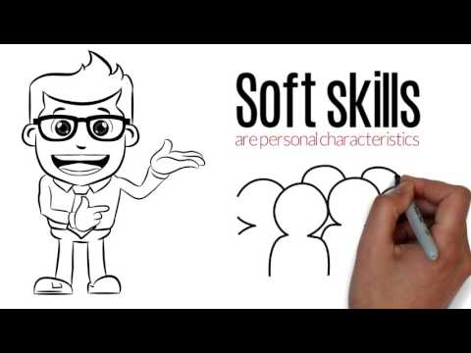
Definition of Soft Skills

Slide 10
Soft Skills Activity

Slide 11
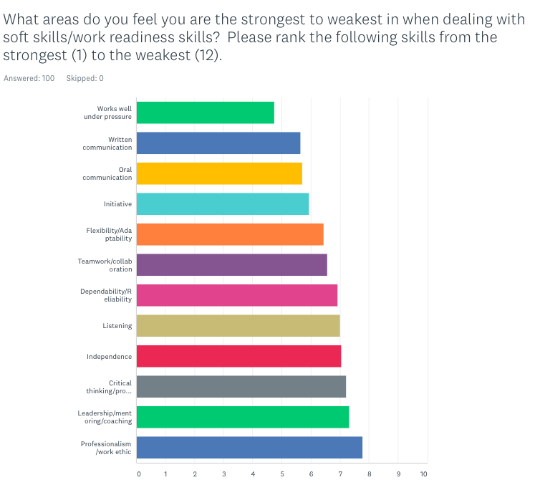
At the start of the school year, CTE students felt. . .

Slide 12
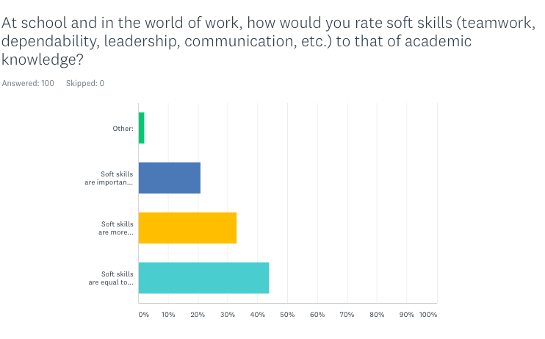
At the start of the school year,
CTE students felt. . .

Slide 13
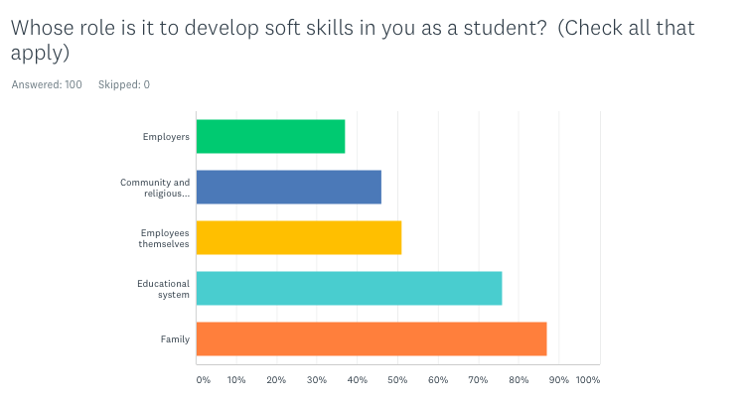
At the start of the school year,
CTE students felt. . .

Slide 14
Soft Skills Activity

Slide 15
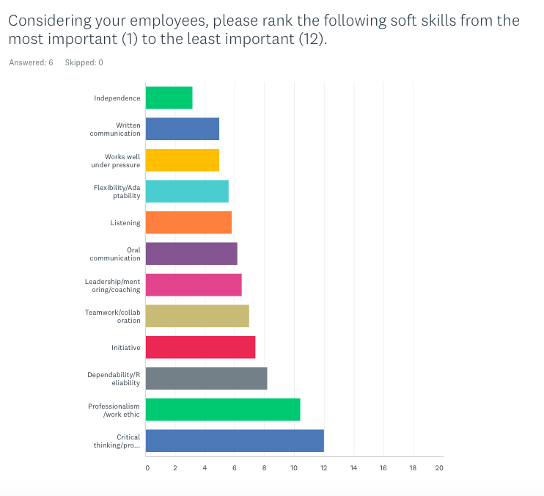
Employers in Harrisburg Feel. . .

Slide 16
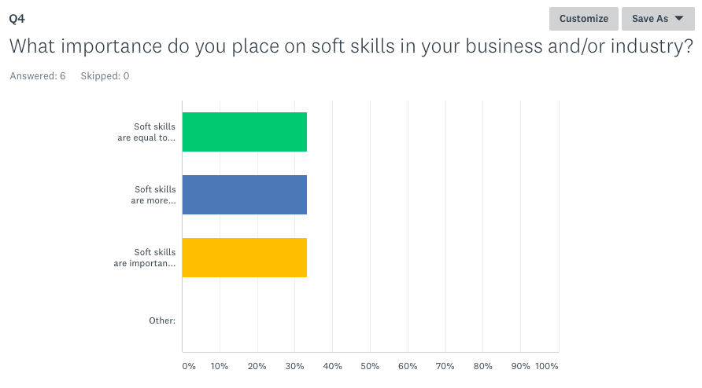
Employers in
Harrisburg Feel. . .

Slide 17
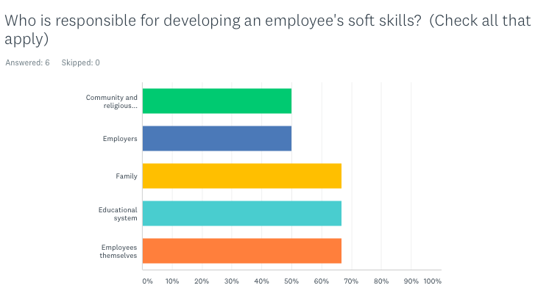
Employers in
Harrisburg Feel. . .

Slide 18
As a classroom teacher, what can I do to help strengthen soft skills in my students?

Slide 19
How Can I Reinforce Soft Skills?
Demonstrate and Model | Provide opportunities for practice. | Use teachable movements.
Teachers must model skills. | High expectations | “School is your job, the classroom is your workplace, I am your supervisor"
Explain the consequences of poor soft skills | Student address teacher as "Hey Girl". Teacher discusses appropriateness of greetings with student. | You notice that late work is being handed in late from the same student. You question the student on their late work and what would happen in the world of work.

Slide 20
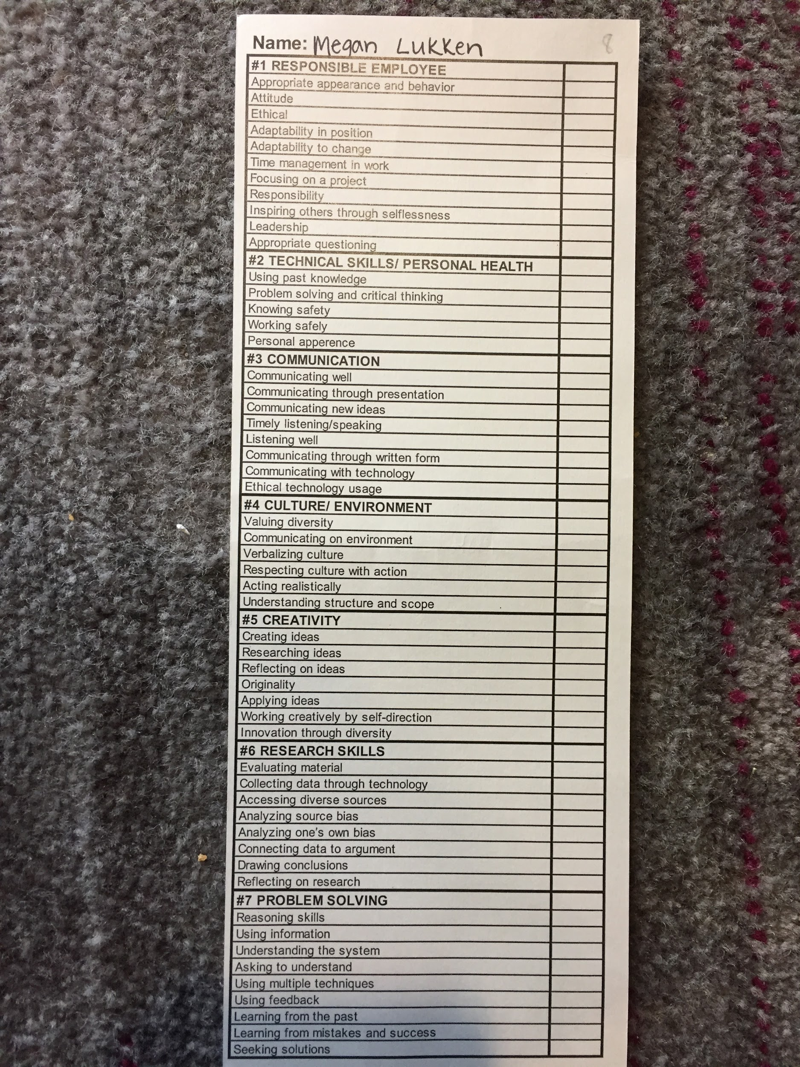
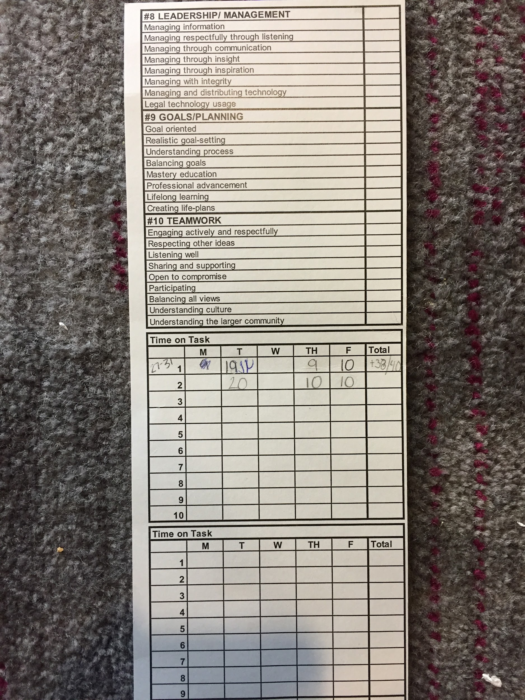
Harrisburg CTE Time Cards

Slide 21
Focus Group Comments :
Students commented:
Students could define with accuracy (no cell phones, completing assignments, being ready for class, etc.) the definition of soft skills.
Employers should be invited to showcase the relevance of soft skills
Students would like to see the implementation of rubric in all high school (academic) classes.
For grading purposes, CTE classes should weigh their class more on soft skills than academic classes.

Slide 22
Soft Skills Resources:
Life/Career Competencies Framework -
http://nyctecenter.org/life-career-competencies-framework?start=0
Arizona Rubrics -
http://www.azed.gov/ccr/wes/wes-standards/
North Dakota Career Ready Practice Assessments https://www.nd.gov/cte/services/career-ready/
Skills to Pay the Bills https://www.dol.gov/odep/topics/youth/softskills/softskills.pdf

Slide 23
Soft Skills Resources:
TN Department of Education Employability Checklist
https://cte.careertech.org/sites/default/files/10-18_WBL_EmployabilitySkillsChecklist.pdf
Common Employability Skills - http://nationalnetwork.org/wp-content/uploads/2015/01/Common_Employability_Skills-03-30-15.pdf
Career Launch SD -
http://careerlaunchsd.com/

Slide 24
Saving Sam
Activity/Challenge

Slide 25
Soft Skills Activities:
The Afterschool Guide for Creating Outstanding Teambuilding Activities - http://naaweb.org/images/Team_Building_Games.pdf
9 Awesome Classroom Activities That Teach Job Readiness Skills - https://www.weareteachers.com/9-awesome-classroom-activities-that-teach-job-readiness-skills/
Workplace Readiness Skills https://www.aeseducation.com/blog/7-best-workplace-readiness-skills-lessons

Slide 26
Thanks!
Any questions?
You can find me at tracy.kern@K12.sd.us

