Slide 1
NAVIGATING CTE NAVIGATOR workshop
March 11, 2019

Slide 2
Navigating cte navigator
WELCOME and INTRODUCTIONS
MI ACTE Board Members
OCTE Consultants
Notes:
Mikki Spagnoli – 9:00 a.m. – 9:15 a.m. slides 2-4

Slide 3
Navigating cte navigator
MI ACTE Overview
Web Site
www.miacte.org
Notes:
Mikki Spagnoli

Slide 4
Navigating cte navigator
Workshop Handouts and Files
Agenda
PPT Slides
CIP Self-Review
Template Files
Electronic files can be found MI ACTE web site – Resources Tab
Notes:
Mikki Spagnoli

Slide 5
Navigating cte Navigator
Who is my CEPD?
What Region am I in?
What is a CIP Self-Review?
What is Navigator?
Notes:
Tom Knight – 9:15 a.m. – 9:35 a.m. slides 5-15

Slide 6
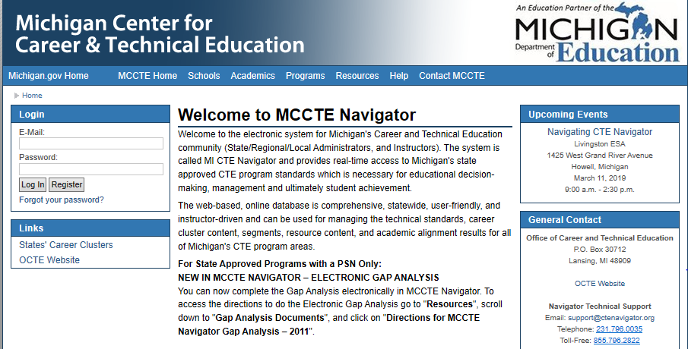
Navigator ctenavigator.org
Notes:
Tom Knight
Brief login explanation (attendees should not go to site during this portion of presentation)

Slide 7
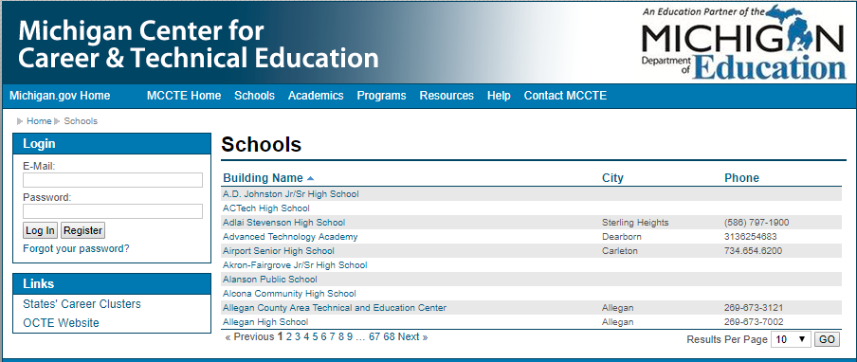
Navigator schools tab
Notes:
Tom Knight
Brief explanation of Schools tab information

Slide 8
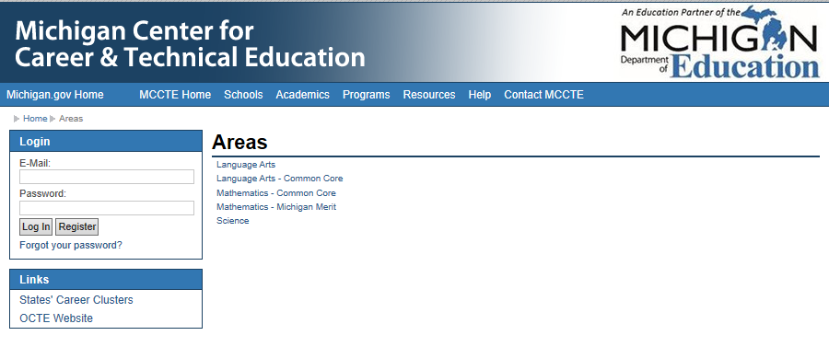
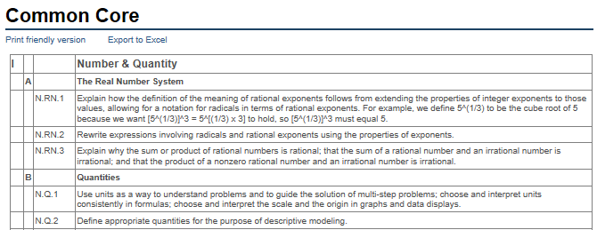
Navigator Academics tab
Notes:
Tom Knight
Basic explanation of Academics tab information

Slide 9
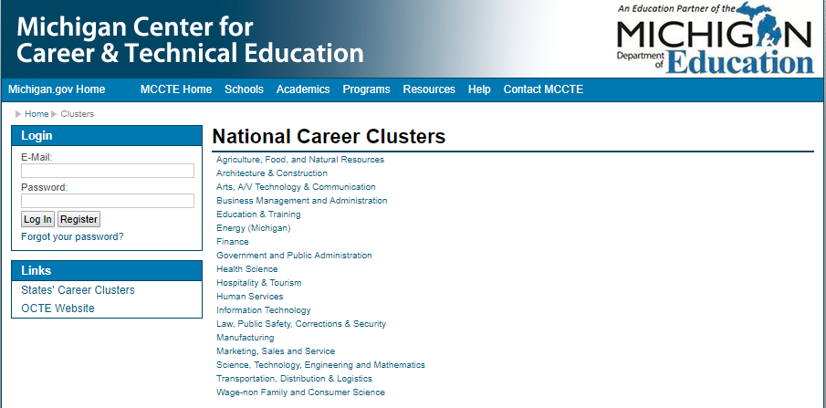
Navigator programs tab
Notes:
Tom Knight
Basic explanation of Programs tab information

Slide 10
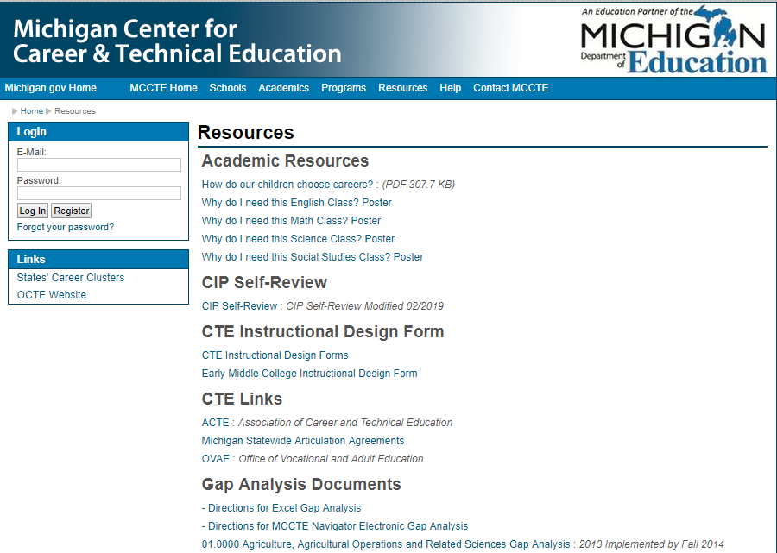
Navigator resources tab
Notes:
Tom Knight
Brief explanation of Resources tab information

Slide 11
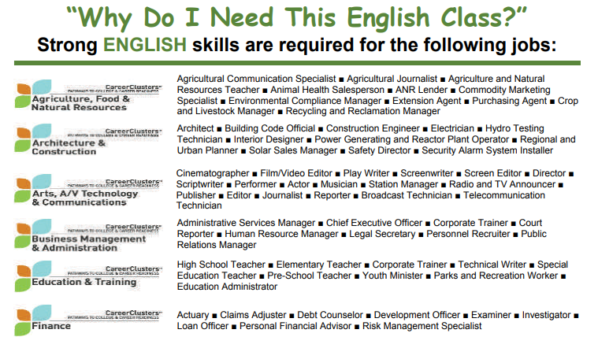
Navigator resources posters
Notes:
Tom Knight
Brief explanation of Resources - Posters

Slide 12
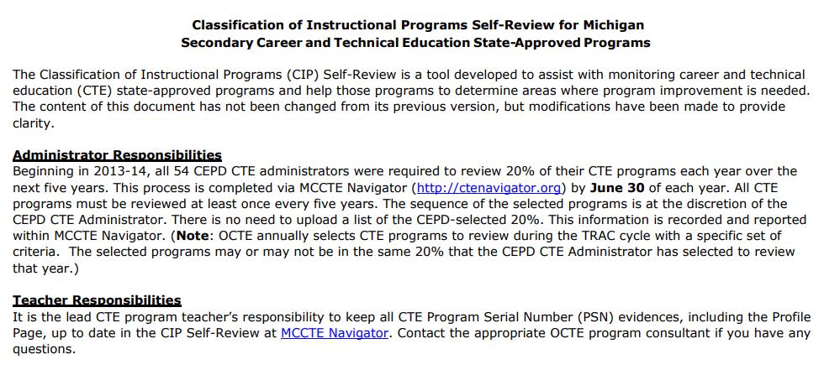
Navigator resources cip self-review
Notes:
Tom Knight
Brief explanation of Resources Tab – CIP Self-Review

Slide 13
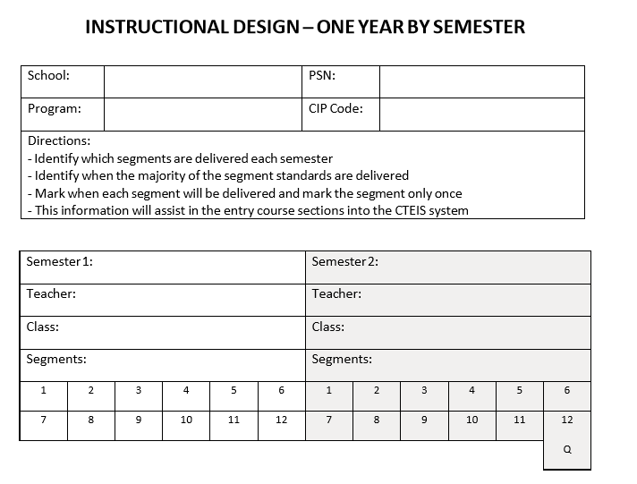
Navigator resources instructional design
Notes:
Tom Knight
Brief explanation of Resources Tab – instructional design form (12 Segments)

Slide 14
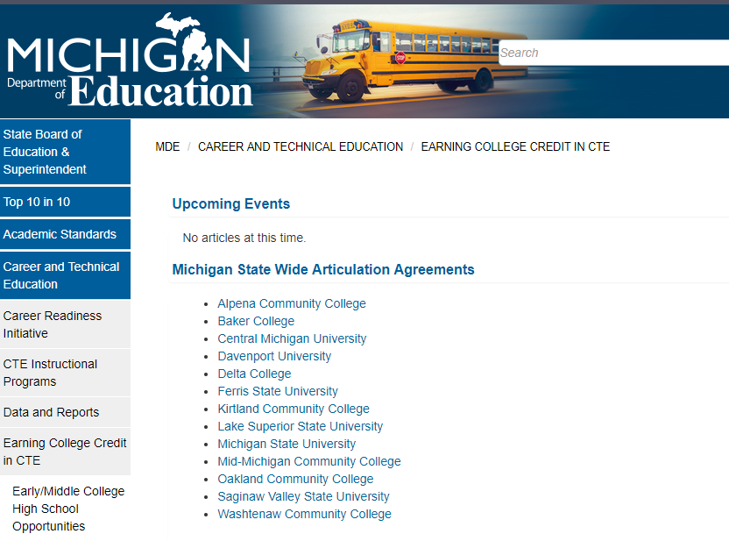
Navigator resources statewide articulation agreements
Notes:
Tom Knight
Brief explanation of Resources Tab – state wide articulation agreements

Slide 15
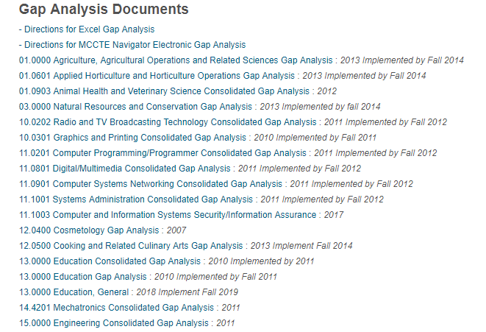
Navigator resources gap analysis
Notes:
Tom Knight
Brief explanation of Resources Tab – gap analysis

Slide 16
Navigator
C01 – Program Teacher Certification (page 2)
Certification must be current
C02 – Program Teacher Professional Development (page 3)
Within the last five years
Program specific
Notes:
Dana Hughes – 9:35 a.m. – 9:45 a.m. slide 16
Page number references CIP Self-Review Document page

Slide 17
NAVIGATOR
C06 – Program Advisory Committee (page 4)
Purpose of Advisory Committee
Must meet a minimum of 2 times per year
Chairperson must be from business/industry
Required Documentation
Roster*
Agenda*
Meeting Minutes*
Notes:
Mark Forbush – 9:45 a.m. – 10:15 a.m. slides 17-22
Page number references CIP Self-Review Document page

Slide 18
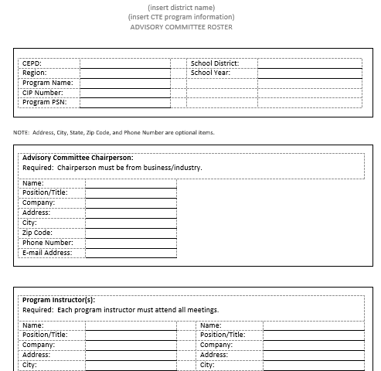
Navigator Advisory Committee Roster
Notes:
Mark Forbush

Slide 19
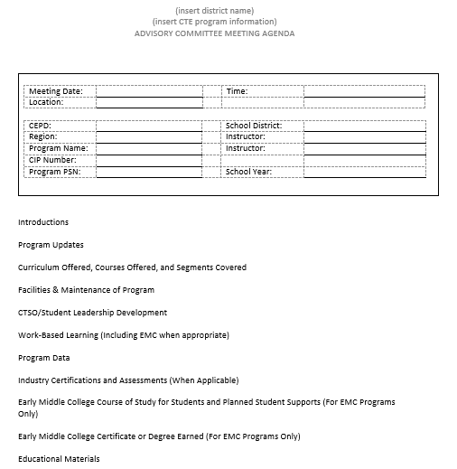
NAVIGATOR Advisory committee Agenda
Notes:
Mark Forbush

Slide 20
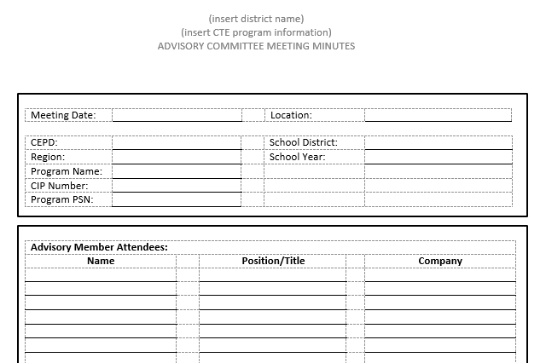
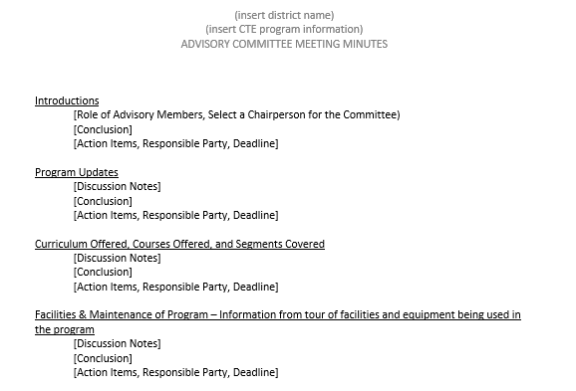
NAVIGATOR advisory committee Meeting Minutes
Notes:
Mark Forbush

Slide 21
NAVIGATOR
C06 – Program Advisory Committee (page 4)
Program Technology Inventory*
Program Technology is any item that allows the instructor to facilitate learning and improve performance by creating, using, and managing appropriate technological processes and resources. Examples are computers, tablets, and notebooks; but are not limited to computers and handhelds. They may also include projectors, scanners, CPS (clickers) and other technology used in your program that cost under $5,000 per unit.
Program Equipment Inventory*
Equipment is any tangible nonexpendable item having a useful life of more than one year and an acquisition cost of $5,000 or more per unit.
Textbooks/Software* (Bias-Free Curriculum and Facilities Statement)
Less than five years old
Notes:
Mark Forbush
Page number references CIP Self-Review Document page

Slide 22
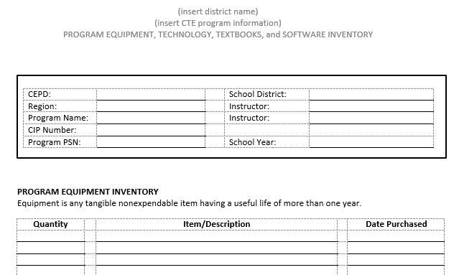
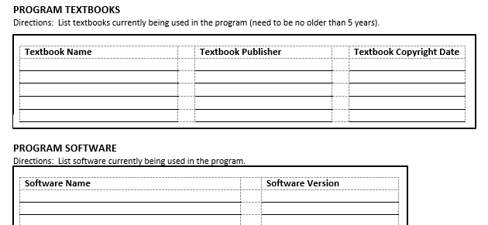
NAVIGATOR PROGRAM INVENTORY (equipment, technology, textbooks, software
Notes:
Mark Forbush

Slide 23
BREAK 10:15 a.m. to 10:30 a.m.
Notes:
Lori Johnson - 10:15 a.m. – 10:30 a.m.

Slide 24
navigator
C10 – Implementation of Program Standards (page 5)
Gap Analysis Document (Navigator – Resources)
Alignment of curriculum
Notes:
Mikki Spagnoli – 10:30 a.m. – 11:45 a.m. slides 24-35
Page number references CIP Self-Review Document page

Slide 25
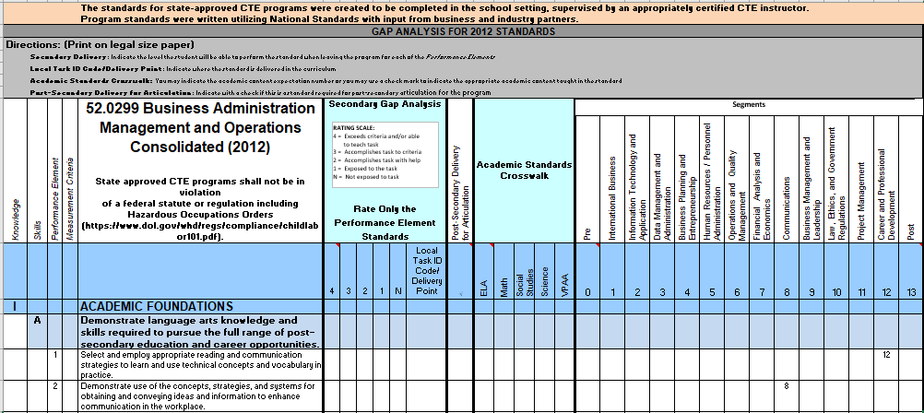
navigator gap analysis
Notes:
Mikki Spagnoli

Slide 26
navigator
C10 – Implementation of Program Standards (page 5)
Syllabus*
Course Title
Instructor Name and School Contact Information
Course Dates
Course Descriptions
Resources
Special Features of Course
Course Outline
Additional items as needed
Notes:
Mikki Spagnoli
Page number references CIP Self-Review Document page

Slide 27
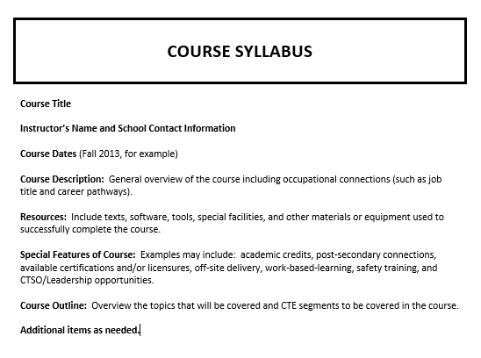
navigator Syllabus
Notes:
Mikki Spagnoli

Slide 28
navigator
C10 – Implementation of Program Standards (page 5)
Instructional Design*
Identify 12 segments
Identify when majority of segment standards delivered
Each segment can be marked only once
Notes:
Mikki Spagnoli
Page number references CIP Self-Review Document page

Slide 29
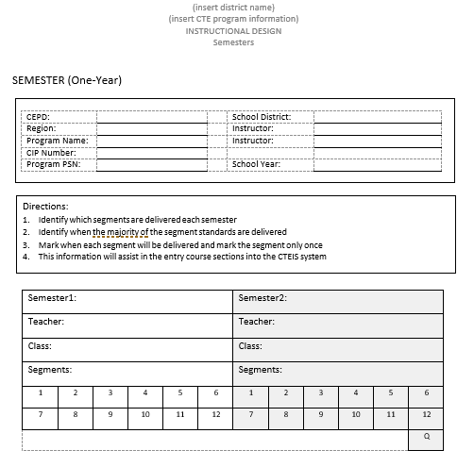
Navigator Instructional Design
Notes:
Mikki Spagnoli

Slide 30
navigator
C10 – Implementation of Program Standards (page 5)
Safety Training*
Program specific
Methods of mastery
Mastery level
Notes:
Mikki Spagnoli
Page number references CIP Self-Review Document page

Slide 31
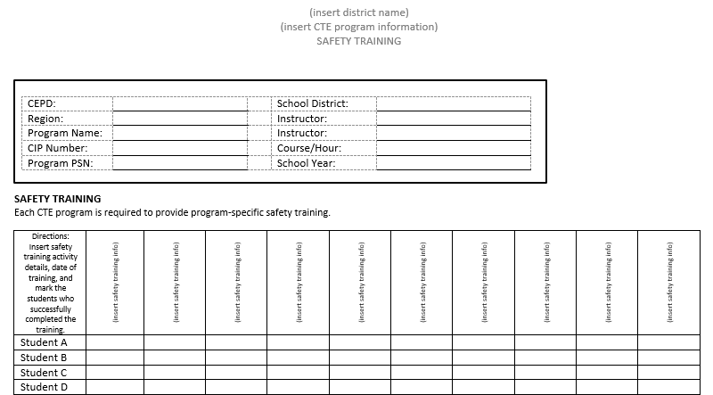
navigator safety training
Notes:
Mikki Spagnoli

Slide 32
navigator
C10 – Implementation of Program Standards (page 5)
Work-Based Learning*
Every student provided opportunity for WBL experience
Career Awareness
Career Exploration
Career Training
Career Preparation
Notes:
Mikki Spagnoli
Page number references CIP Self-Review Document page

Slide 33
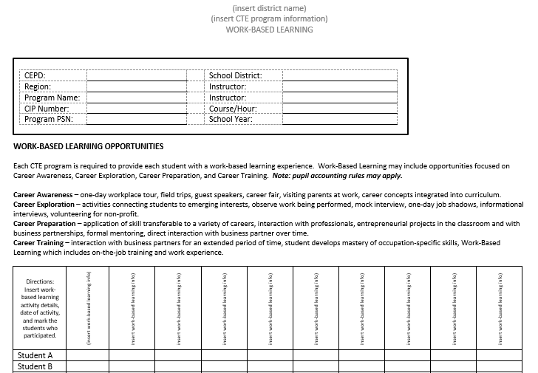
navigator Work-based learning
Notes:
Mikki Spagnoli

Slide 34
navigator
C10 – Implementation of Program Standards (page 5)
Student Leadership*
Provide student leadership opportunities
CTSO
Other activities and opportunities
Notes:
Mikki Spagnoli
Page number references CIP Self-Review Document page

Slide 35
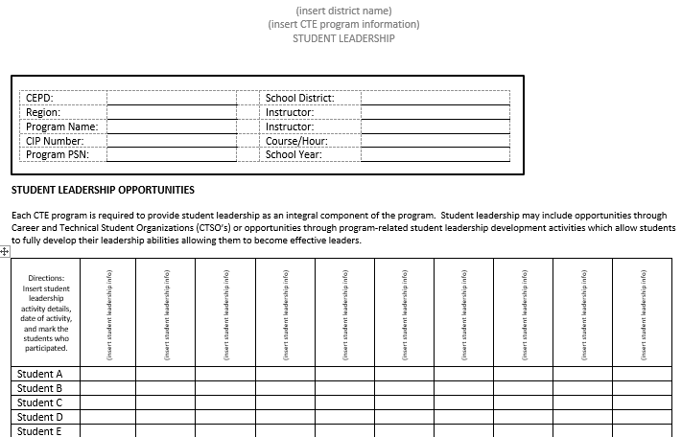
navigator student leadership
Notes:
Mikki Spagnoli

Slide 36
LUNCH 11:45 A.M. – 12:30 P.M.
Notes:
Lori Johnson - 11:45 a.m. – 12:30 p.m.

Slide 37
navigator
C13 – Strategies to Eliminate Barriers (page 6)
Classroom/lab pictures or invoices
room arrangements accessible for all students including disabled individuals, and it includes an adjustable workstation
Textbook publishers bias-free statement (if available)
Photos of classroom displays and learning environment
Notes:
Mikki Spagnoli – 12:30 p.m. – 1:00 p.m. slides 37-38
Page number references CIP Self-Review Document page

Slide 38
navigator
C13 – Strategies to Eliminate Barriers (page 6)
Include when applicable
Recruitment Materials/Brochures
Program Applications/Pre-Requisites
Policy/Procedure for Enrolling Students
Notes:
Mikki Spagnoli
Page number references CIP Self-Review Document page

Slide 39
navigator
C16 – Secondary-Postsecondary Connections (page 7)
Upload ONE or more of the following:
Program of Study
Articulation Agreement
Dual Enrollment
Direct Credit
Notes:
Dana Hughes – 1:00 p.m. – 1:15 p.m. slide 39
Page number references CIP Self-Review Document page

Slide 40
Navigator Log in
www.ctenavigator.org
Notes:
Mikki Spagnoli and Tom Knight – 1:15 p.m. – 1:30 p.m. slide 40

Slide 41
BREAK 1:30 p.m. – 1:45 P.M.
Notes:
Lori Johnson - 1:30 p.m. – 1:45 p.m.

Slide 42
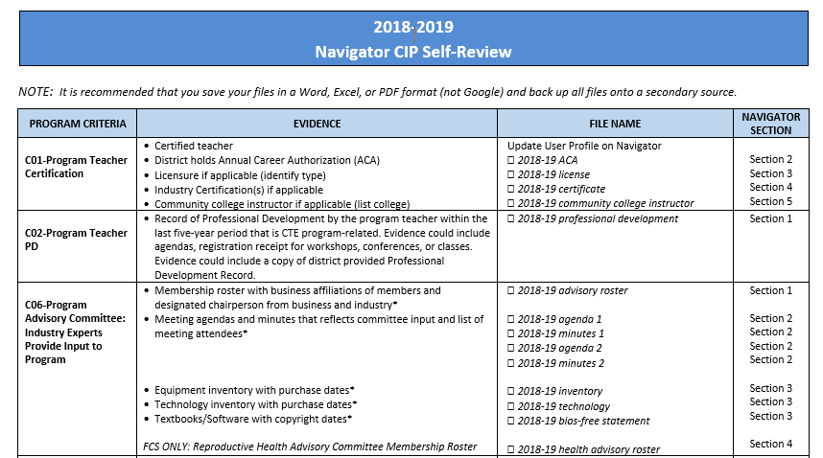
Navigator directions & naming conventions
Notes:
Mikki Spagnoli – 1:45 p.m. – 2:15 p.m. slides 42-43

Slide 43
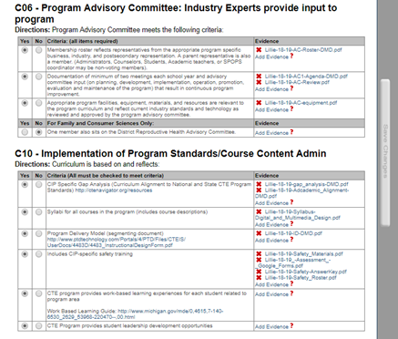
Navigator uploading evidence
Notes:
Mikki Spagnoli

Slide 44
OFFICE OF CTE CONSULTANT CONTACT INFORMATION
Tom Knight
knightt@michigan.gov
517-241-5345
Dana Hughes
hughesd9@michigan.gov
517-335-0359
Mark Forbush
forbushm@msu.edu
989-277-9249
Notes:
Mikki Spagnoli – 2:15 p.m. – 2:30 p.m. slides 44-46

Slide 45
Michigan acte INFORMATION
WEBSITE
miacte.org
MI ACTE PRESIDENT
Mikki Spagnoli
mikki.spagnoli@lewiscassisd.org
Notes:
Mikki Spagnoli

Slide 46
Navigating cte navigator
Wrap Up
Q and A
https://tinyurl.com/y4x6pjsf
Notes:
Mikki Spagnoli

