Slide 1
HIGHER EDUCATION ACT 101
3 / 24 / 2019
Alisha Hyslop, Director of Public Policy
Association for Career and Technical Education
Jennifer Stiddard, Director of Government Relations
Association of Community College Trustees

Slide 2
Higher Education Act 101
Title I – General Provisions
Title II – Teacher Quality Enhancement
Title III – Institutional Aid
Title IV – Student Assistance
Title V – Developing Institutions
Title VI – International Education Programs
Title VII – Graduate and Postsecondary Improvement Programs
Title VIII – Additional Programs

Slide 3
Title I – General Provision
Definitions
What is an institution of higher education?
Protection of student free speech
College navigator, data collection, consumer information
Textbook provisions

Slide 4
Title II – Teacher Quality Enhancement
Provisions on program accountability and evaluation
program data collection
state and institutional report cards
identifying low-performing programs
Teacher Quality Partnership Grants
partnerships among institutions of higher education, high-need local education agencies, high-need schools, and other eligible entities that work together to develop a pipeline of profession-ready teachers
Grantees must provide clinical experience and induction program
Requires 3-year teaching commitment
Enhancing Teachers
increasing educator diversity, educator use of technology in classrooms, adjunct teacher corps, and PD on teaching students with disabilities
Never received funding

Slide 5
Titles III and V
Title III – Institutional Aid
Strengthening Institutions Program
Strengthening Historically Black Colleges and Universities
Tribally Controlled Colleges and Universities
Alaska Native and Native Hawaiian-Serving Institutions
Predominately Black Institutions
Native American-Serving, Nontribal Institutions
Asian American and Native American Pacific Islander-Serving Institutions
Title V – Developing Institutions
Hispanic-Serving Institutions

Slide 6
Title IV - Pell Grant Basics
The Pell Grant program operates as an entitlement in order to assist low-income students cover the cost of attendance for postsecondary education.
Students who wish to receive a Pell Grant must fill out a Free Application for Federal Student Aid (FAFSA).
The FAFSA form helps determine each students Expected Family Contribution (EFC) based on their income, assets, dependency status, and postsecondary cost of attendance.
Recipients must be undergraduates and cannot have received a bachelor’s degree previously (with the exception of certain teacher certificate programs), and must be enrolled with the purpose of obtaining a degree or certificate at an eligible institution.

Slide 7
Title IV - Pell Grant Basics
Full-time students are eligible for a maximum Pell Grant of up to $6,095. Students attending less-than full-time received a scaled reduction of their grant.
Pell Grants pay for cost of attendance – tuition, fees, course materials, housing, food, transportation, dependent care, and other miscellaneous living expenses.
Cost of attendance is determined by the institution.
Students may receive assistance via the Pell Grant for up to 12 full-time semesters.

Slide 8
Title IV - Pell Grant Basics
Notes:
Over the lifetime of the Pell Grant program, the share of Pell Grant aid to proprietary institutions has changed significantly. For example, in the 2009-2010 award year, approximately 25 percent of total Pell Grant aid went to students at proprietary institutions; in the 2015-2016 and 2016-17 award years those figures were 17 and 15 percent, respectively.

Slide 9
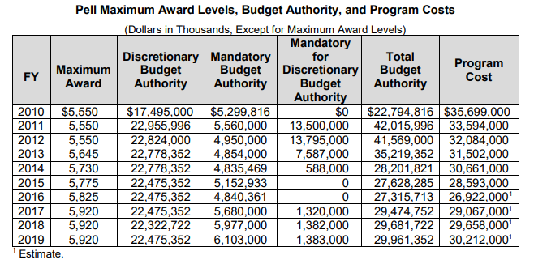
Title IV - Pell Grant Basics

Slide 10
Title IV – Campus-Based Aid
Federal Supplemental Educational Opportunity Grants (SEOG):
The SEOG program provides an additional source of grant aid for low-income students. Pell Grant recipients receive priority for SEOG awards.
The federal share of the award cannot exceed 75 percent; the remaining 25 percent must be matched by the participating institution.
The grants range from a minimum of $100 to a maximum annual award of $4,000.
Federal Work-Study:
The Federal Work-Study program leverages resources from schools and the private sector to provide opportunities for students to earn money to pay for college.
In addition to providing self-help assistance to students, Federal Work-Study funds help support partnerships between the federal government, postsecondary schools, students, and communities.

Slide 11
Title IV - Direct Loans
The Direct Loan program is the primary source of loans for college students.
Those with financial need are eligible for subsidized Direct Stafford Loans.
Interest rates are fixed, but vary year to year based on the 10-year Treasury note.
Typically, rates range from three to seven percent, and are capped at 8.5 percent for undergraduate students.
While Pell Grant size depends on enrollment intensity, annual loan limits are the same for full-time and part-time students.
Independent students are permitted to borrow larger unsubsidized loans than their dependent peers.
Other federal loans – Graduate; Grad PLUS; Parent PLUS
Loan repayment plans

Slide 12
Title IV – TRIO & GEAR UP
TRIO:
The federal TRIO programs (TRIO) are outreach and student services programs designed to identify and provide services for individuals from disadvantaged backgrounds.
TRIO includes eight programs targeted to serve and assist low-income individuals, first-generation college students, and individuals with disabilities to progress through the academic pipeline from middle school to post-baccalaureate programs.
Gaining Early Awareness and Readiness for Undergraduate Programs (GEAR UP):
GEAR UP works to increase income-eligible students’ academic skills, help them graduate from high school, and help them enroll in college.
The program also helps students persist from their first year to second year of college.

Slide 13
Q & A

