Slide 1
NPS First Time Attendees
Advocacy and Messaging on Capitol Hill

Slide 2
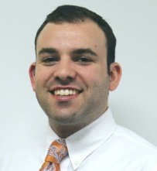
ACTE Public Policy Staff
Stephen DeWitt
Deputy Executive Director
Alisha Hyslop
Director of Public Policy
Jarrod Nagurka
Advocacy and Public Affairs Manager
Catherine Imperatore
Research Manager
Michael Matthews
Government Affairs Manager

Slide 3
Agenda
Importance of advocacy and intro to lobbying
How a bill becomes a law and how to pay for it
CTE Policy 101
Current Education Policy Landscape
Successful advocacy on and off Capitol Hill

Slide 4
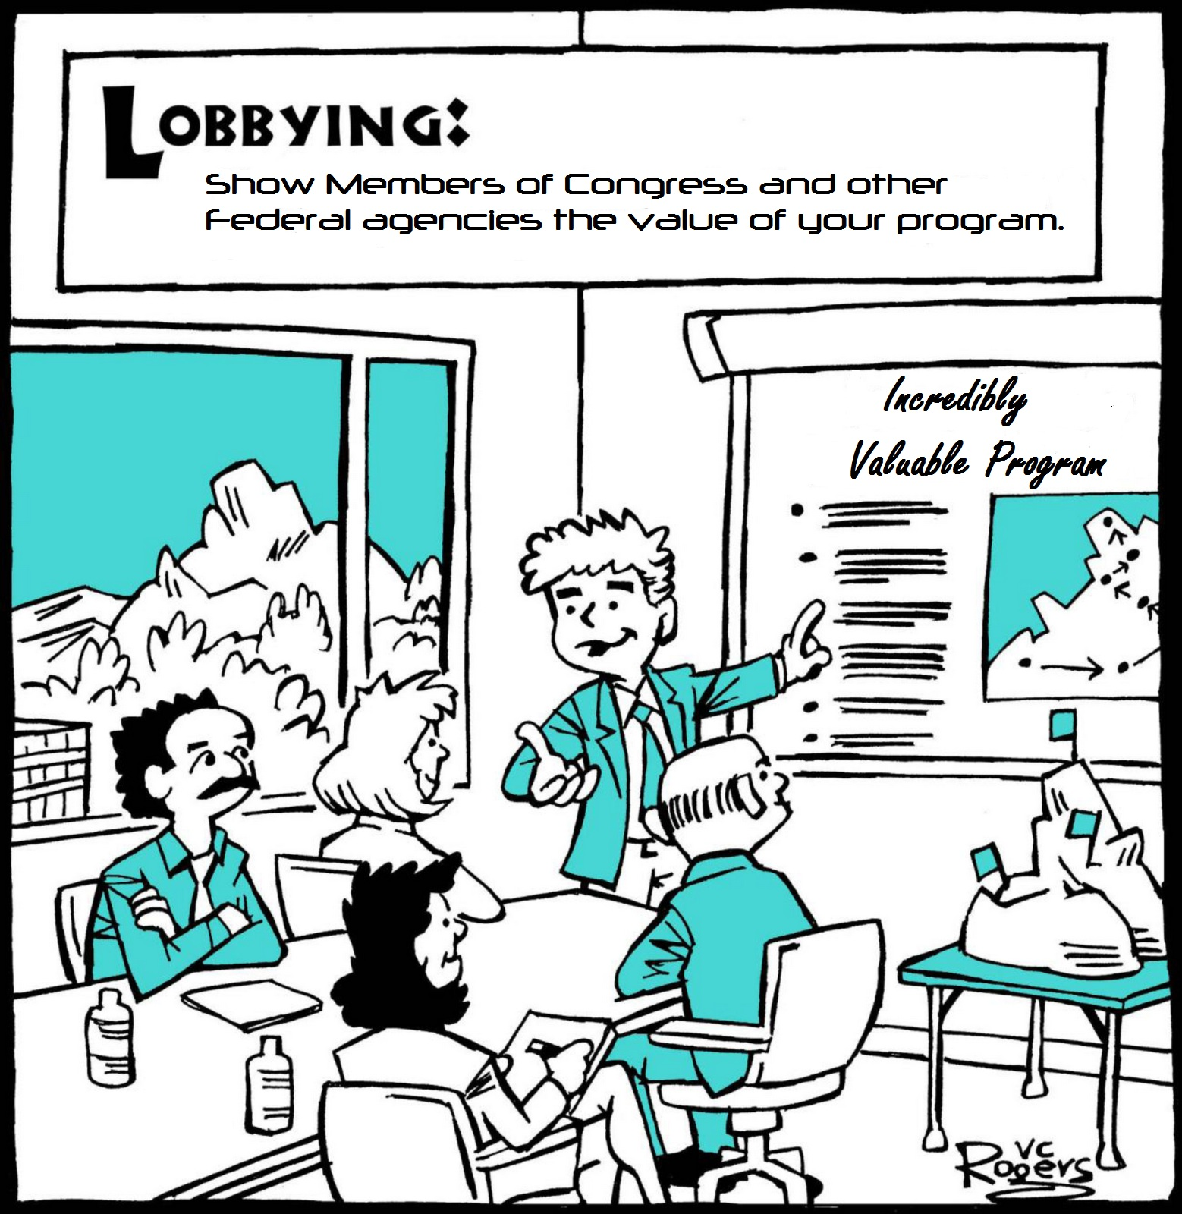

Slide 5
Importance of Federal Advocacy and Lobbying
Federal advocacy
Most education policy decisions are made at the state and local levels. However, federal law provides a critical framework for those decisions
Congress has the “power of the purse,” providing needed funds to states and locals through federal programs like Perkins, ESSA, HEA and WIOA
Furthermore, the Department of Education has significant leverage to influence federal education policy through implementation and can guide state decisions

Slide 6
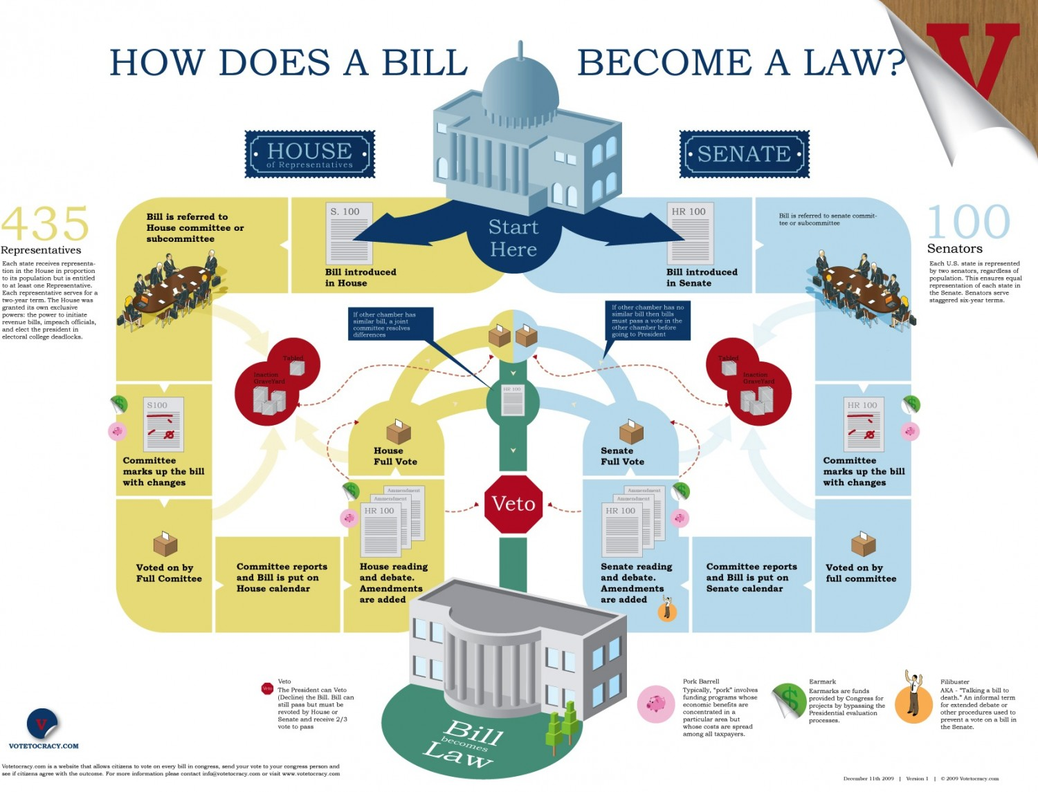
Legislative Process

Slide 7
Notable CTE Priorities
Perkins CTE Funding
Bipartisan support for CTE, but budget caps spell trouble
Funding increases in each of the last two fiscal years
Check the Federal Funding section of your notebook
Higher Education Act
Forecast to be a major education policy push this Congress
Both parties support principle of expanding Pell Grants to shorter-term programs
Check the HEA Section of your notebook
Infrastructure
Bipartisan infrastructure package discussed by both parties
Check the Hot Topics Section of your notebook

Slide 8
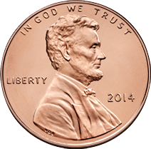
Federal Funding: Authorization and Appropriations
Authorizing is the process of creating a program. When a program, such as Perkins, is authorized by the House, Senate and President, then Congress is allowed to assign or appropriate funding for the program.
The funding of an authorized program is known as appropriations. After a budget has been set, Congress can determine how much money to designate for each individual program.

Slide 9
Appropriations Committee
Produce bills that define specific funding allocations; make line-item budget decisions
12 Subcommittees in the House and Senate
Education and labor funding occur in the Labor, Health and Human Services and Education Appropriations Subcommittee

Slide 10
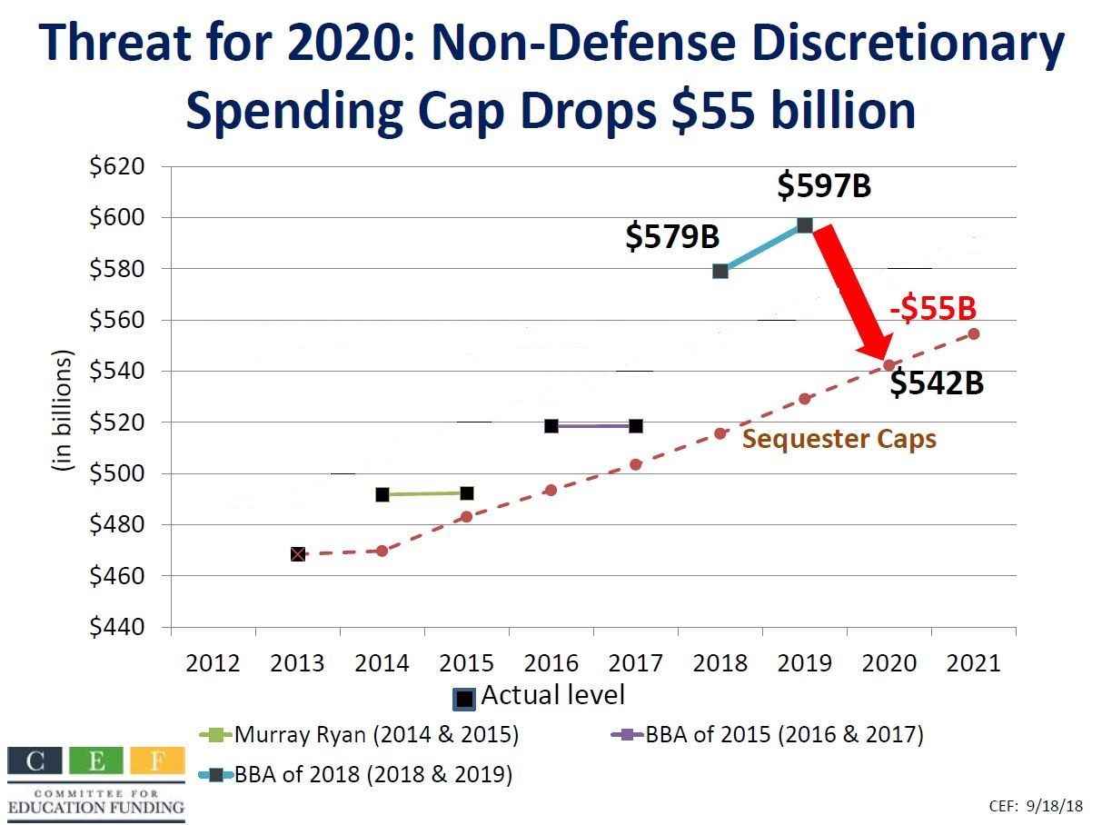
Budget Caps

Slide 11
Budget Timeline
February
President releases budget request
March/April
House and Senate work to complete budget resolutions by April
May-July
Appropriations committees set discretionary funding levels
September
Final appropriations bills passed and signed by President
October 1
Beginning of federal fiscal year
Learn more in the Federal Funding
section of your Notebook!

Slide 12
Getting To Your Visits
The most convenient method of transportation to and from your visits is the Metro.
Plan to leave here at least one hour before your first meeting, and build in time to purchase your farecard if you have not already done so.
Trains are not a foolproof means of transportation, and service can be slow outside of rush hour or due to track work.
Trains are marked by color and final destination.
Alternatives: Uber, Lyft, taxicabs

Slide 13
Getting There Continued
Please open your notebooks to Hill Maps and Directories, page two.
If your meeting is on the Senate side of the Hill, your best route is:
Yellow Line in the direction of Fort Totten or Greenbelt
Transfer at Gallery Place/Chinatown to the Red Line in the direction of Glenmont
Get off at Union Station
If your meeting is on the House side of the Hill, your best route is:
Yellow line in the direction of Fort Totten or Greenbelt
Transfer at L’Enfant Plaza to any Orange, Silver or Blue Line train in the direction of Largo Town Center or New Carrolton
Get off at Capitol South

Slide 14
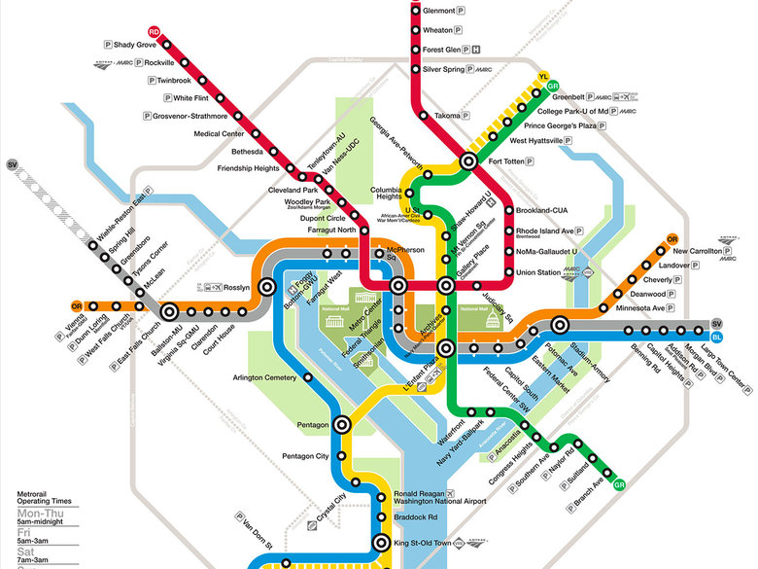

Slide 15
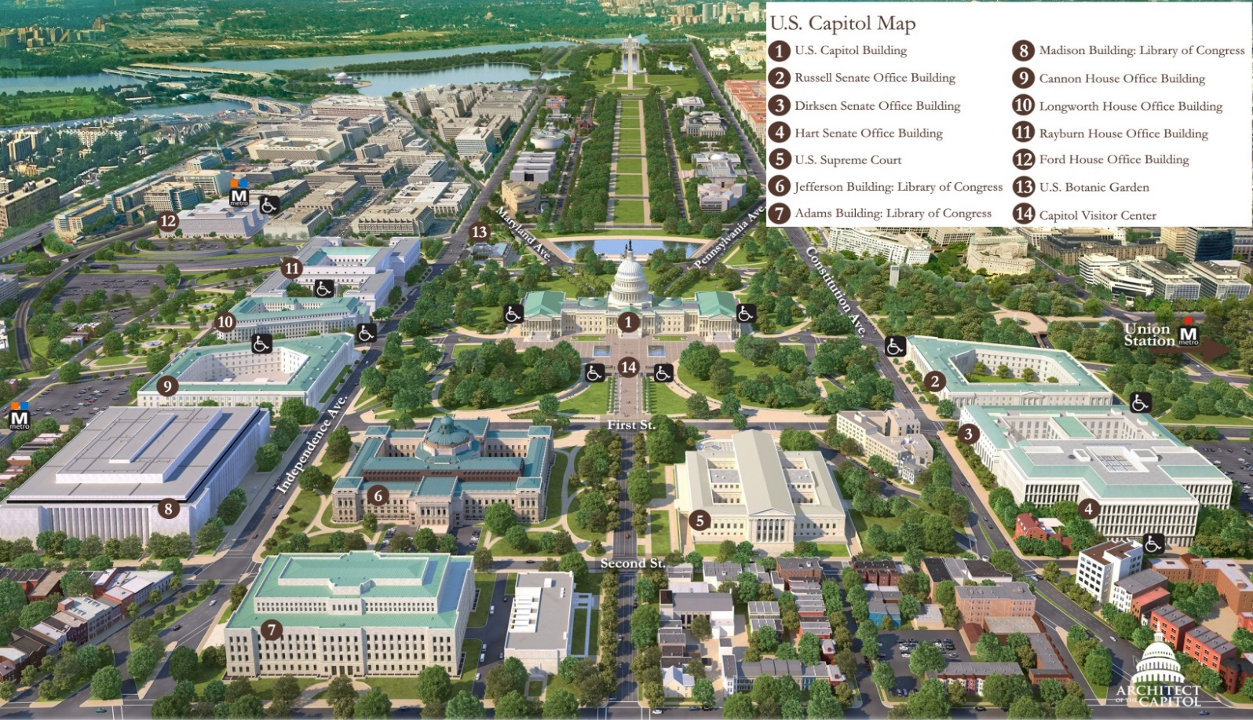
Capitol Hill Map
See the Hill Maps and Directories Section of your Notebook

Slide 16
Capitol Hill Basics
Security on Capitol Hill is similar to an airport:
Metal detectors and x-ray machines
Put bags, folders, belts, watches and other metal objects in the x-ray machine
Do not remove your shoes or jacket
Snacks, bottled water OK (but not in CVC)

Slide 17
When You Arrive
If a Member’s office door is closed, just open the door. No need to knock.
Introduce yourself to the front desk staff and leave a business card, if you have one.
Office Staff
Chief of Staff (COS)
Legislative Director (LD)
Legislative Assistant (LA)
Legislative Correspondent (LC)
Staff Assistant (SA)

Slide 18
What to Expect on the Hill
Congressional climate has changed significantly since November election.
House is now in Democratic control
Senate, White House remains in Republican control.
Balance of Power in House
235 Democrats
198 Republicans
2 vacancies
Balance of Power in Senate
53 Republicans
45 Democrats
2 Independents (caucus w/ Democrats)
Bernie Sanders (VT)
Angus King (ME)
Notes:
4 Republican vacancies for Trump Administration posts, 1 Democrat because he was elected California Attorney General

Slide 19
What to Expect on the Hill
Conservative (Tea Party) Republicans Virtually no role for federal government Strong focus on fiscal austerity Willing to go against own party on some issues; many are members of the “Freedom Caucus” | Conservative (Blue Dog) Democrats More conservative on social issues Role of government is to support “blue collar” workers Occasionally at odds with party leadership
Moderate Republicans Limited role for federal government Emphasis on low taxes and support for private sector Rank and file with party leadership | Liberal Democrats Important role for federal government Emphasis on economic fairness and social safety net Compose majority of party leadership

Slide 20
Messages for Congress
Tell Members of Congress how critical Perkins, education and job training programs are for your community.
Be sure to stress that any cut is unacceptable; Increased investments needed. Total Perkins funding for FY 2019 is still less than it was a decade ago.
Reinforce the support CTE has from business, and mention any industry partnerships.
Explain that without federal investment these programs are not possible.
Help them understand how CTE overcomes the skills gap and prepares students to succeed in postsecondary education AND careers.
Invite them to join the House or Senate CTE Caucus.

Slide 21
Lobbying Tips
Be informed.
Know the issues – resources to read up include your notebook, the latest ACTE News and the CTE Policy Watch Blog.
Check the policymaker’s website to learn which committees they serve on, and read up on their background.
Also check in notebook “Hill Maps & Directories” section
Know the legislator’s work – check out his/her voting record
Be prepared.
Have data and specifics – How will legislation impact your school and your district?
Know your position and the rationale for that position – ACTE’s reauthorization priorities documents include helpful information.

Slide 22
Lobbying Tips
Be friendly and open to listening
Share your ideas with the legislator and their staff in an organized way, and make sure that you’re clear and concise.
If you can find something the legislator did well in the past, compliment that action.
Listen to their perspective, and make sure you’re considering all side of the issue.

Slide 23
Lobbying Tips
Be calm.
Maintain a professional demeanor – remember, you’re the expert in the room.
Don’t get flustered – know your issue and bring the discussion back to your point.
Give examples.
Most Members of Congress are not educators by profession, so the more examples you can provide, the better they can understand your message.

Slide 24
Lobbying Tips
Don’t get sidetracked.
Don’t let the conversation get off topic! If you notice the issues becoming muddled, try to bring it back to your core message.
Don’t be afraid to admit that you don’t know something.
If you’re asked a question on an unfamiliar topic, maintain your credibility by saying that you don’t know.
It’s ok to say that you’ll follow up after checking.

Slide 25
Lobbying Tips
Find common ground
Even if a legislator doesn’t yet support your position on an issue, try to find opportunities to establish common ground – every policymaker wants an effective education system for our students.

Slide 26
Always Have An Ask
If you are lobbying for issue support, ask for their support.
“Will the Congressman support CTE issues?”
Use this meeting to invite your Member to see your program.
“Would the Senator be interested in visiting our biotechnology program at McKinley Tech High School?”
If you don’t ask, the answer will always be no!

Slide 27
Post Visit
Follow up with the staff person you met with in a thank-you note or email.
Thank them for meeting with you.
Remind them of the importance of your issue.
Thank them for the member’s support or ask again.
Continue your dialogue with the office after you leave! Building a sustained conversation will lay the foundation for your future advocacy.

Slide 28
Student Lobbying
Students should be able to articulate a personal story to members and staff.
Prepare your students with data to go along with their story.
Select one main speaker to deliver the story and message – other students should contribute in support of that message.

Slide 29
District Advocacy
Members are normally in their DC offices Tuesday-Thursday, and in a district office Friday-Monday.
Invite a Member to see your program!
Attend a legislative forum held by your Member.
Members tend to hold weekly “coffee hours” open to all constituents.
Attend a town hall meeting your Member is hosting.

Slide 30
Contact Info
Jarrod Nagurka
jnagurka@acteonline.org
(703) 683-9312
Association for Career and Technical Education
1410 King Street
Alexandria, VA 22314
(800) 826-9972
www.acteonline.org

