Slide 1
U.S. Army presents leader development practices for 21st century leaders
Presented by MAJ Rob Mays and MAJ Derek Imig
Army ROTC, University of Nevada-Las Vegas
4 DEC 2013

Slide 2
Agenda
Administration/Intros
Leadership Defined
Discussion – Leadership Examples
Leadership Assessment
Army Leadership 101
Group Exercise: Vignettes
Closing Remarks

Slide 3
Introductions
Name
Position
Organization
Why are you here?

Slide 4
Leadership Defined
Army Leadership:
The process of influencing people by providing purpose, direction, and motivation, while operating to accomplish the mission and improve the organization.
ADRP 5-0, The Operations Process

Slide 5
Army Leadership Example
Leadership Dilemmas
What would you do?

Slide 6
Group Discussion – Leadership Examples
In groups, discuss your organizations.
1. Are there good or bad examples of leadership you can share?
2. What traits, characteristics, competencies, or behaviors do good leaders have around you?

Slide 7
Secretary of the Army Quote
“In short, Army leaders in this century need to be Pentathletes, multi-skilled leaders who can thrive in uncertain and complex operating environments...innovative and adaptive leaders who are expert in the art and science of the profession of arms.”
“The Army needs leaders who are decisive, innovative, adaptive, culturally astute,
effective communicators and dedicated to life-long learning.”
Dr. Francis J. Harvey
Secretary of the Army
23 June 2005 Speech to CGSOC

Slide 8
Leadership Assessment Exercise
Handout:
Complete the handout.
Discuss the results.

Slide 9
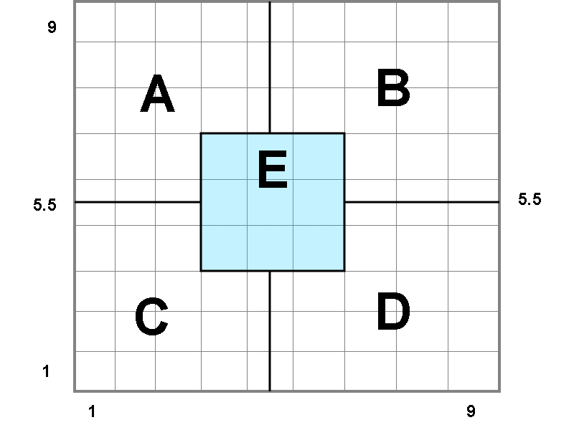
Leadership Assessment Results
A - 1,9 Attentive to People - Thoughtful attention to needs of people for satisfying relationships leads to a comfortable, friendly organization atmosphere and work tempo.
B - 9,9 Team Focused – Work accomplishment is from committed people; interdependence through a common stake in purpose leads to relationships, trust, and respect.
C - 1,1 Minimal Effort Management – Exertion of minimum effort to get required work done is appropriate to sustain organization membership.
D - 9,1 Task Focused – Efficiency in operation results from arranging conditions of work in such a way that the human elements interfere to a minimum degree.
E - 5,5 Focused on Balance and Compromise - Adequate organization performance is possible through balancing the necessity to get out work accomplished with maintaining morale of people.
People Oriented
Production Oriented

Slide 10
Military Leadership: 101

Slide 11
The Pentathlete
Multi-skilled Leader
- Strategic & creative thinker
- Builder of leaders and teams
Competent full spectrum warfighter or accomplished professional who supports the Soldier
Effective in managing, leading & changing the business side of the Army
Skilled in governance, statesmanship, and diplomacy
- Understands cultural contexts, and works effectively across them
Leader Attributes
Decisive, with integrity and character
Confident and competent decision-maker in uncertain situations:
Prudent risk taker
Innovative
Adaptive
Accountable
Empathetic & always positive
Professionally educated, life-long learner
Effective communicator
Personifies the
Warrior Ethos in all
aspects, from war fighting
to statesmanship to
enterprise management…
It’s a way of life

Slide 12
Competency Based Leadership
LEADERS IN THE 21ST CENTURY
Competency Areas
Competencies
Leads others
Extends influence beyond chain
Leads by example
Communicates
Leads
Develops
Creates a positive environment
Prepares self
Develops others
Achieves
Get results
Leadership is influencing people – by providing purpose, direction, and motivation –
While operating to accomplish the mission and improving the organization ( FM 6-22)

Slide 13
Full Range of Core Leader Competencies
Near-term
Far-term
Lead
Achieve
Develop
Focus on people –
Purpose,
Motivation,
Influence,
Balance mission
with welfare
Focus on task –
Assigns,
Manages,
Executes,
Adjusts
Focus on
organization -
Develop,
Improve
Who –
Lead others in
chain
Extend influence
outside chain
What/Why –
Get results
What –
Environment
Self
Others
How –
Example set
Communication

Slide 14
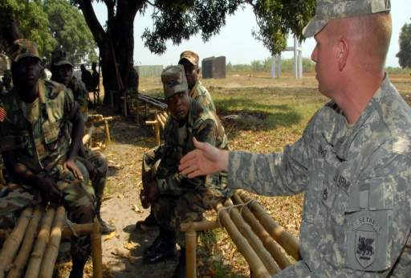
Leadership Adaptability
Learn to adapt by adapting
Lead across cultures/ diverse backgrounds
Seek challenges

Slide 15
Group Exercise: Vignettes
Break back up into your groups
Read through the situation/vignette
Develop two courses of action
Select a primary/best course of action
You have 30 minutes to discuss/prepare
Select member(s) to brief the results

Slide 16
Closing
Leadership Dilemmas
What did we do?

Slide 17
QUESTIONS

