Slide 1
About ACTE
Largest national education association of professionals dedicated to the advancement of career and technical education.
Members include teachers, administrators, guidance counselors, students, government officials, affiliated organizations and corporate partners sharing in the common mission to advance CTE.
Leader in legislative and regulatory issues impacting CTE.
Representing academic excellence and leadership in CTE for 85+ years.

Slide 2
Professionals In All Positions of CTE
Students
Secondary and Middle School
Federal & State Government
Business
Guidance Counselors & Career Development
Nonprofit Organizations
Postsecondary
Education Institutions

Slide 3











Professionals From All Facets of CTE
Agricultural Education
Health Science Education
Administration
Postsecondary, Adult & Career Education
Business Education
Marketing Education
Engineering & Technology Education
New & Related Services
Guidance & Career Development
Family & Consumer Sciences
Trade & Industrial Education

Slide 4
ACTE Membership Options
Professional ($80) – Individuals and groups engaged in the CTE community.
Student (free!) – Rising CTE professionals preparing for their new careers.
Retiree ($31) – Individuals who wish to remain active in the CTE community.
International ($60) – Open to CTE professionals outside the U.S.
Educational Institution – School districts, career and technical centers, curriculum centers, community colleges or universities.
National Affiliate ($500) – An active voice in the advancement of CTE for nonprofits.
Corporate ($1,200) – Interested in working with schools and educators on real-world CTE issues and workplace skills.
www.acteonline.org/join

Slide 5

ACTE Leadership Programs
National ACTE Leadership
  Committees and Task Forces
  Board of Directors
Professional Leadership
  Fellowship Program
ACTE State Leadership
  Leadership Development
  Networking
  Resources and Tools
  Recognition
www.acteonline.org/leadership

Slide 6


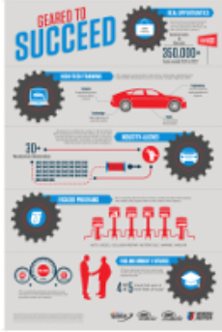
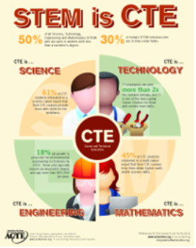
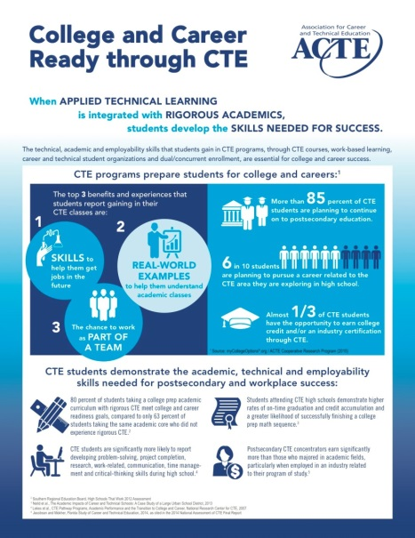
Tell Your CTE Story

Slide 7

CTE News and Information
Techniques: Award-winning magazine covering CTE issues and innovations
Digital Publications: Career Tech Update; STEM SmartBrief; Legislative Alerts; ACTE News
Job Bank
Online seminars
Robust, content-rich website

Slide 8

CTE Products & Resources
Collection of CTE-focused books and resources
CTE Month® products
ACTE members receive 10% off on all purchases
www.acteonline.org/shop

Slide 9

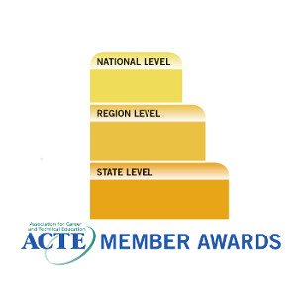

CTE Recognition
ACTE annually presents 10 national Excellence Awards—member and image—to showcase excellence and recognize individuals and groups for their support of CTE.
ACTE members demonstrating innovation and best practices in CTE
Groups and individuals from business, industry
and education communities for their support of CTE
www.acteonline.org/awards
Notes:
The ACTE Awards recognize those individuals who have made extraordinary contributions to CTE, programs that exemplify the highest standards and organizations that have conducted activities to promote and expand CTE programs. The Excellence Awards fall into two categories: the Member Awards, for ACTE members demonstrating innovation and best practices in CTE; and the Image Awards, for groups and individuals from the business, industry and education communities for their support of CTE.

Slide 10


ACTE Microdocs
Stories of Putting America to Work in High-Demand Industries
www.acteonline.org/microdocs

Slide 11

ACTE Online Seminars
Watch Anytime, Anywhere
Complimentary professional development for members. Recent seminars include:
  Flipped Classroom
  Your First Year in CTE: 10 More Things to Know Expert Session
  Education for All: Rural CTE and Distance Learning
www.acteonline.org/onlineseminars

Slide 12

Awareness to Elevate Perceptions of CTE
Gathers resources to help you relay intrinsic value of CTE
Showcases CTE’s essential role in students’ career exploration, discovery and readiness
Generates positive engagement
  Use the hashtag #CTEWorkingWonders to share your success stories during CTE Month® in February and in celebration of the 100-year anniversary of the Smith-Hughes Act
acteonline.org/working_wonders
Notes:
Our new CTE Working Wonders campaign gathers key resources and information to help us raise public awareness, support and advocate for CTE.
Some key talking points include:
- CTE is relevant for all age groups, from early exposure to careers in elementary school to career transitioning throughout adulthood. The upcoming 100-year anniversary of the Smith-Hughes Act celebrates a lifetime of learning in CTE.
- CTE exposes students of all ages to the full spectrum of career possibilities.
- CTE is not just "the trades." It's the how-to for all fields.
- CTE teaches soft skills, such as time management, problem-solving skills, and teamwork.
- CTE ensures students are college and career ready, leading to a vast array of respectable professions contributing to the livelihood of our economy.
- CTE provides resources for integrative and interactive learning in and outside of the classroom.
In February, we’re hosting a month-long social media campaign to help generate positive engagement and collect success stories from the CTE community (#CTEworkingwonders), and I encourage you to participate! We'll then publish these collected success stories in a reader-friendly piece that we'll then promote to CTE professionals and their communities.

Slide 13
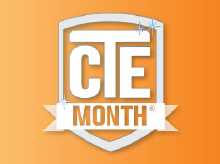
Celebrate CTE Month!
Celebrate Today. Own Tomorrow!
CTE Month® is an annual celebration, held every February, that showcases CTE community achievements and accomplishments nationwide.
www.acteonline.org/ctemonth
Notes:
Encourage your CTE community to share stories of leadership and excellence in CTE from your classrooms and raise awareness of the crucial role that CTE has in readying our nation for economic success and workforce competitiveness.

Slide 14

ACTE’s Role in Federal Policy
Through comprehensive outreach efforts, ACTE ensures policymakers and the public hear from the CTE community.
Position Development
Direct Lobbying
Technical Assistance
Coalition Building
Resource Development
Education and Training

Slide 15


Policy and Research Resources
CTE Policy Watch Blog
  State Policies Impacting CTE: 2015 Year in Review
Legislative Alerts
Action Center
Sector Fact Sheets
  Research-to-Practice Brief Series
Issue Briefs
Online Advocacy Toolkit
www.acteonline.org/policy

Slide 16

ACTE’s CareerTech VISION 2017
December 6-9
Gaylord Opryland Resort & Convention Center, Nashville
Engaging keynote speakers
300+ CTE sessions
STEM is CTE Symposium
Comprehensive CareerTech Expo & Career Pavilion
careertechvision.com

Slide 17

National Policy Seminar
March 5-7, 2018
Crystal Gateway Marriott
Arlington, Virginia
Shape Perkins reauthorization efforts
Communicate to policymakers on the crucial role Perkins and effective CTE programs play in providing career exploration and opportunities for students nationwide
Celebrate and proudly present “I am CTE” to policymakers and education and workforce development leaders
acteonline.org/nps

Slide 18

Best Practices & Innovations in CTE Conference
Sept. 27-29, 2017
Hotel Albuquerque
Albuquerque, NM
CTE leaders exchange ideas on innovative CTE programming and curriculum to address the needs of today’s learners.
acteonline.org/bestpractices

Slide 19





Connect with ACTE
Facebook.com/actecareertech
Twitter.com/actecareertech
Actete.ch/CTEGroup
Pinterest.com/actecareertech
Youtube.com/actecareertech

